Slide 1
Synthesis of Lignin Monomers
Rachel Sitko
Senior Chemistry Major
Notes:
Hi. My name is Rachel Sitko. I am a senior chemistry major and today I will be talking about my research on the synthesis of lignin monomers.

Slide 2
Overview
Background: What is lignin?
Synthesis of ferulic acid
Advancements in synthesis
Future work

Slide 3
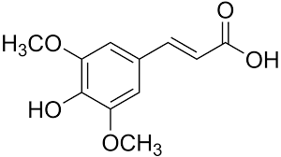
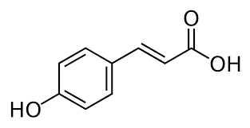
What is lignin?
Lignin is the second most abundant natural polymer in the world
A polymer built up of three monomers
Ferulic acid
Sinapic acid
p-Coumaric acid
Notes:
The principal function of lignin in plants is to assist in the movement of water; the lignin forms a barrier for evaporation and helps to channel water to critical areas of the plant.

Slide 4
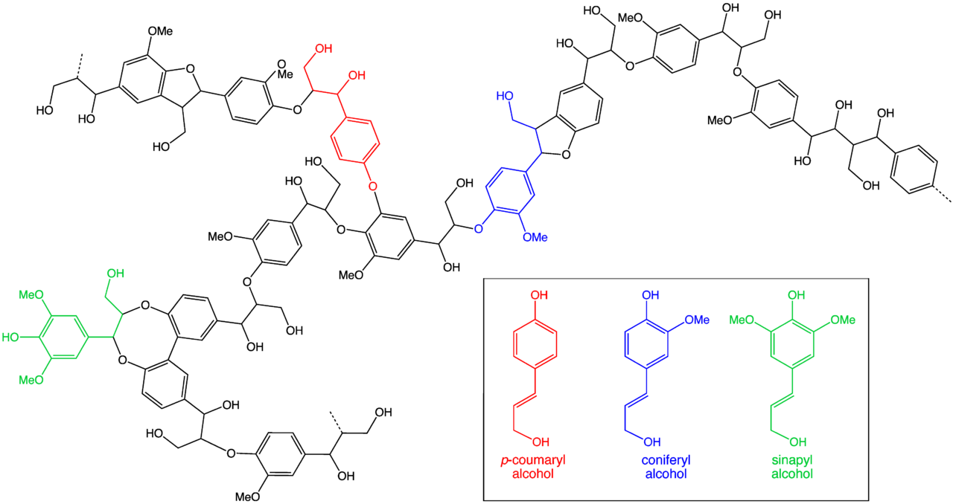
Notes:
This is images shows where the three monomers couple together.

Slide 5
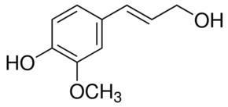
Ferulic Acid Coniferyl Alcohol
~$7.25
$345.00
*Sigma-Aldrich website
Notes:
While the alcohol form of this compound can be found through sigma, the others are harder to come by. But even the access of these compounds comes at a high price. Which is why we chose to synthesis the alcohol form ourselves.

Slide 6
Synthesis
H₃C
Notes:
The synthesis process is broken down into two general separate parts. In the first step is the esterification where we are changing the carboxylic acid group into an ester group.
This process is done through a 2 day reflux and extraction.

Slide 7
Synthesis
Notes:
Changing the ester group to the alcohol group
This process is done through a DIHBAL-H reaction and extraction

Slide 8
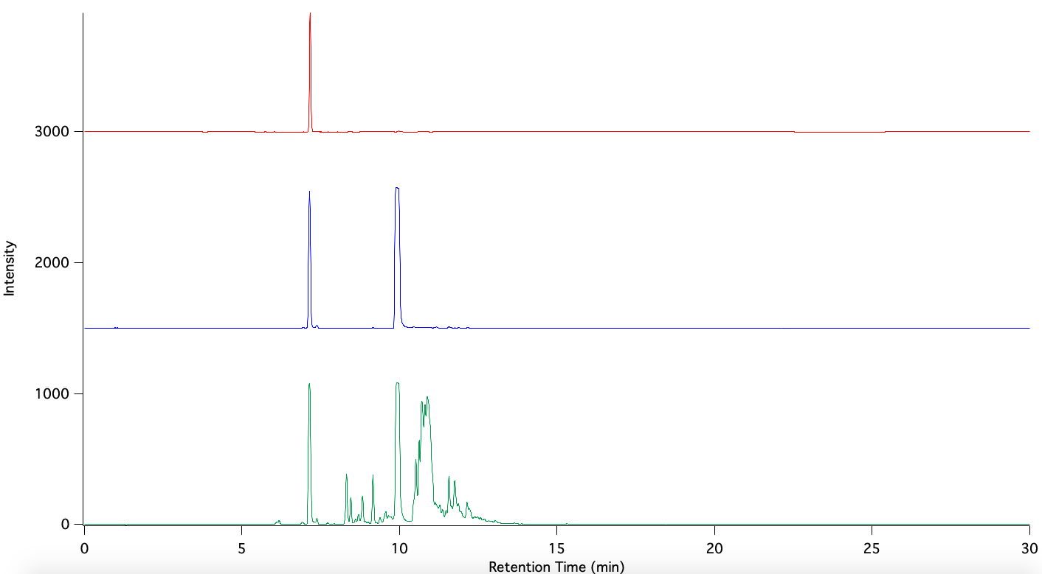
HPLC Data
Ferulic Acid Standard
Ferulic Acid in acetyl chloride
Product after 2 day reflux
Notes:
So far I have been trying to solidify the first step of the synthesis ensuring that I have made the ester form before proceeding to the DIBAL-H reaction. Looking at the green graph at the bottom we can see that I have not successfully made what we might be looking for. This set of data also had a set back by the solution being made but sitting there not being refluxed due to a minor flood I caused in the pchem lab.

Slide 9
Notes:
This is a 3D plot of my ferulic acid standard. While the axis are hard to read

Slide 10
Microwave Synthesis
Monowave 400
High performance microwave reactor
Benefits:
Allows for higher temperature reactions
Complete control over parameters
Energy efficient
Rapid synthesis results in less evaporation of solvents
* Anton Paar website
Notes:
So to further our advancements on the synthesis we would like to you microwave synthesis. Brad has recently finished a grant to purchase this instrument. The monowave 400 is a high performance microwave reactor used for fast reactant synthesis. The benefits of this instrument is that it allows for higher temperature reactions, complete control over parameters, is energy efficient, and decreases chances of loss of solution.

Slide 11
Microwave Synthesis
Time Decrease
Water Saving
2 day reflux → at 80 ℃
1 day → at 90 ℃
12 hours → at 100 ℃
6 hours → at 110 ℃
3 hours → at 120 ℃
1.5 hours → at 130 ℃
45 min → 140 ℃
500 mL flows through every 30 sec
Every minute is 1000 mL
Each day is 1,440,000 mL
For 2 days is 2,880,000 mL
Converting to 760 gallons of water
Notes:
Using the microwave synthesis shows two major benefits though time and water. For every half the time is cut the temperature that the instrument would be set at would increases by 10 ℃ and an increase in pressure. We can take the 2 day reflux and turn it into a 45 min reaction at 140 ℃. Through the esterification step, there is cold water running constantly though a condenser, which is very wasteful. Using the microwave synthesis and assuming that 500 mL of water flows though every 30 seconds, the two day reflux would use about 800 gallons of water, while the microwave synthesis would use none.

Slide 12
Green Chemistry
With the microwave synthesis
Save about 800 gallons of water
Save 2 days
Save power

Slide 13
Future Research
Finalize second step of synthesizing ferulic acid
Synthesize other lignin monomers
Notes:
For my future research, I plan to finalize both synthesis processes for ferulic acid and then continue using that process on the sinapic and p-coumaric acids to produce their alcohol forms.

Slide 14
Acknowledgments
Dr. Bradley E. Sturgeon
Steve Distin
Monmouth College Chemistry Department

Slide 15
Questions

