Slide 1
Electrochemical Oxidation of Acetaminophen
Matthew W. Simonson

Slide 2
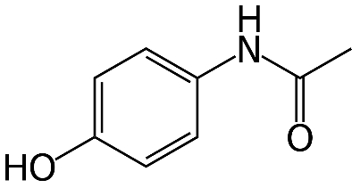
N-acetyl-para-aminophenol (APAP)
Goes by Acetaminophen or Paracetamol
Common ingredient in over the counter and prescription analgesics
Tylenol
Percocet
Norco
Therapeutic in moderation, but overdose is largely prevalent
Responsible for 50% of acute liver failures
Yan, M; Huo, Yazhen; Yin, Shutao; Hu, Hongbu. (2018) “Mechanisms of Acetaminophen-Induced Liver Injury and Its Implications for Therapeutic Interventions.” Redox biology. Vol. 17 pages 274-283.

Slide 3
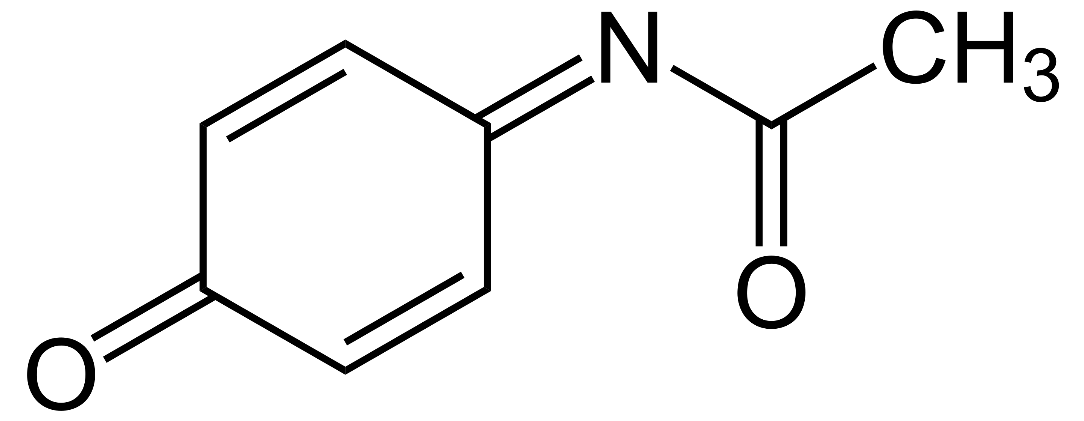
N-acetyl-para-aminophenol (APAP)
Current accepted mechanism: enzymatic two-electron oxidation
Acetaminophen
NAPQI
^{“Free” Radical}
- 1 e⁻
- 1 e⁻
2 e⁻
^{Other Products???}
Yan, M; Huo, Yazhen; Yin, Shutao; Hu, Hongbu. (2018) “Mechanisms of Acetaminophen-Induced Liver Injury and Its Implications for Therapeutic Interventions.” Redox biology. Vol. 17 pages 274-283.

Slide 4
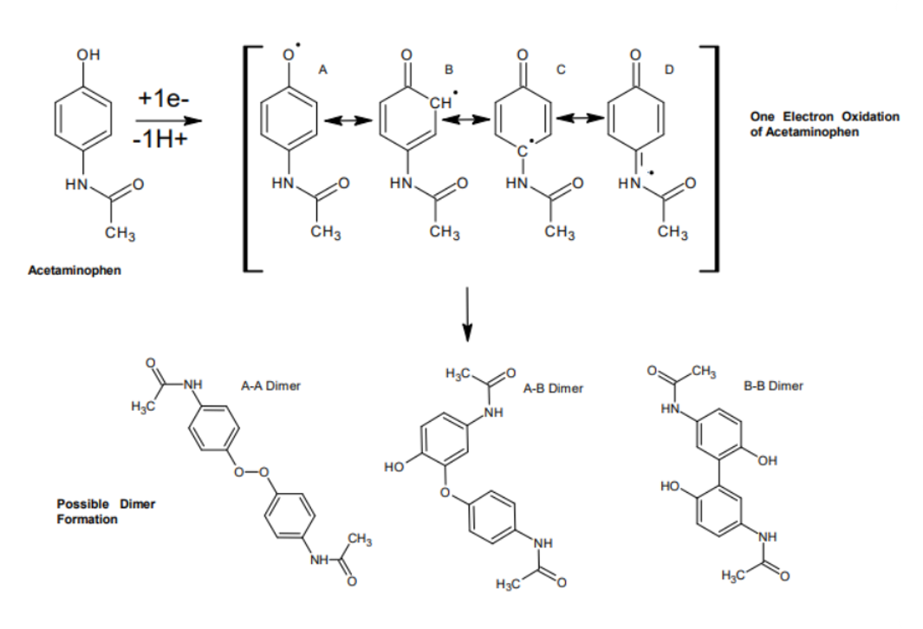
Acetaminophen One Electron Oxidation Cascade

Slide 5
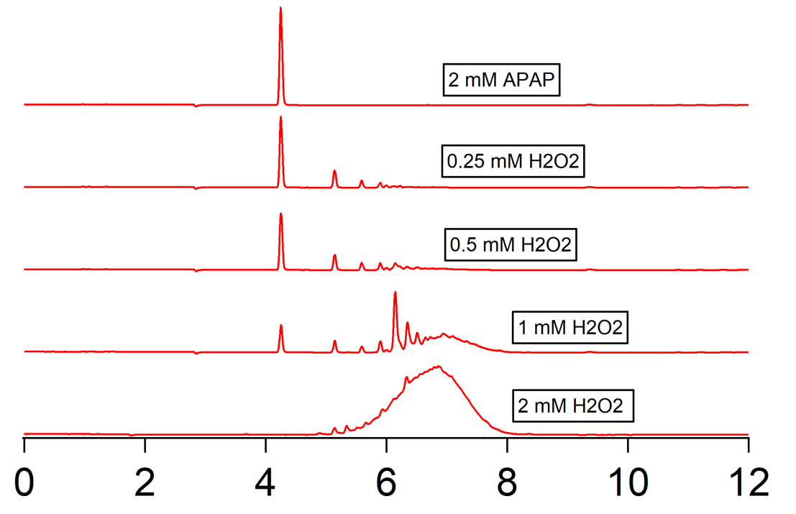
Enzymatic Oxidation of Acetaminophen
Hydrogen peroxide used as fuel for enzyme
Countless new oxidation products formed, which are potential metabolites in the liver during overdose
Characterization via NMR, LC-MS, and EPR indicates oxidation products consistent with a mechanism of radical polymerization
Absorbance @ 270nm
Time (min)

Slide 6
Cyclic Voltammetry
Substrate is in solution with a thin electrode
Voltage is applied cyclically
Current peaks at certain voltage
Allows visualization of oxidation and reduction

Slide 7
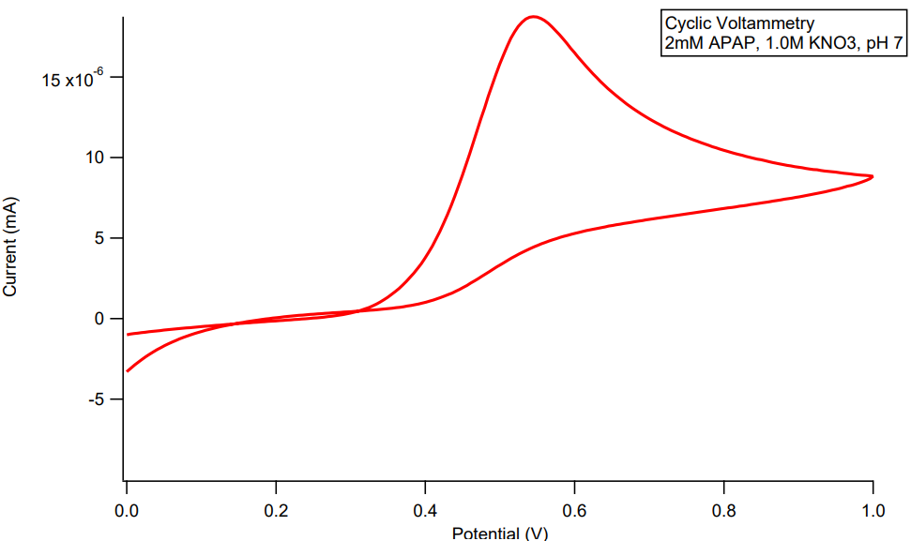
Cyclic Voltammetry to visualize Acetaminophen Oxidation
APAP APAP●
^{Reduced Oxidized}
^{At 0.6V}
No reduction wave indicates irreversible reaction
???

Slide 8
Bulk Electrolysis
Only one substrate used (clean)
Voltage held constant over time
Resulting current carries electrons to oxidize substrate in bulk
“Shocking” the substrate until it reacts

Slide 9
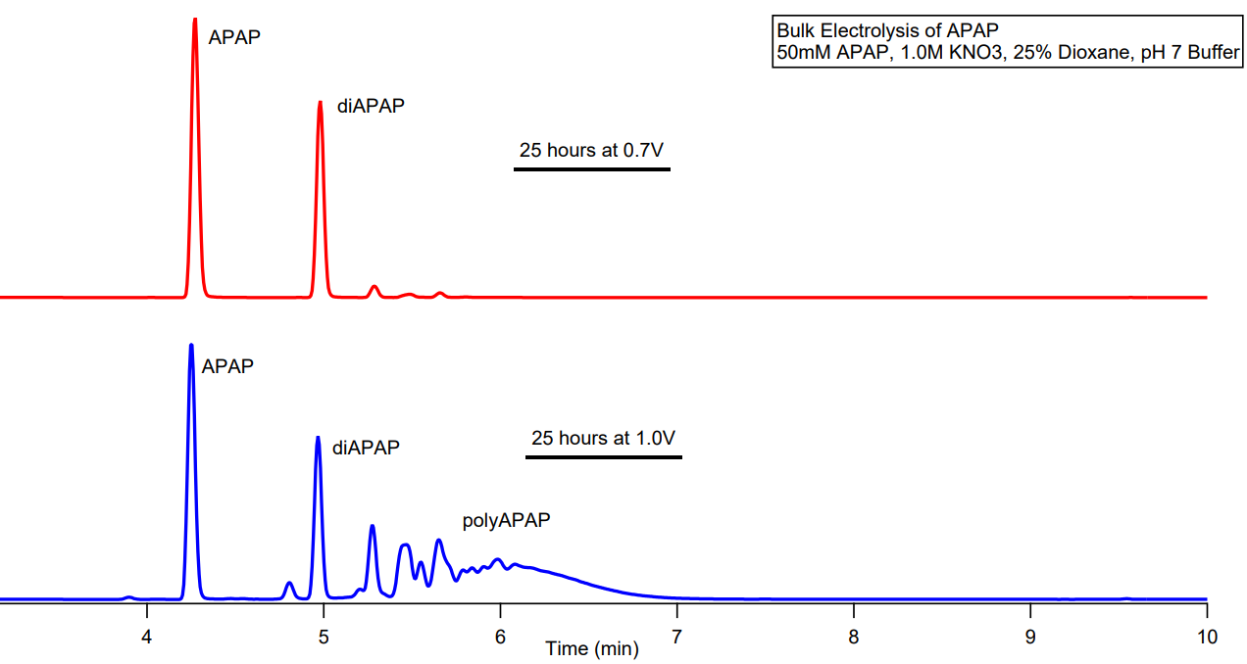
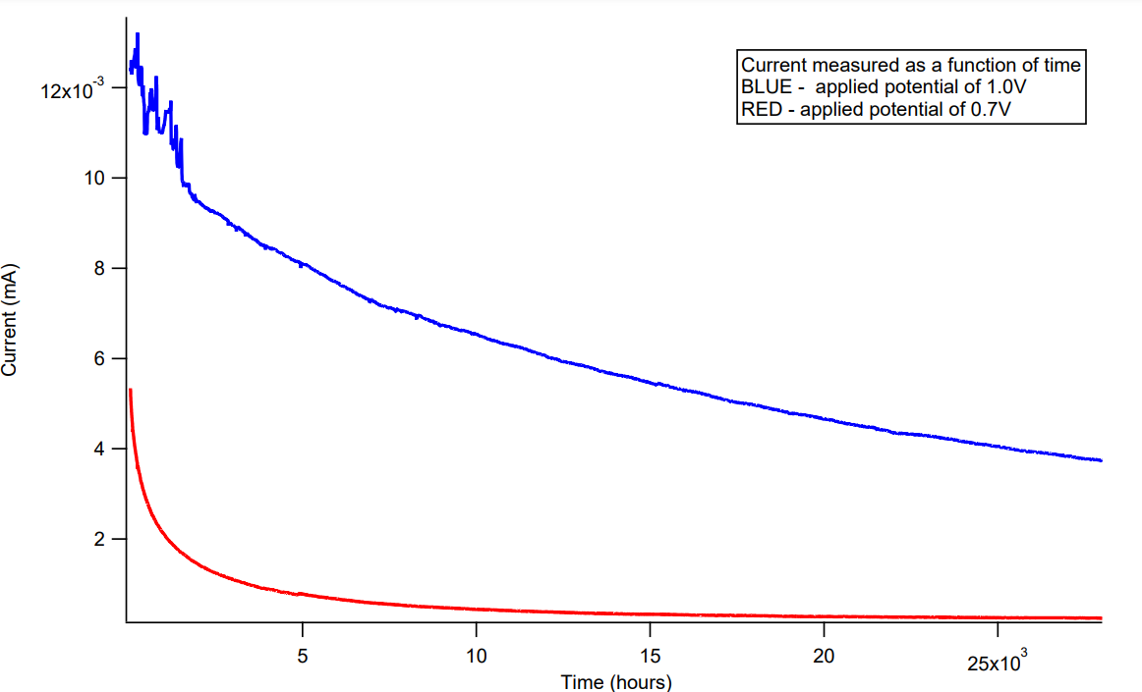
Choosing Products through Electrosynthesis
pH 9 Buffer
pH 7 Buffer

Slide 10
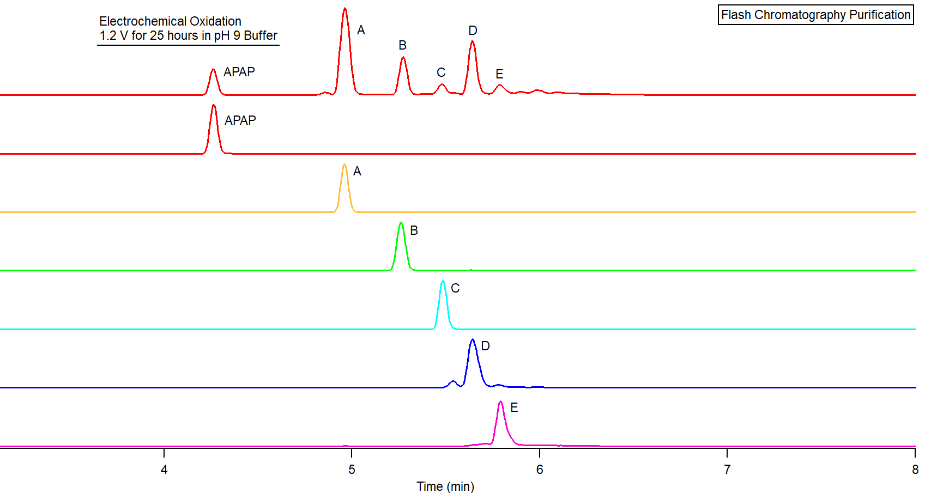
Flash Purification of Oxidation Products
Worked up electrosynthesis utilized as product standard on top
Flash Chromatography used to isolate unknown oxidation products
This synthesis allowed clean purification and eventual characterization
Absorbance @ 270nm

Slide 11
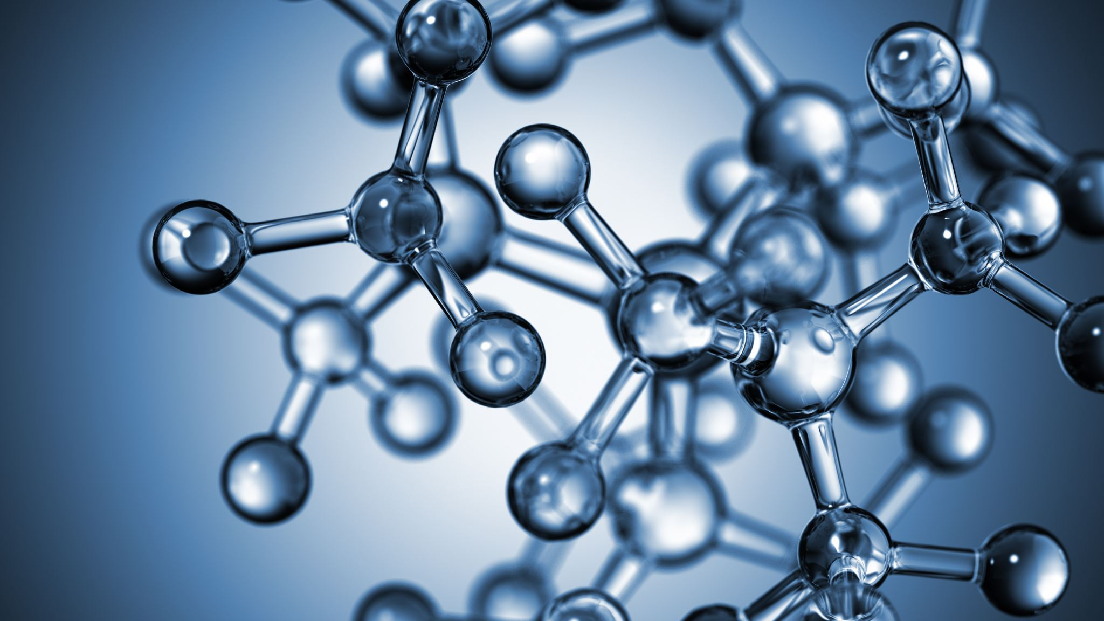
In Summary
Enzymatic and Electrochemical Oxidation
Purification
Characterization through EPR, NMR, and MS

Slide 12
Acknowledgments
Brad Sturgeon
Monmouth College Chemistry Department

Slide 13
Questions? msimonson@monmouthcollege.edu

Slide 14
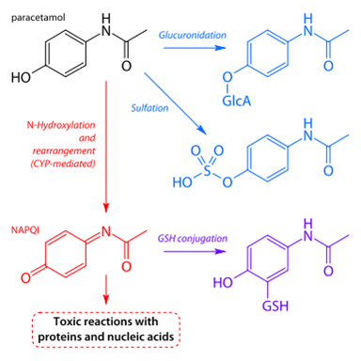
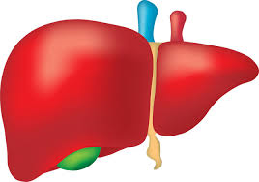
Acetaminophen Filtration through the Liver
Acetaminophen
Glucuronidation
Sulfation
Cytochrome P450 mediated 2e- oxidation???
NAPQI
Reduction via glutathione
+ GSSG

Slide 15
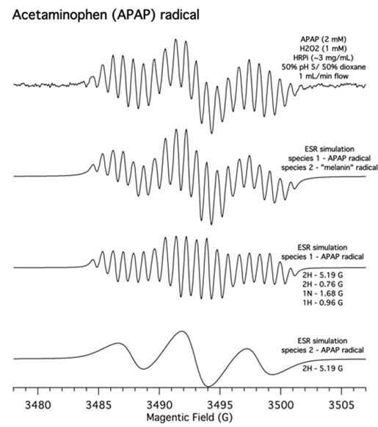
ESR Experiments
Acetaminophen radical detected
Validates that the Acetaminophen radical exists in solution and is not bound to the enzyme
Simulation with WINSIM software
Gave us hyperfine coupling values
Tells us where the lone electron spends its time and is most likely to react
^{Magnetic Field (Gauss)}

Slide 16
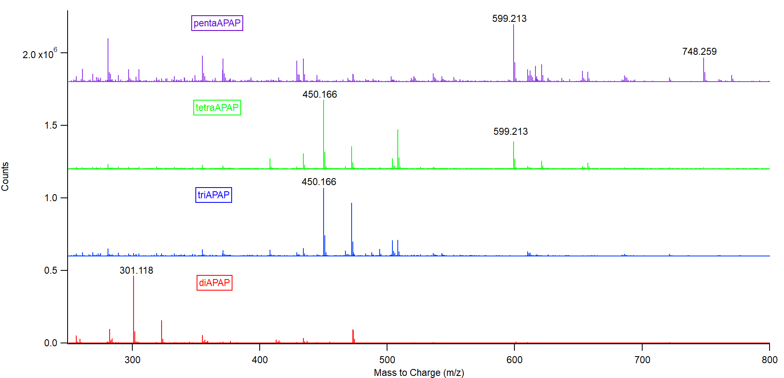

Slide 17
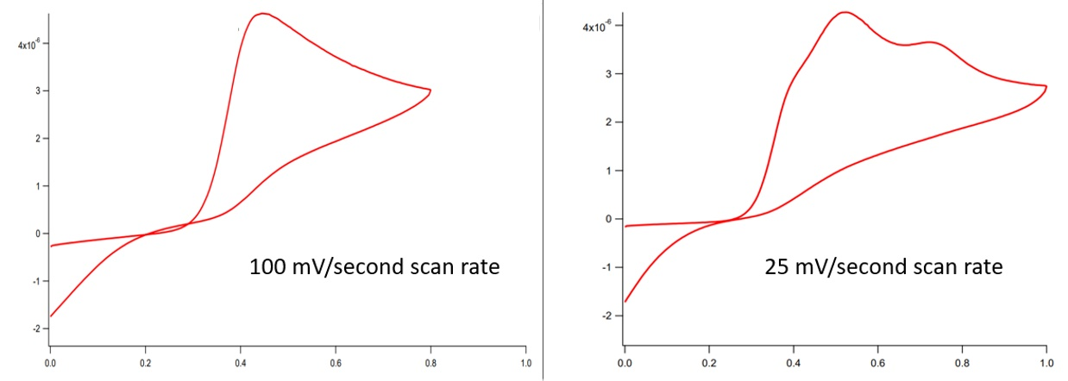
Cyclic Voltammetry to visualize diAPAP Oxidation
diAPAP diAPAP●
Reduced Oxidized
^{At 0.5V}
diAPAP diAPAP●
Reduced Oxidized
^{At 0.5V}
tetraAPAP tetraAPAP●
Reduced Oxidized
^{At 0.75V}
Current (mA)
Current (mA)
Potential (V)
Potential (V)

Slide 18
Peroxidase Enzymatic Cycle
Tafazoli, S., O’Brien, P. (2005) “Peroxidases: a role in the metabolism and side effects of drugs” Drug Disc. Vol. 10(9), pages 617-625

Slide 19
