Slide 1
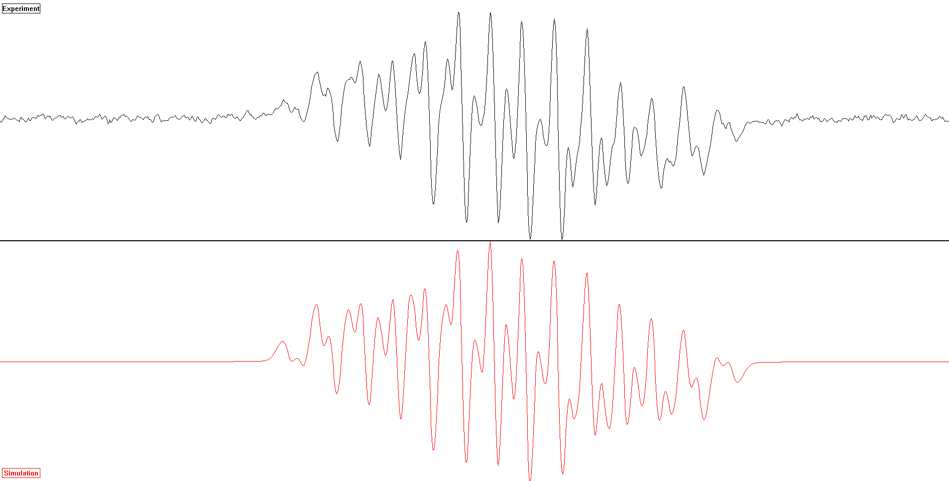
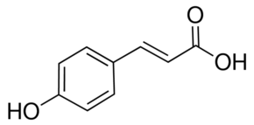
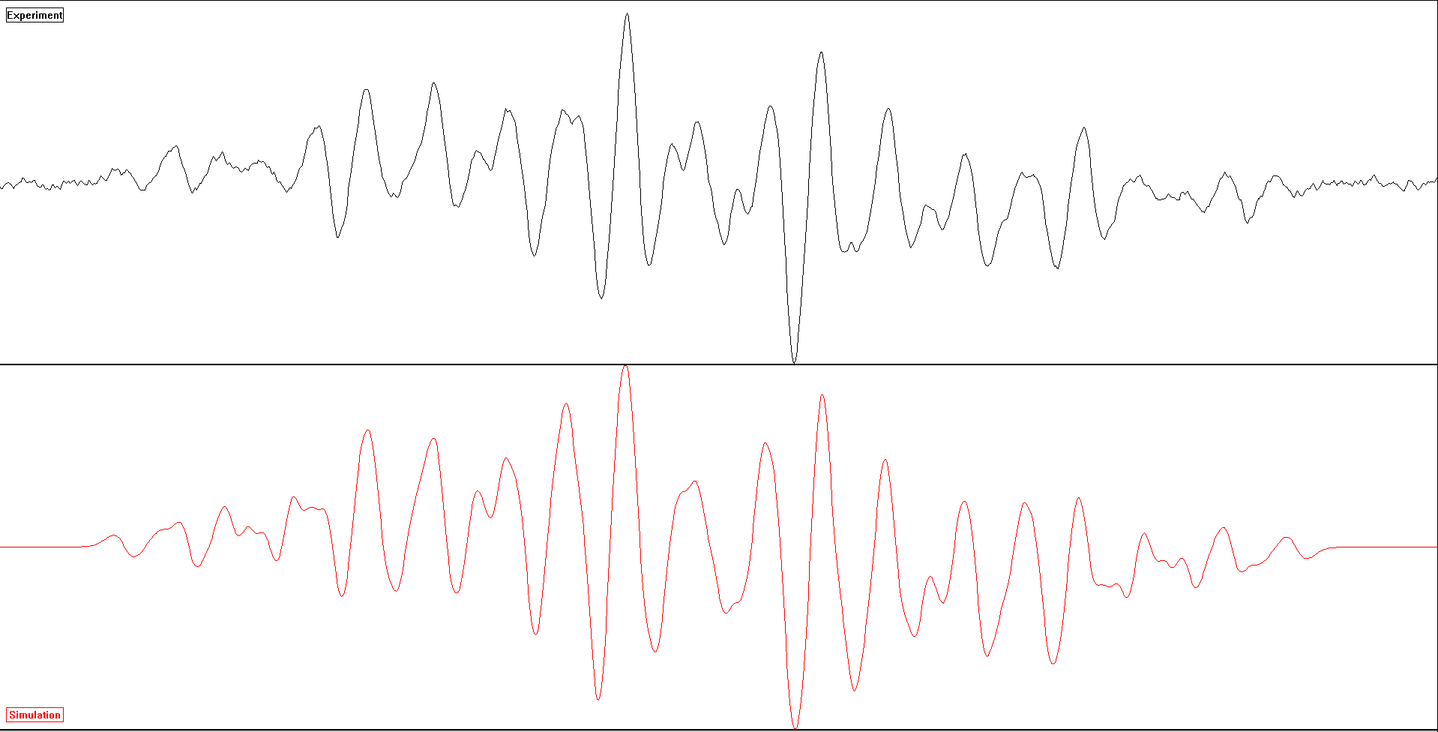
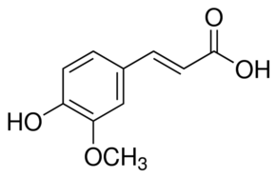
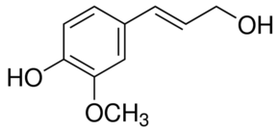
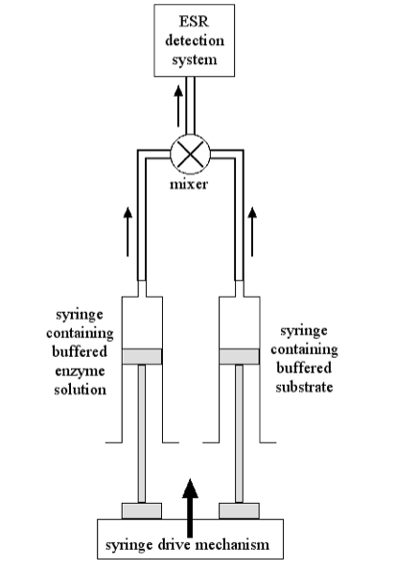
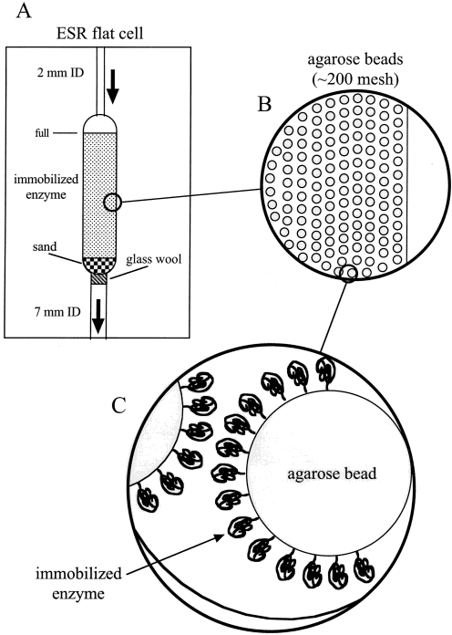
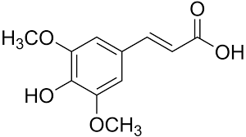
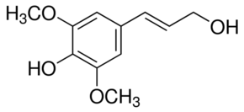
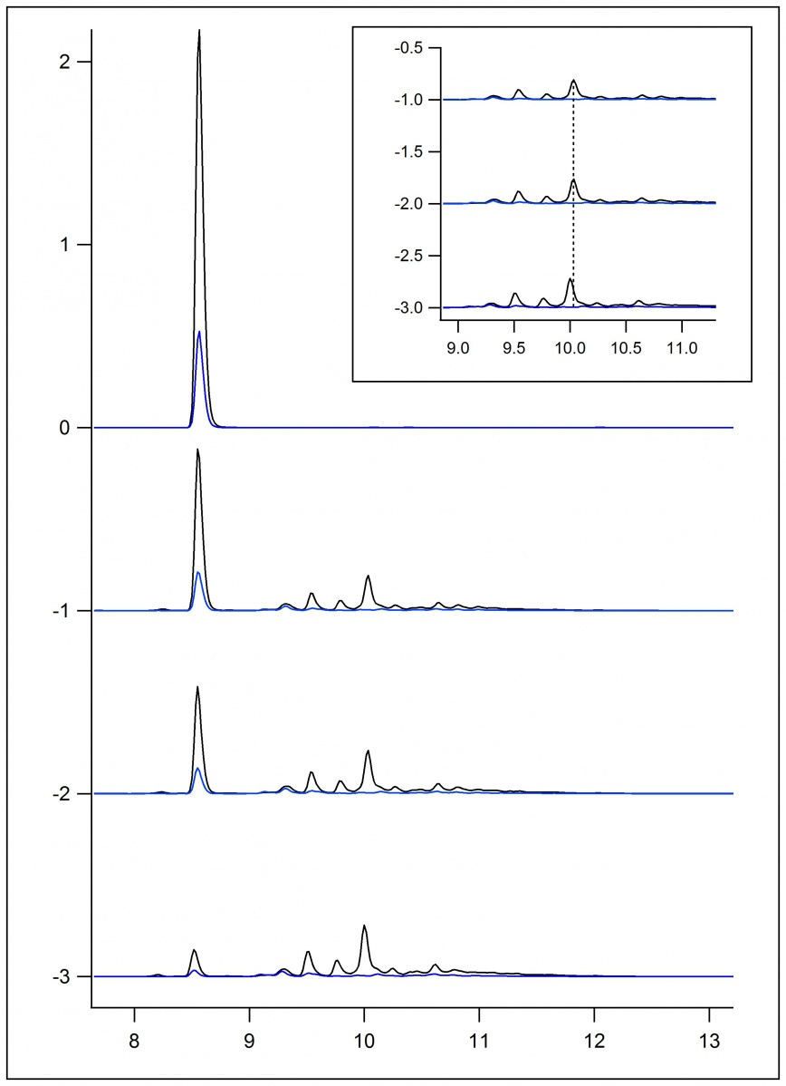
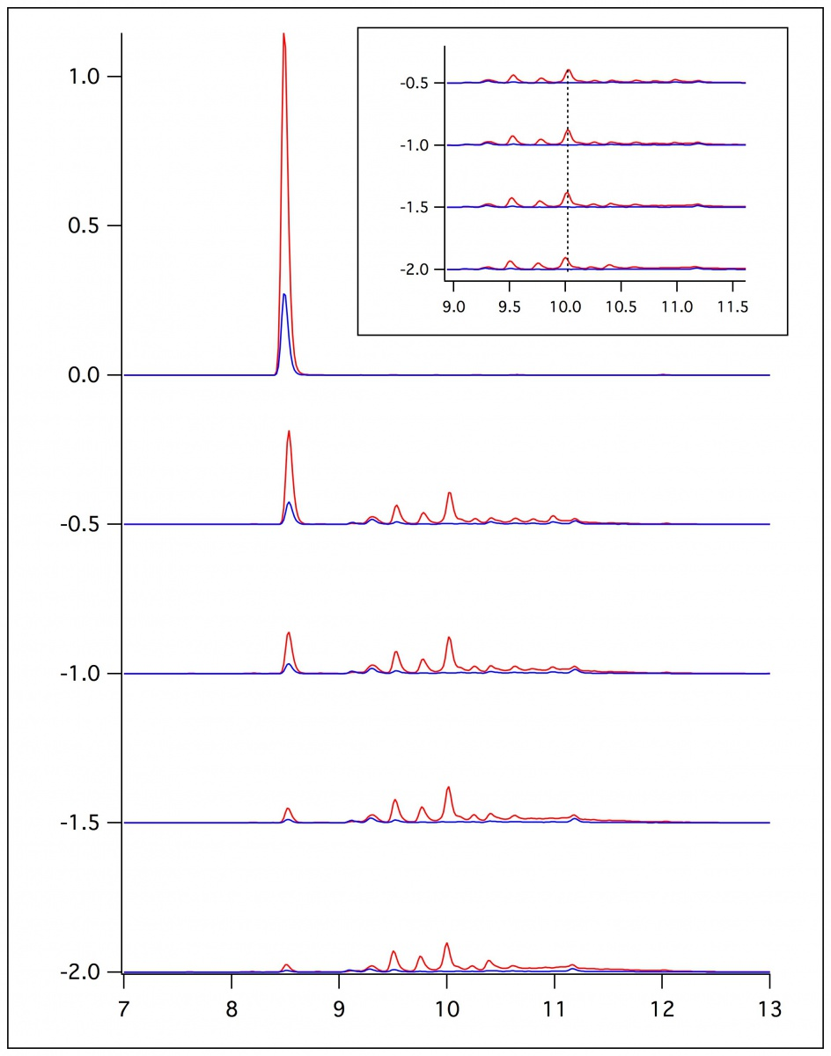
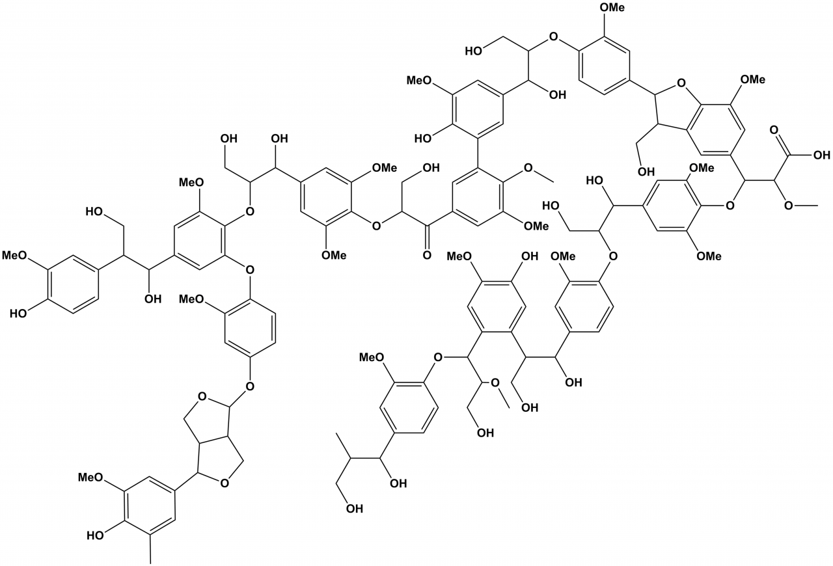
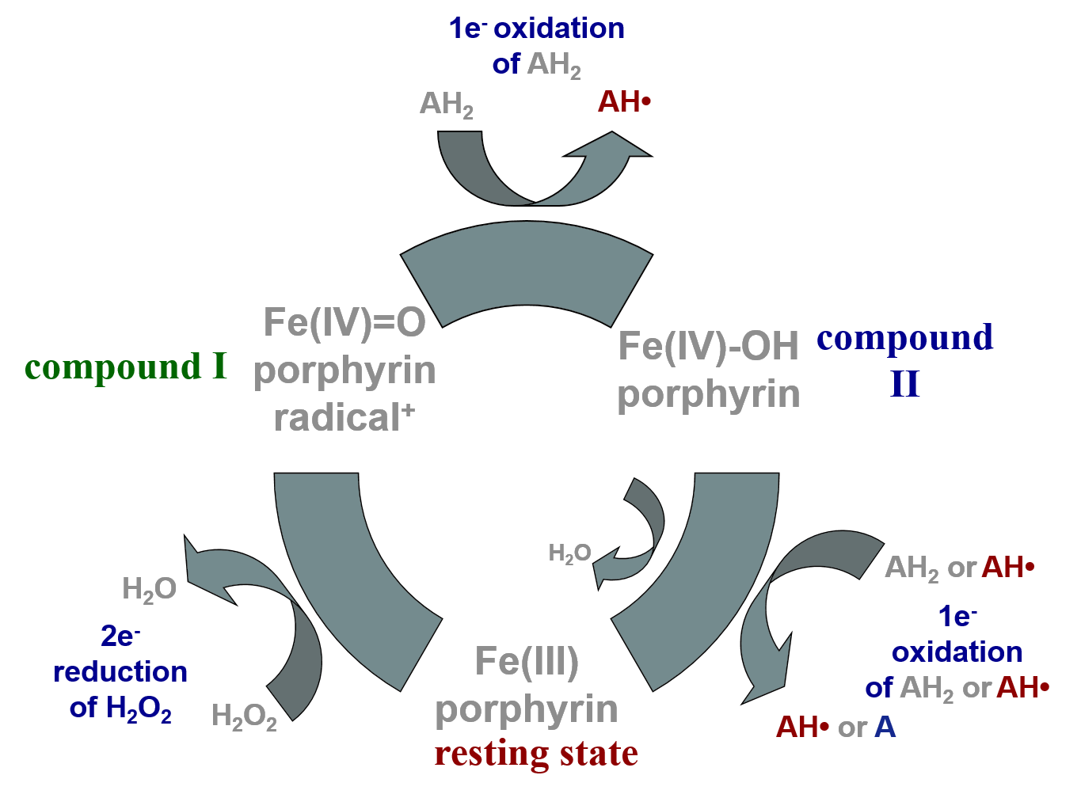
Oxidation of Lignin Monomers
Zelinda Taylor
Bradley E. Sturgeon
Department of Chemistry, Monmouth College, Monmouth, Illinois
Abstract
IE-ESR Spectroscopy
Ferulic Acid Resonance
The lignin polymer is synthesized via oxidative coupling of three basic monomers: p-coumaryl alcohol, coniferyl alcohol, and sinapyl alcohol. These three monomers each possess a phenol group that stabilizes the radical intermediate generated during the oxidation reaction. Although some literature exists showing the ESR spectra of these short-lived radical intermediates, we have revisited these intermediates using a combination of experimental techniques [HPLC and immobilized enzyme-ESR technique (IE-ESR)] and computational approaches [B3YLP/ESR-II and WINSIM].
O-4
C-5
C-1
C-β
methoxy
5
2
6
Lignin Monomers
α
β
A
B
Figure 2: Ferulic acid simulation using IE-ESR with 10mM ferulic acid in 50/50 dioxane pH 7.4 buffer and 10 mM H₂O₂ and a g-shift = -0.26, lineshape = 22, linewidth = 0.32.
5
ESR Flat Cell Technique
C
methoxy
2
6
Fast-Flow ESR
Immobilized Enzyme ESR
D
α
β
γ
Figure 3: Coniferyl alcohol simulation using IE-ESR with 10 mM coniferyl alcohol in 50/50 dioxane pH 5 buffer and 10 mM H₂O₂ and g-shift = -0.26, lineshape = 22, linewidth = 0.32.
E
F
Location | Ferulic Acid Simulation | Ferulic Acid Calculation | Ferulic Acid Burkitt Simulation | Coniferyl Alcohol Simulation | Coniferyl Alcohol Calculation | Coniferyl Alcohol Burkitt Simulation
C-5 | 4.09 | 4.99 | 5.56 | 5.52 | 5.01 | 5.33
C-6 | 1.87 | 1.90 | 1.70 | 1.78 | 1.57 | 1.86
C-2 | 0.55 | 2.46 | 1.53 | 1.18 | 2.56 | 1.16
C-α | 2.62 | 2.71 | 2.64 | 3.08 | 2.49 | 2.32
C-β | 5.39 | 5.87 | 5.28 | 7.16 | 6.0 | 5.50
C-γ | x | x | x | 3.97 | 1.29 | 3.92
methoxy | 1.36 | 0.15 | 1.69 | 1.78 | 2.77 | 1.38
methoxy | 1.36 | 2.54 | 1.69 | 1.78 | 0.15 | 1.38
methoxy | 1.36 | 2.55 | 1.69 | 1.78 | 2.75 | 1.38
Figure 1: The three lignin monomers in the acidic and alcohol forms: A. p-coumaric acid, B. p-coumaryl alcohol, C. ferulic acid, D. coniferyl alcohol. E. sinapic acid, and F. sinapyl alcohol.
Importance of Lignin
Lignin is an organic polymer that is crucial to the growth and support of vascular plants and some algae. It is made up of lignin monomers that are held together via the oxidative coupling of the monomers. These monomers also dimerize with one another to form lignan, which has biological activity.
HPLC Analysis
Future Work
Analyze other monomers using ESR spectroscopy
Compare the isotropic coupling constants between the acidic and alcohol forms of the monomers
Compare the isotropic coupling constants among the monomers to determine the effect of the methoxy groups on the benzene ring
Lignin and the Peroxidase Cycle
standard
standard
Acknowledgements
0.25 mM H₂O₂
2.00 mL/min
Richard “Doc” Kieft Summer Research Program
Monmouth College Chemistry Department
Stephanie Saey
0.50 mM H₂O₂
1.00 mL/min
0.50 mL/min
References
1.00 mM H₂O₂
0.25 mL/min
Figure 4: 2 mM ferulic acid in 50/50 dioxane pH 5 buffer with HRP and 0.5 M H₂O₂
Figure 5: 1 mM ferulic acid in 50/50 dioxane pH 5 buffer with HRP_{i} and 1 mM H₂O₂.
Kersten, P., Kalyanaraman, B., Hammel, K., Reinhammar, B., and Kirk, T. “Comparison of lignin peroxidase, horseradish peroxidase and laccase in the oxidation of methoxybenzenes.” Biochemical Journal, 268, 1990, 4475-480.
Sturgeon, B., Chen, Y., and Mason, R. ”Immobilized Enzyme Electron Spin Reasonance: A Method for Detecting Enzymatically Generated Transient Radicals.” Analytical Chemistry, 75, no.19, 2003, 5006-5011.
Russel, W., Forrester, A., Chesson, A., and Burkitt, M. “Oxidative Coupling during Lignin Polymerization Is Determined by Unpaired Electron Delocalization within Parent Phenylpropanoid Radicals.” Archives of Biochemistry and Biophysics, 332, no. 2, 1996, 357-366.
Heitner, C., Dimmel, D., and Schmidt, J. Lignin and Lignans Advances in Biochemistry. Boca Raton, Taylor and Francis Group, LLC, 2010.
Beaker reactions were completed using a method applying an acetonitrile (ACN) and water gradient for 25 minutes. For 0-10 minutes, a gradient of 100% water and 0% ACN, for 10-20 minutes, a gradient of 80% ACN and 20% water, and for 20-25 minutes a 100% water and 0% ACN gradient. Each trial was ran on the HPLC two times. A differing concentration of hydrogen peroxide was present in each trial and HRP was used. The same procedure was used with HRP_{i} but the flow of the substrate was altered with a constant concentration of H₂O₂.

