Slide 1
Investigating the Effect of Regiochemistry on ESIPT of Bis Coumarin Enamine Probes
Sara Simonson (PI: Dr. Karl J. Wallace)

Slide 2
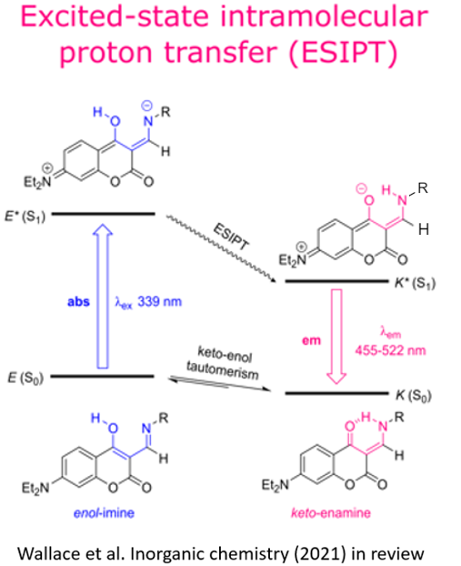
Photophysical properties of a family of coumarin enamine probes

Slide 3
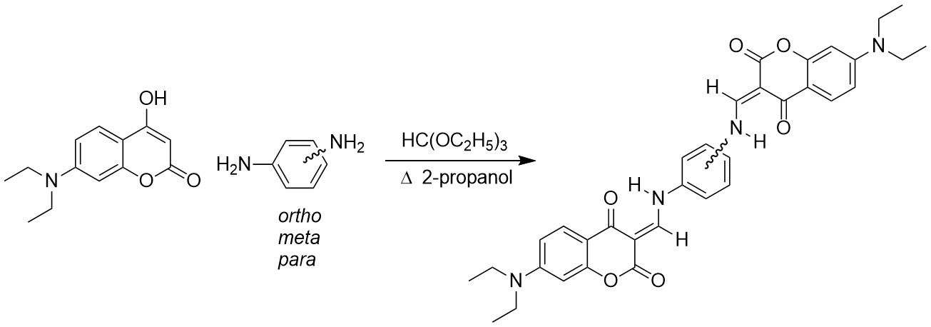
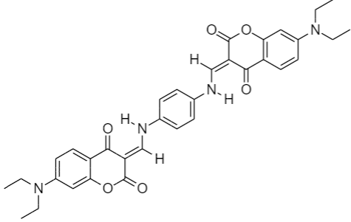
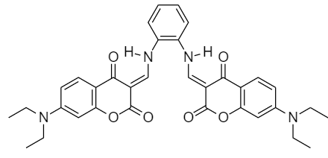
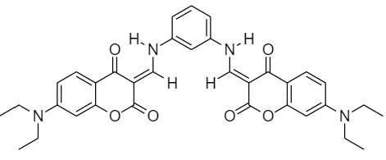

Slide 4
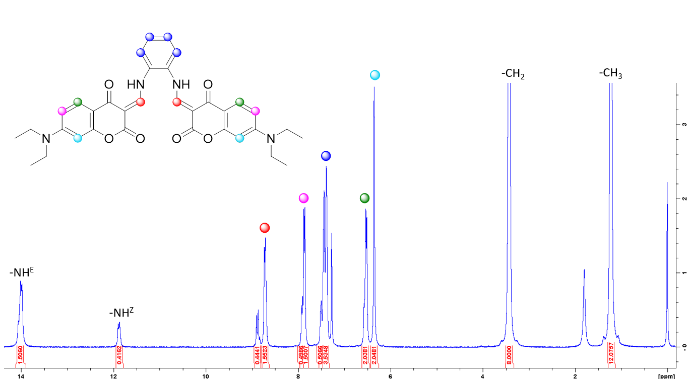
Characterization of the bis ortho coumarin enamine compound

Slide 6
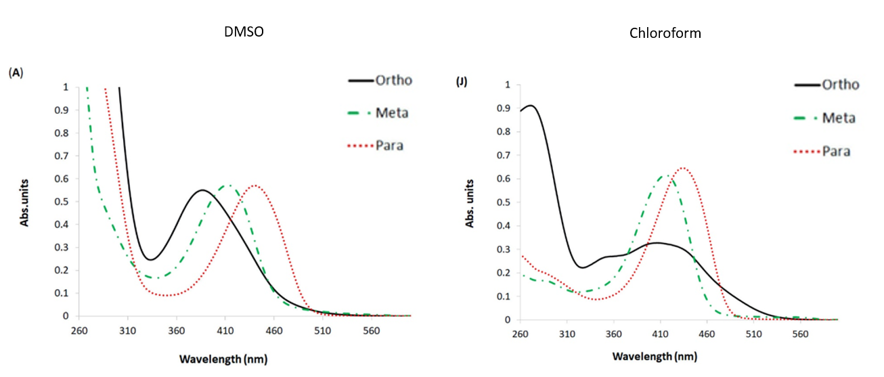
UV-Vis Data Collection

Slide 7
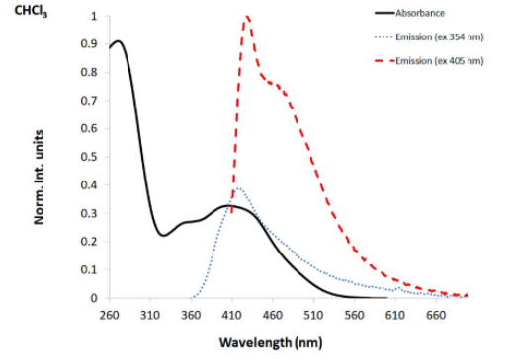
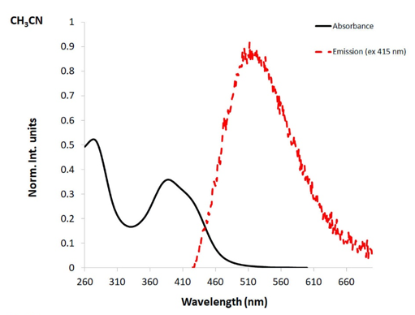
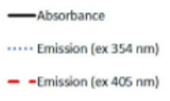
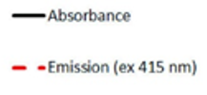
Emission and Absorbance Spectra

Slide 8
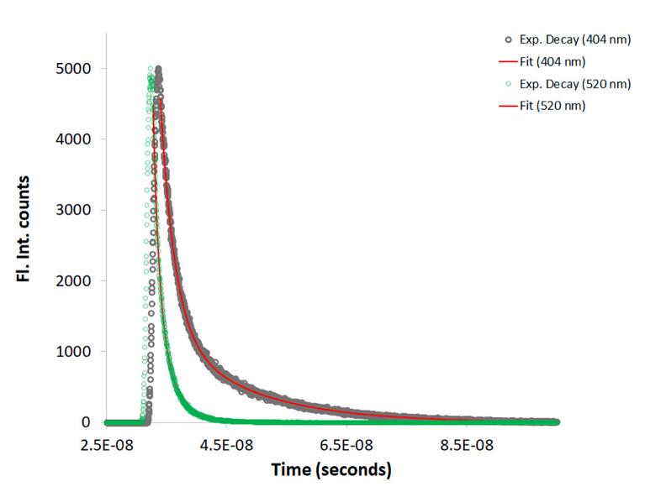
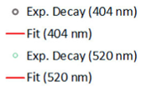
Lifetime Fluorescence Data of the Bis Ortho Compound in DCM

Slide 9
Overview
Analysis
The ortho compound holds the most promise
Future applications:
Probe for divalent metal ions
OLEDs

Slide 10
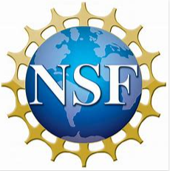
Acknowledgements
University of Southern Mississippi – Department of Chemistry and Biochemistry
Monmouth College Chemistry Department
NSF

