Slide 1
The role of a Robotic Liquid Handling System in Combinatorial Chemistry
Praburaman Mohan
Science Seminar 2020

Slide 2
Content
Background
Definition
Approaches of Combinatorial Chemistry
Combinatorial Library
Instrumentation
Research article
My Research

Slide 3
Background
Furka Á (Eötvös Loránd University ) : i) synthesis of multi-unit compound mixture
ii) screening to find useful products
iii) 1982
2. Basic Goal: i) Make a lot
ii) Identify the useful ones
3. Applications: i) Libraries
ii) Drug Discovery
iii) Pharmaceuticals

Slide 4
Definition of Combinatorial Chemistry
Combinatorial Chemistry makes a large number of products in a single reaction.
The resulting products are stored in the form of chemical libraries with different specification criteria
After the discovery of the desired compounds, further reactions are conducted to test the presence of any biological activity.

Slide 5
Conventional vs Combinatorial
Conventional Combinatorial
Synthesis of one Synthesis of many
Make Purity Test Make Test Purity
Few products in a month Many products in a month
Slower lead generation Faster lead generation
Narang, Shastri. “Combinatorial Chemistry - Modern Synthesis Approach.” PharmaTutor, PharmaTutor Edu Labs, 2017, www.pharmatutor.org/articles/combinatorial-chemistry-modern-synthesis-approach.
Notes:
Type it out
Synthesize one vs many,
Emphasis on the make
Remove the last one

Slide 6
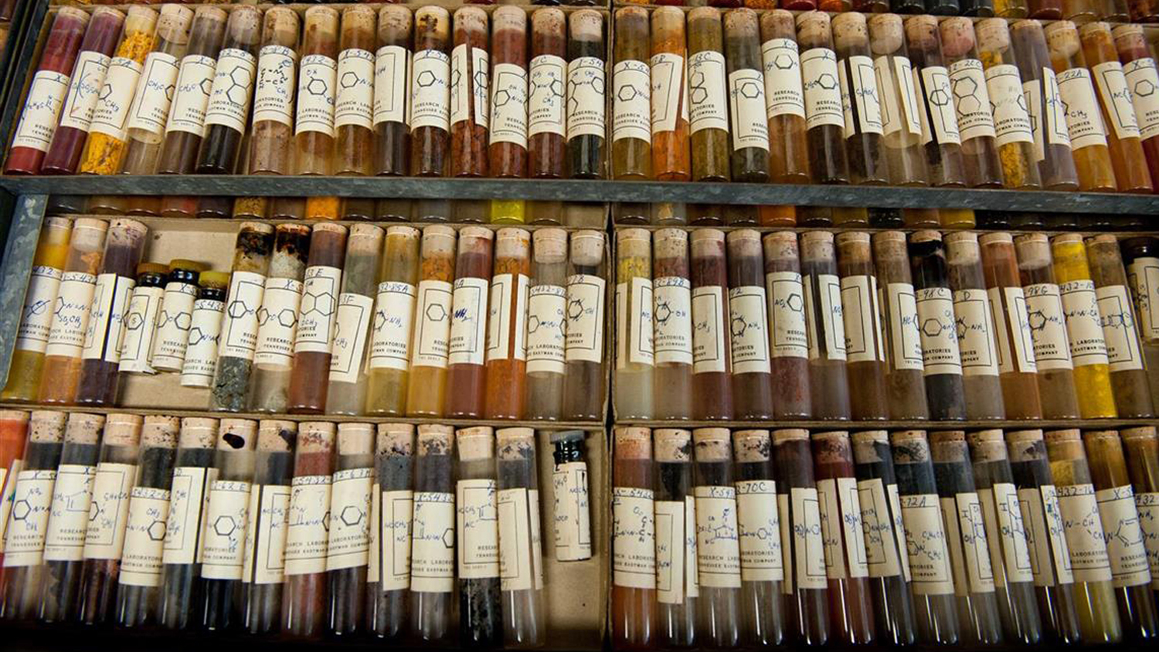
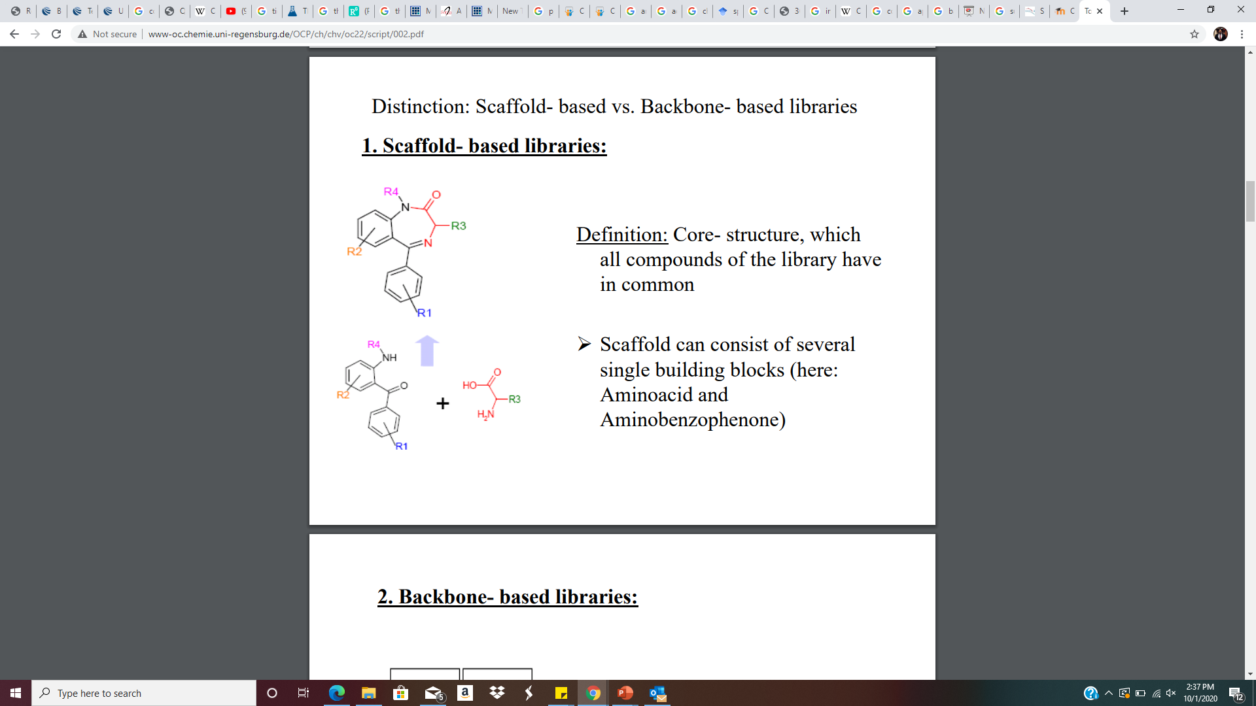
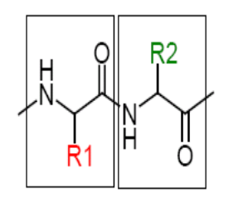
Chemical Libraries
1. Chemical Libraries: i) collection of final products
ii) structure, physiochemical properties, purity, quantity, etc.
2. Types: i) Scaffold
ii) Backbone
Peak, Tracey. “Researchers Release First Chemical Map of Dyes from Historic Dye Library: Wilson College News: NC State University.” Wilson College News, 5 Aug. 2020, textiles.ncsu.edu/news/2017/04/researchers-release-first-chemical-map-dyes-historic-dye-library/.
Notes:
Scaffold may consist of various single building blocks that allow for generation of diversity in synthesis, but the scaffold structure will always remain intact

Slide 7
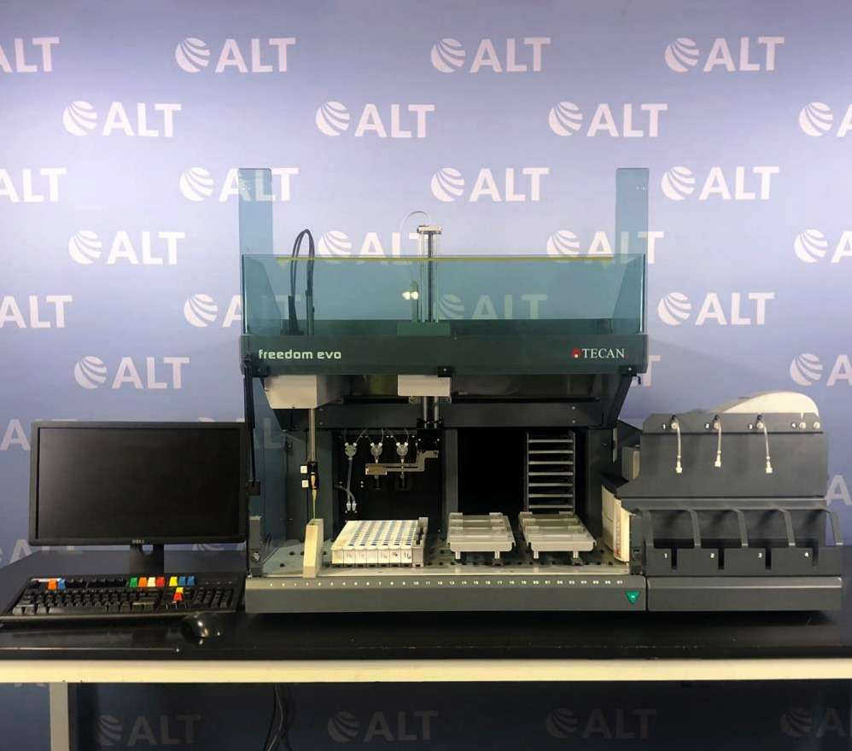
Instrumentation
Tecan Freedom EVO 75 Liquid Handling System With Columbus Pro Microplate Washer And Sunrise Microplate Reader
Cost
Time of arrival
Designs, WebDuck. “Your Trusted Source for Used Lab Equipment.” Tecan Freedom EVO 75 Liquid Handling System With Columbus Pro Micropla, americanlaboratorytrading.com/lab-equipment-products/tecan-freedom-evo-75-liquid-handling-system-with-columbus-pro-microplate-washer-and-sunrise-microplate-reader_18195.

Slide 8
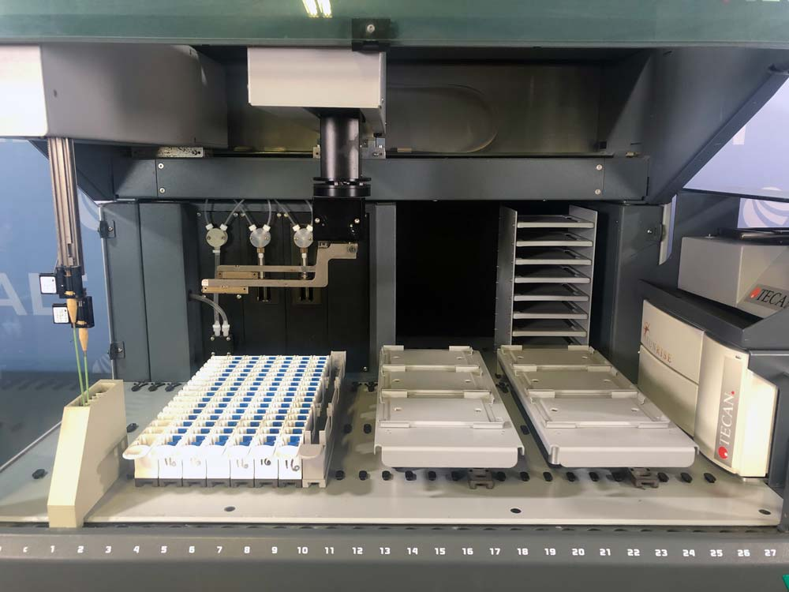
Tecan Freedom EVO 75 Liquid Handling System
1. Liquid Handling features: i) Syringe sizes 50/250/500/1000/2500/5000 μl
ii) Diluter Cavro XP Smart diluter
2. Safety features: i) Liquid level detection
ii) Low Disposable tip eject
iii) Safety screens
3. The Software: Evoware
Designs, WebDuck. “Your Trusted Source for Used Lab Equipment.” Tecan Freedom EVO 75 Liquid Handling System With Columbus Pro Micropla, americanlaboratorytrading.com/lab-equipment-products/tecan-freedom-evo-75-liquid-handling-system-with-columbus-pro-microplate-washer-and-sunrise-microplate-reader_18195.
Notes:
Work on the jargons

Slide 9
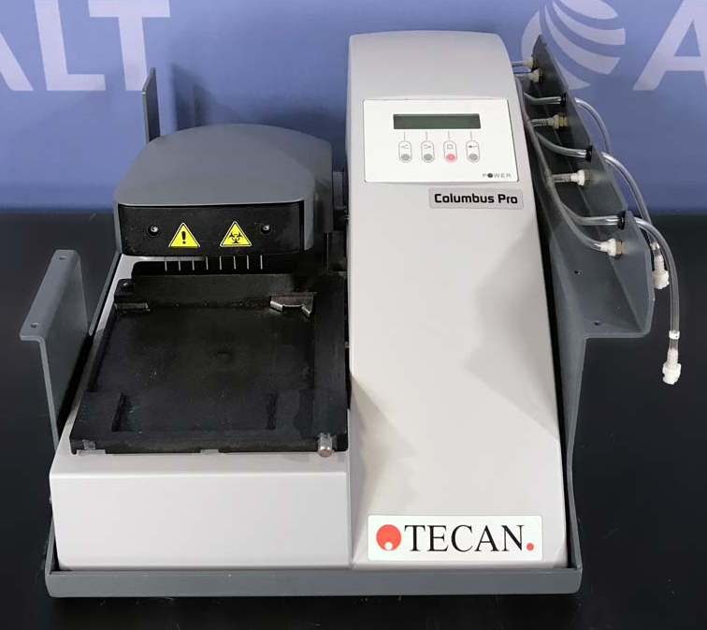
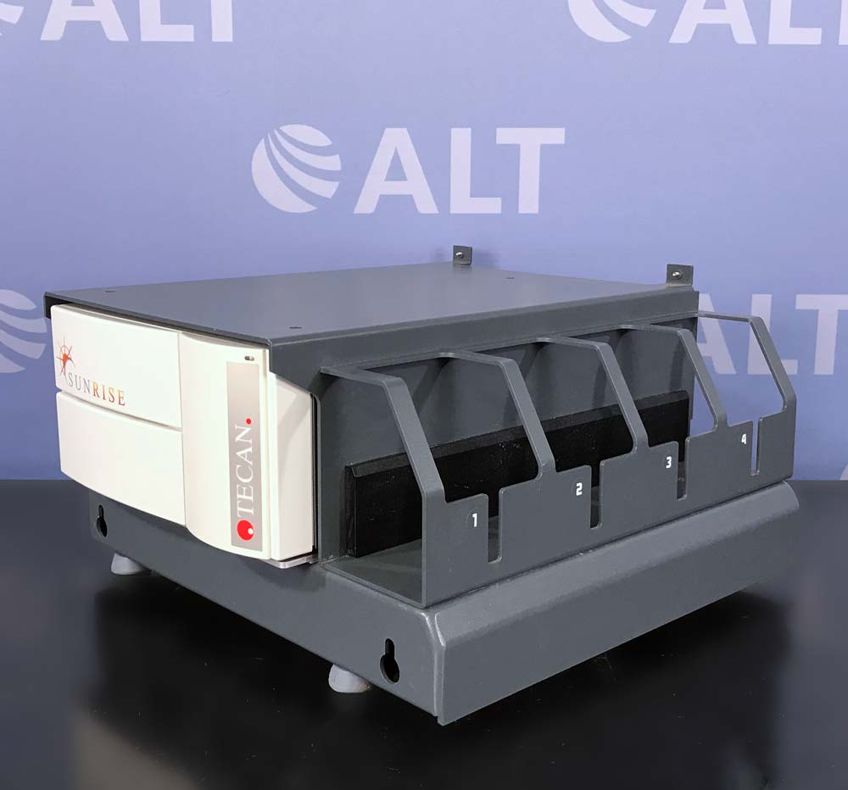
Designs, WebDuck. “Your Trusted Source for Used Lab Equipment.” Tecan Freedom EVO 75 Liquid Handling System With Columbus Pro Micropla, americanlaboratorytrading.com/lab-equipment-products/tecan-freedom-evo-75-liquid-handling-system-with-columbus-pro-microplate-washer-and-sunrise-microplate-reader_18195.
Notes:
1. Key Specifics: i) Up to 6 filters
ii)Wavelength range: 340 to 750nm
2. Key Applications: i) ELISA
ii) Temperature controlled
iii)Tunable wavelength
Columbus Pro Microplate Washer
Crosswise aspiration
Residual volume to <2 µL
Overflow

Slide 10


Advantages:
Fast
Economical
Easy
Drug Discovery and Drug Optimization
Disadvantages:
Efficiency

Slide 11
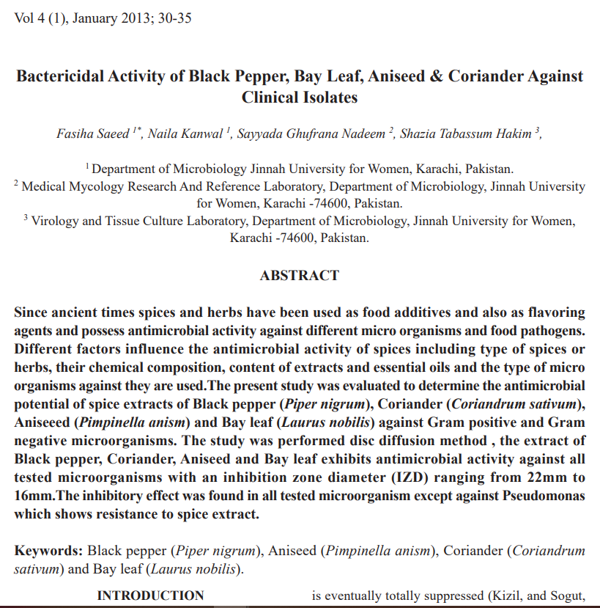
Reference Literature
Introduction: 1. Different sizes
2. Shelf Life
3. Potential Cure to Chronic conditions
Materials :1. Aniseed, Black Pepper, Coriander and Bay Leaf
2. Studies 6 different genera
3. 10g distilled, 45minutes
Methods: The Kirby-Bauer Test / Disk Diffusion Test
Chaudhry, Nazia Masood Ahmed, and Perween Tariq. “Bactericidal activity of black pepper, bay leaf, aniseed and coriander against oral isolates.” Pakistan journal of pharmaceutical sciences vol. 19,3 (2006): 214-8.

Slide 12
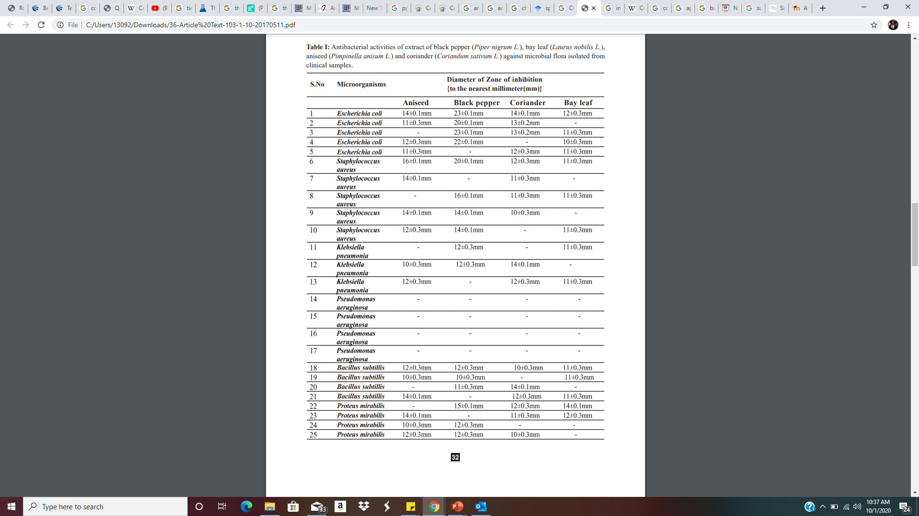
Results and Discussion
Based on the several zones of inhibition, they were able to conclude that the spices exhibited antibacterial characteristics.
Black pepper, Aniseed, Coriander and Bay Leaf.
Chaudhry, Nazia Masood Ahmed, and Perween Tariq. “Bactericidal activity of black pepper, bay leaf, aniseed and coriander against oral isolates.” Pakistan journal of pharmaceutical sciences vol. 19,3 (2006): 214-8.

Slide 13
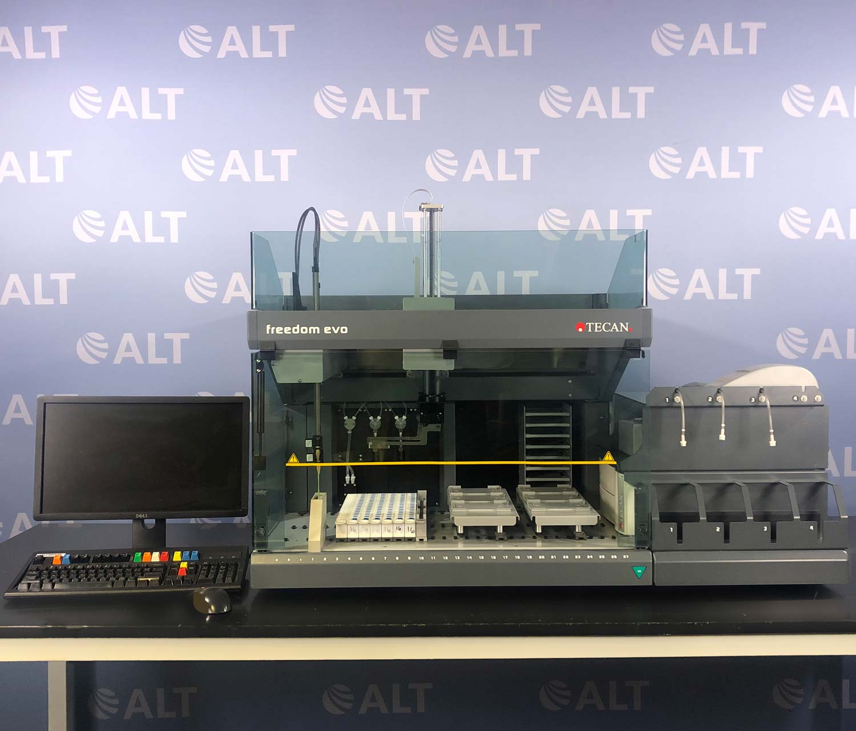
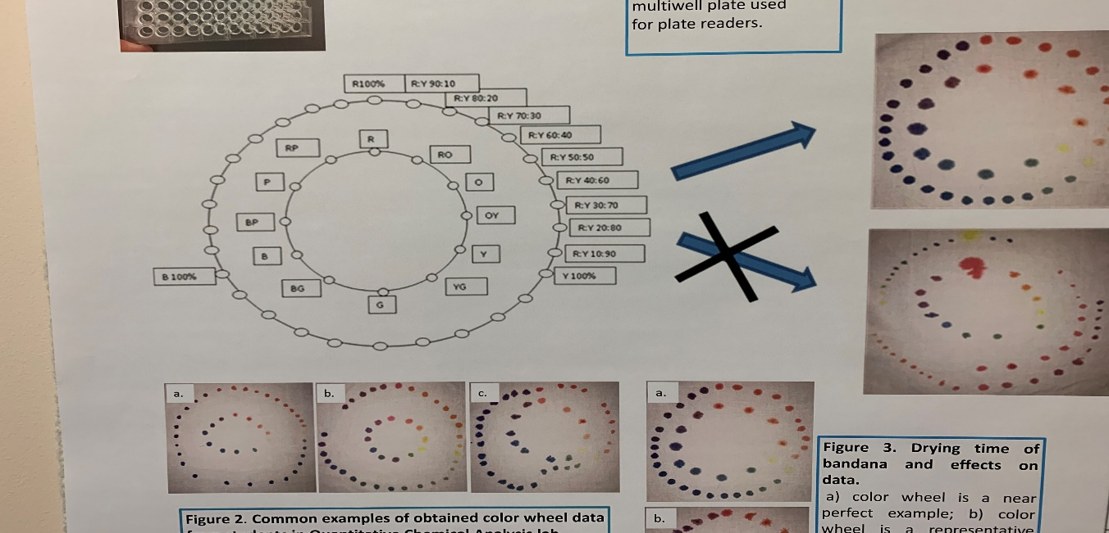
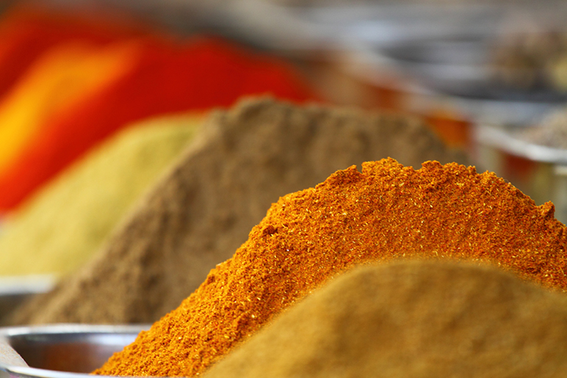
My Goals
Become proficient with the instrument and the software.
Recreate the Tie Dye experiment
The effect of spices on microbial growth

Slide 14
Recap
Concept of Combinatorial Chemistry
Compared it against the conventional approach
Chemical Libraries
The Instrumentation
Discussed my Reference Article
Discussed my future Research Plans

