Slide 1
Biological Dimers: Lignans
By: Zelinda Taylor

Slide 2
Outline
What is lignan?
Interest
Monomers
Radicals and Oxidation
HPLC Analysis

Slide 3
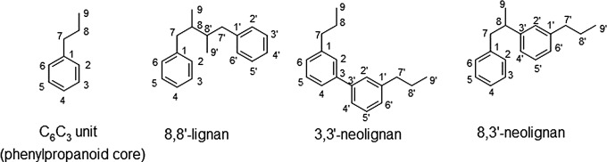
Biological Dimers
Biological activity
Isolation from medicinal plants
  Interest in more traditional treatments
Potential health benefits
Often linked between the beta-carbons of the side chains
Source: Plant Biotechnology and Agriculture

Slide 4
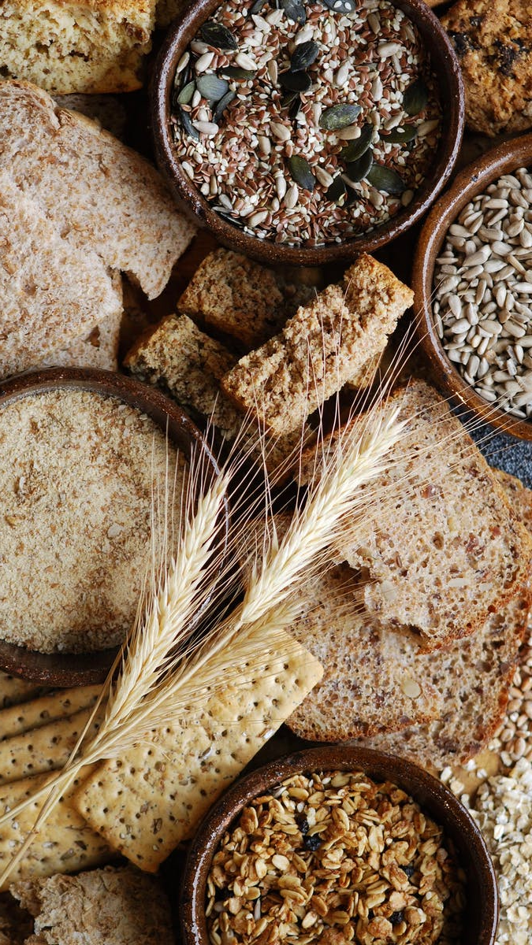
Foods rich in lignans
Examples: seeds, whole grains, bran, vegetables, beans, fruit
  Highest in flax seeds: 294.21 mg/100 g
Exhibit antioxidant activity
Intake on a near daily basis

Slide 5
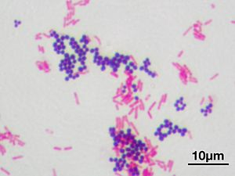
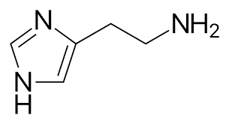
Pharmacological properties
  Antimicrobial
  Anti-inflammatory
  Anti-oxidant
  Relation to antiallergy effect
histamine
Source: Wikipedia
Notes:
-Against gram + bacteria through alteration of biofilm formation
-Suppress nitric oxide generation and decrease inflammatory cell infiltration
-Inhibitory activity on histamin activity
-causes contraction of smooth muscle and dilation of capillaries

Slide 6
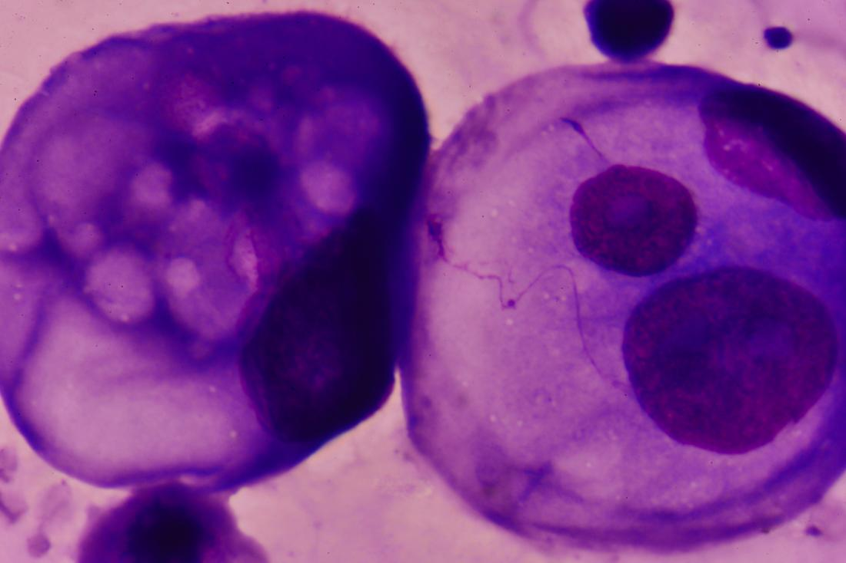
Breast Cancer
Additional lignan intake among post-menopausal women significantly reduced risk of mortality from breast cancer
Flax seed intake was associated with a significant reduction in breast cancer risk
Estrogen receptor and lignan intake
  Matairesinol and lariciresinol intake
  Competitive inhibitor
Other cancers have been studied but few human studies have been completed
  No clear association between lignan consumption and decreased risk of cancer
Source: Medical News Today
Notes:
-Lignan structure is able to bind to ER of breast cancer to block estrogen from binding

Slide 7
Lignin Monomers
Sinapyl Alcohol
Coniferyl Alcohol
P-coumaryl Alcohol
Notes:
-three monomers
-differ in the number of methoxy groups they have attached to the phenol group
-the phenol creates stability in the assumed radical forms due to resonance capabilities
-focused currently on coniferyl alcohol because the one methoxy allows for easier oxidation compared to sinapyl alcohol, but more controlled compared to p-coumaryl alcohol

Slide 8
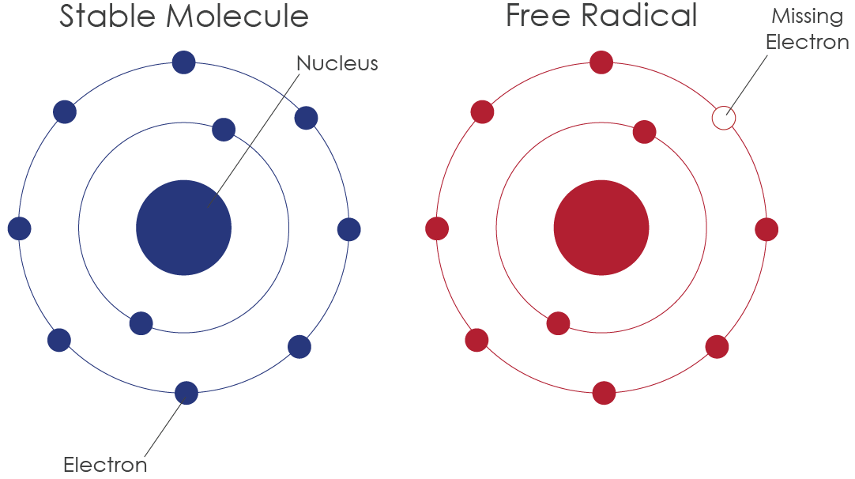
Free Radicals
Source: PrimoNutra
Notes:
-interested in the free radicals these monomers make
-this is when there is an unpaired electron in the valence shell of the molecule
-since it is unpaired and desires to be paired, they are very reactive with one another

Slide 9
Coniferyl Alcohol Radicals
O-4
C-5
C-1
C-β
Notes:
-here are the radical forms of coniferyl alcohol
-forms at O4, C5, C1, CB
-done using the process I showed on the last slide of losing a H and 1 e from the alcohol group to form a radical.
-Electrons moving around the molecule via bonds breaking and unpaired electron moving

Slide 10
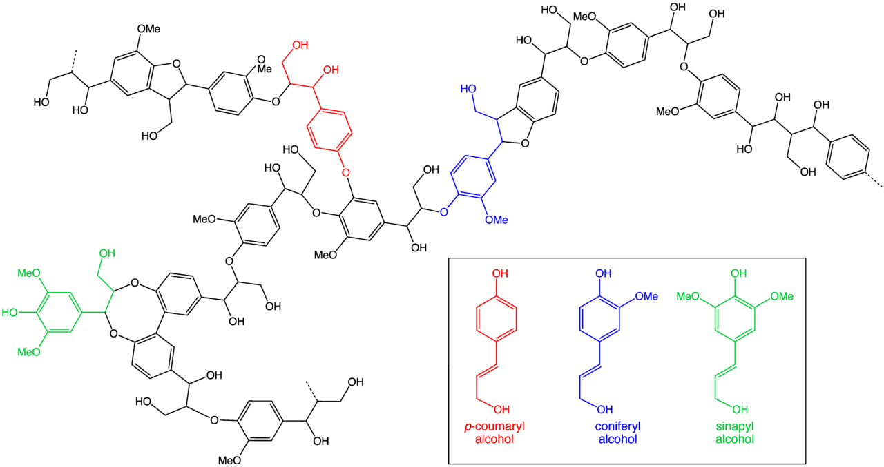
Radical Coupling
Notes:
-showing the monomers coupling together
-color coded to see where each one exists in this polymer

Slide 11
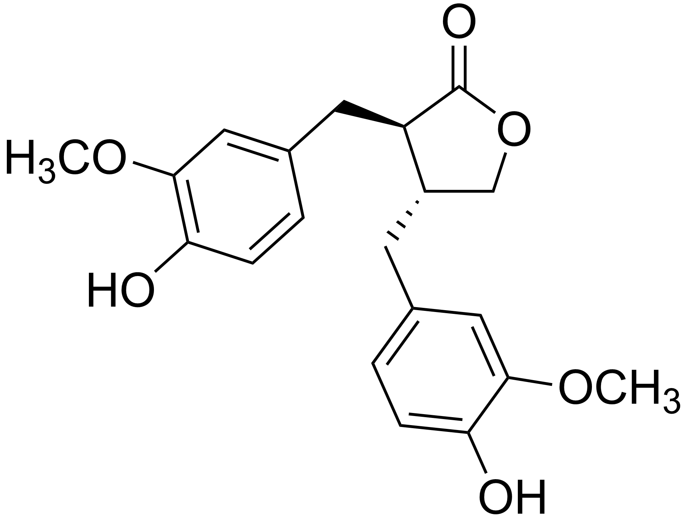
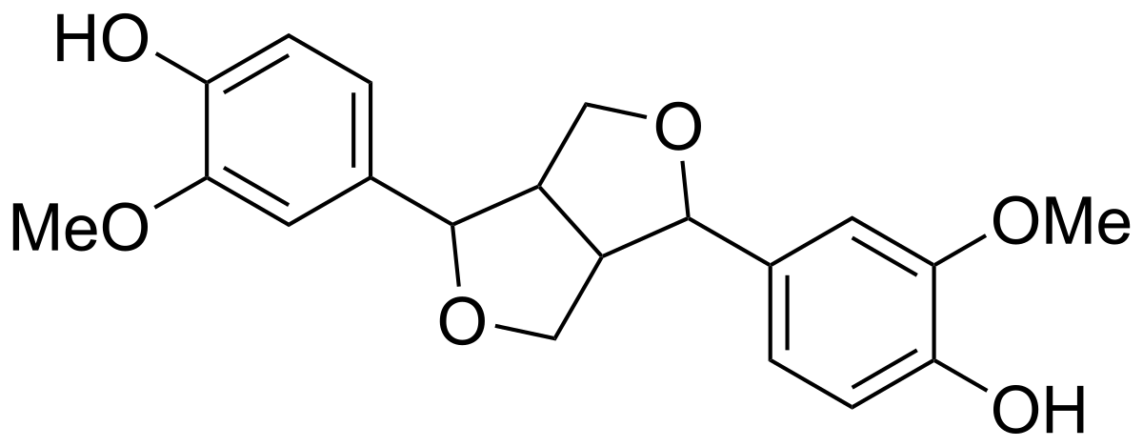
Lignan
(+) pinoresinol
matairesinol
Source: http://lpi.oregonstate.edu/mic/dietary-factors/phytochemicals/lignans
Notes:
-lignan is the dimer of lignin monomers, meaning only two monomers are in this structure
-both dimers are dimers of coniferyl alcohol
-focused data collection on these two as they were available for purchase

Slide 12
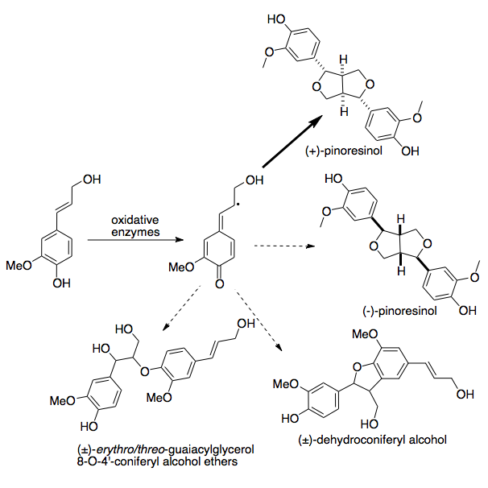
General structure
Eight structural subgroups
Variety can be produced dependent on enzyme used with the precursor metabolite
Ingestion
  Converted to mammalian lignans which are metabolized from plant lignans by intestinal bacteria
  Availability depends on how much in ingested
    More ingested = more gut microbiota production
Source: Wikipedia
Notes:
-according to the manner oxygen is incorporated into their ring structure

Slide 13
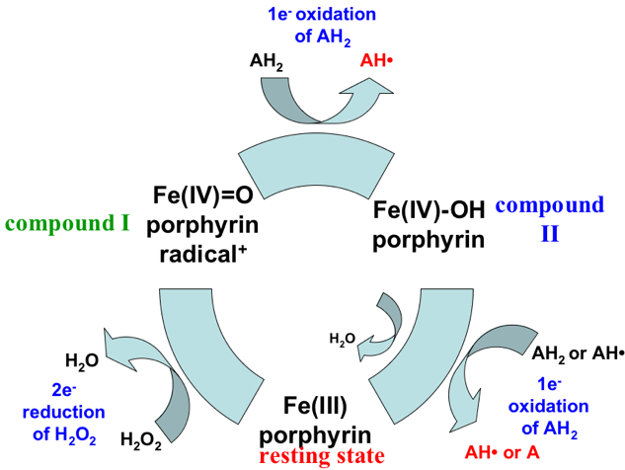
Peroxidase cycle
Notes:
-in order to simulate these radicals in the lab, we used an enzyme called HRP and hydrogen peroxide
-we are interested in a one electron oxidation like the one seen at the top of this cycle
-imagine the AH2 is a monomer and it is forming the AH* by losing one electron and a hydrogen

Slide 14
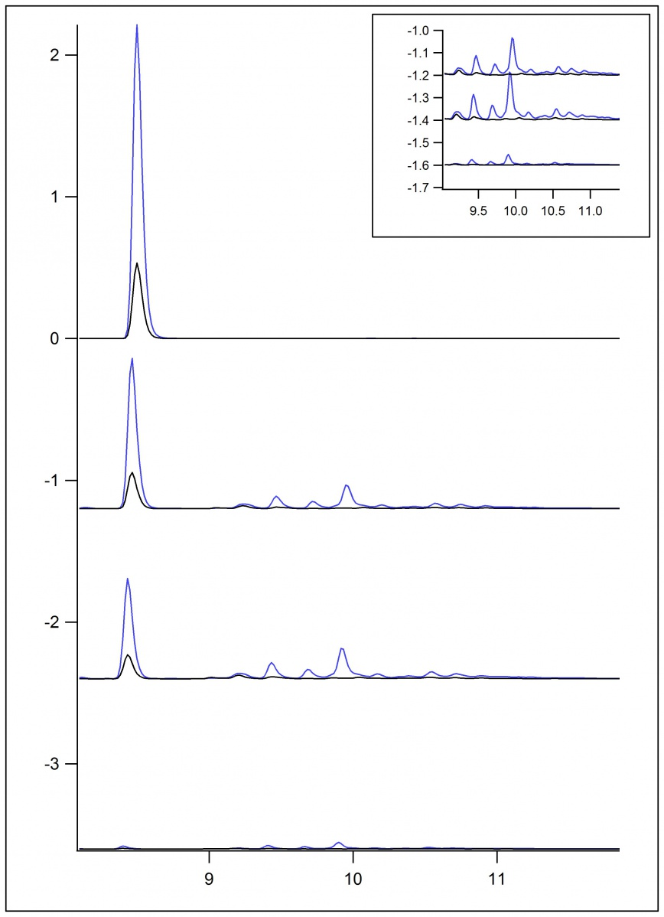
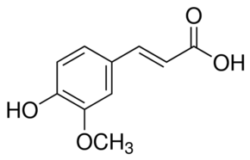
Ferulic
Acid
standard
0.25 mM
0.50 mM
1.00 mM

Slide 15
Ferulic
Acid
standard
0.25 mM
0.50 mM
1.00 mM

Slide 16
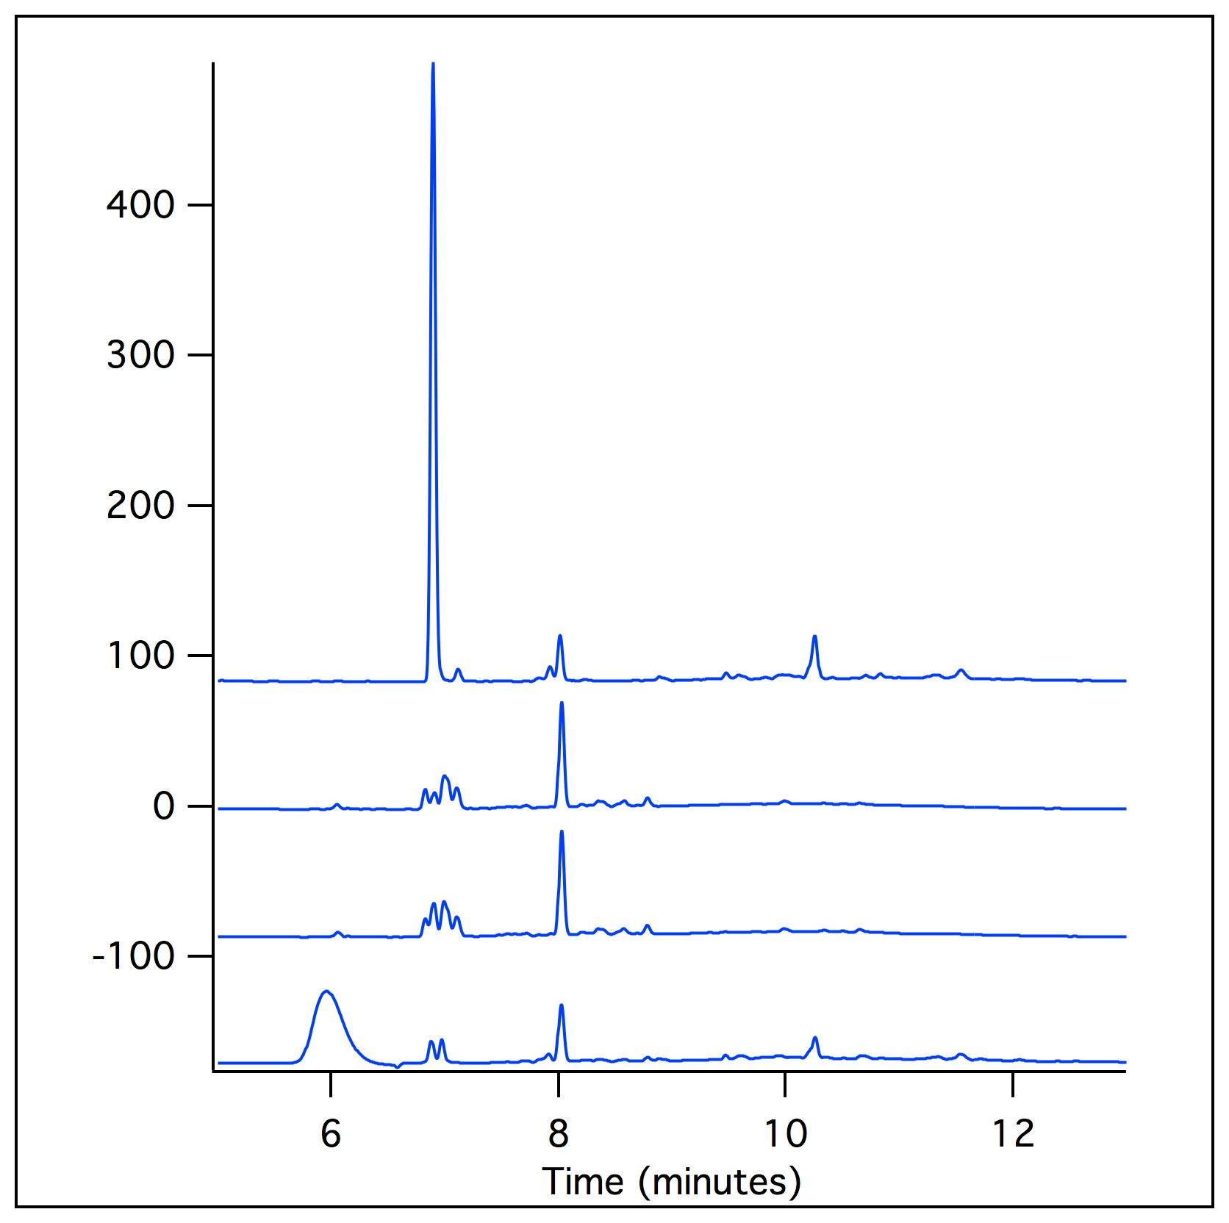
Coniferyl
Alcohol
standard
0.25 mM
0.50 mM
1.00 mM

Slide 17
Future Plans
Understand what the HPLC data is showing of the oxidation reactions of coniferyl alcohol
Understand the mechanisms behind the formation of dimers
Study other lignans and their oxidative properties

Slide 18
Acknowledgments
Brad Sturgeon
Stephanie Saey
Monmouth College Chemistry Department
Doc Kieft Endowment

Slide 19
General References
Deyama, Takeshi and Nishibe, Sansei. Pharmacological Properties of Lignans. Lignin
  and Lignans: Advances in Chemistry. Taylor and Francis Group, 2010, pp.
  586-619.
  Rodriguez-Garcia, Carmen et al. Naturally Lignan-Rich Foods: A Dietary Tool for
  Health Promotion. Molecules, 2019, 24, pp. 1-25.
Questions?

