Slide 1

Synthesis and Oxidation of Lignin Monomers
Lexi Tibbs & Zelinda Taylor
Dr. Bradley Sturgeon
Monmouth College Chemistry Department

Slide 2
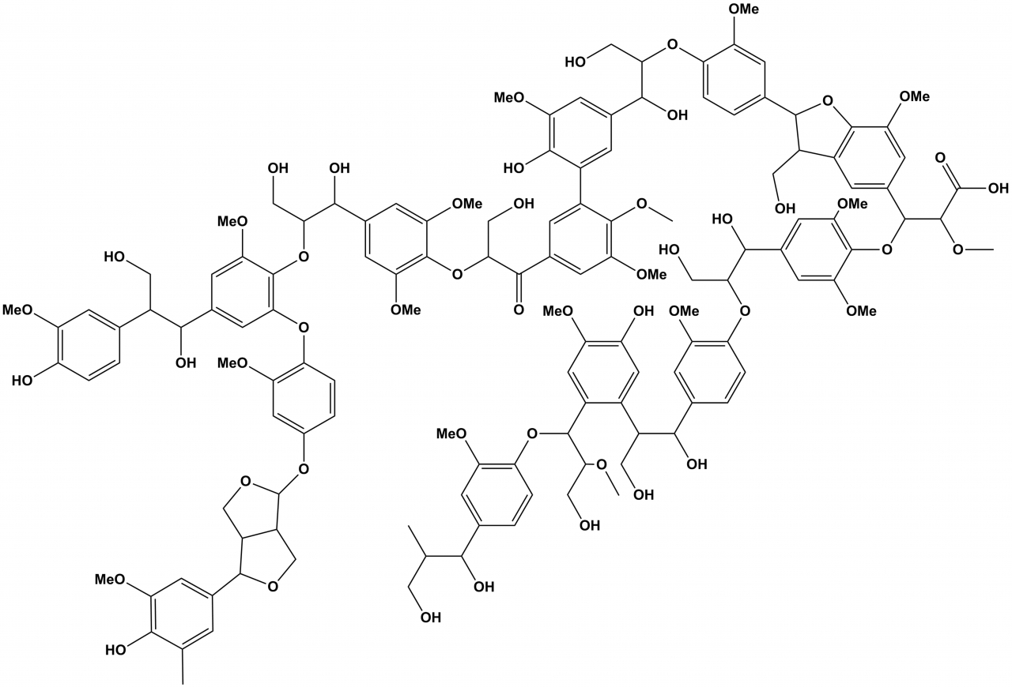
Lignin

Slide 3
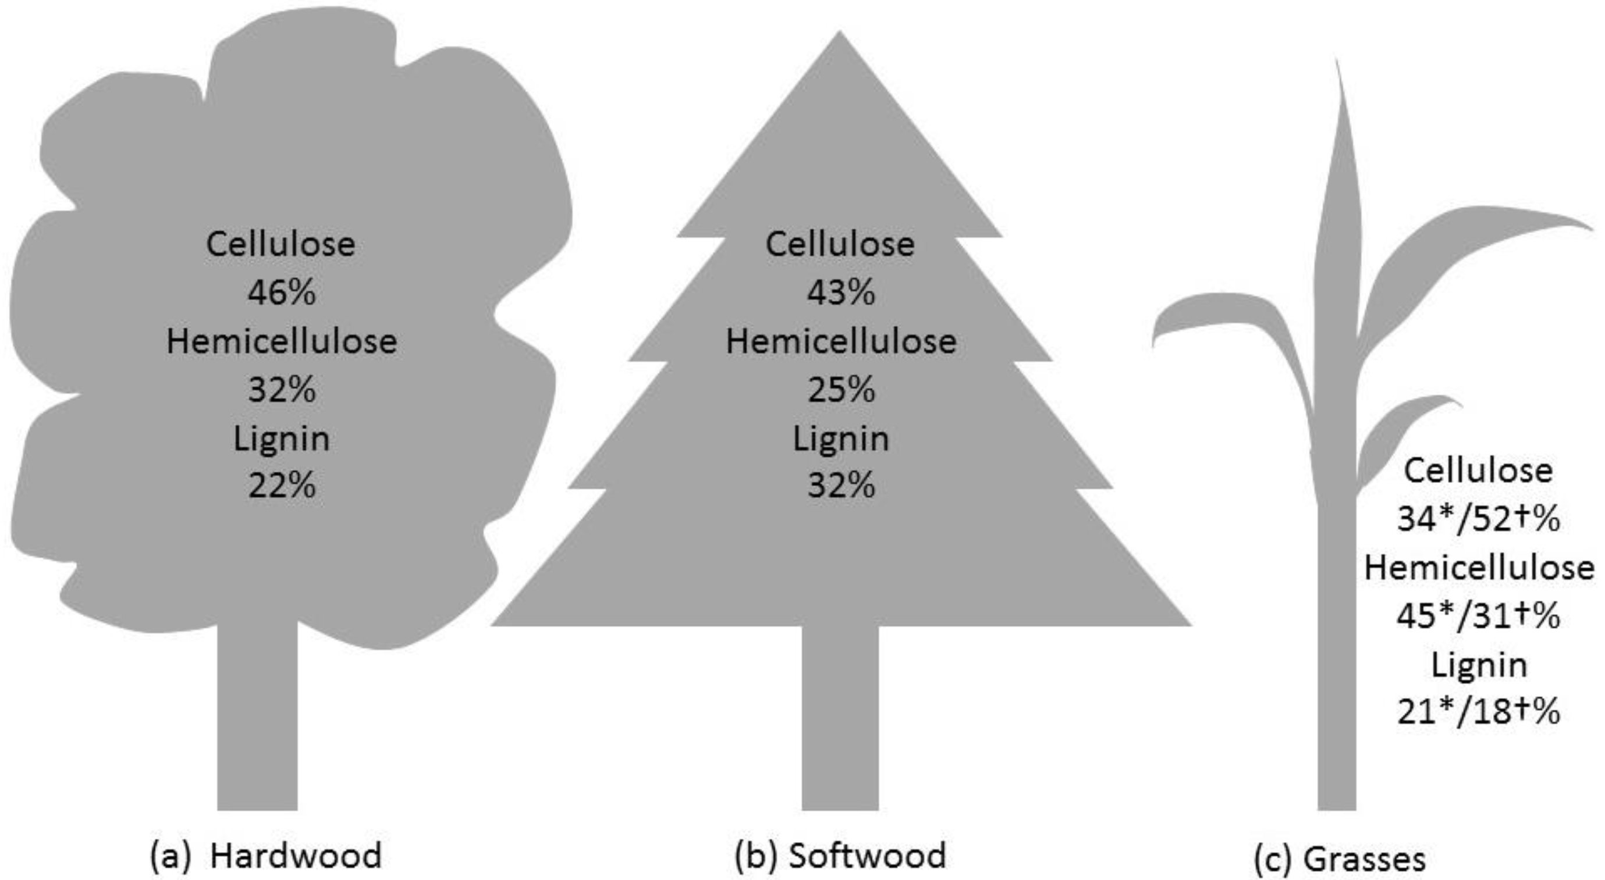
*Sorieul, M., Dickson, A., Hill, S. J., & Pearson, H. (2016). Plant fibre: molecular structure and biomechanical properties, of a complex living material, influencing its deconstruction towards a biobased composite. Materials, 9(8), 618.
Notes:
Second must abundant natural polymer
Found in both hard woods and softwoods, as well as in other plants but in much lower levels

Slide 4
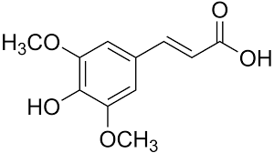
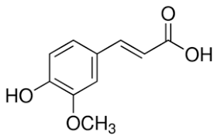
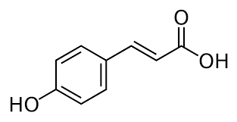
Monomers
Sinapic acid
Ferulic acid
P-coumaric acid
Source: Sigma Aldrich
Notes:
The three monomers of lignin I focused on were sinapic acid, ferulic acid, and p-coumaric acid.
These monomers also come in an alcohol form, but create a cost restriction.
Each has a phenol group
Contributes to stability in formed radicals
The only difference among the three is the number of methoxy groups present on the phenol.

Slide 5
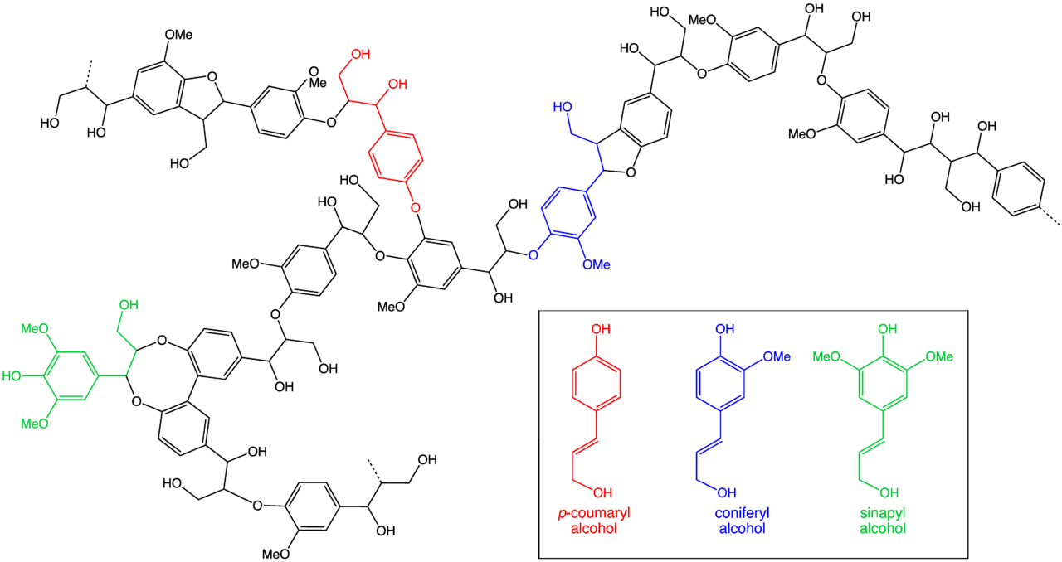
Notes:
Large group of aromatic polymers
Results from oxidative coupling of 4-hydroxyphenolpropanoids

Slide 6
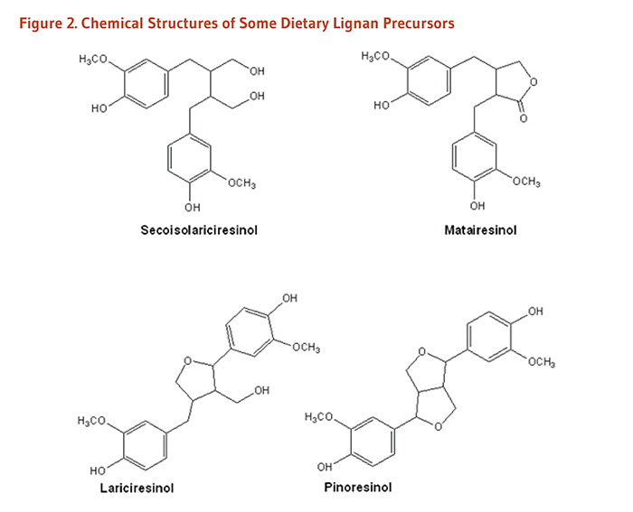
Lignan
Source: http://lpi.oregonstate.edu/mic/dietary-factors/phytochemicals/lignans
Notes:
Lignan is the result of the monomers dimerizing & has biological activity.
Also called polyphenols.
These are found in seeds and grains.

Slide 7
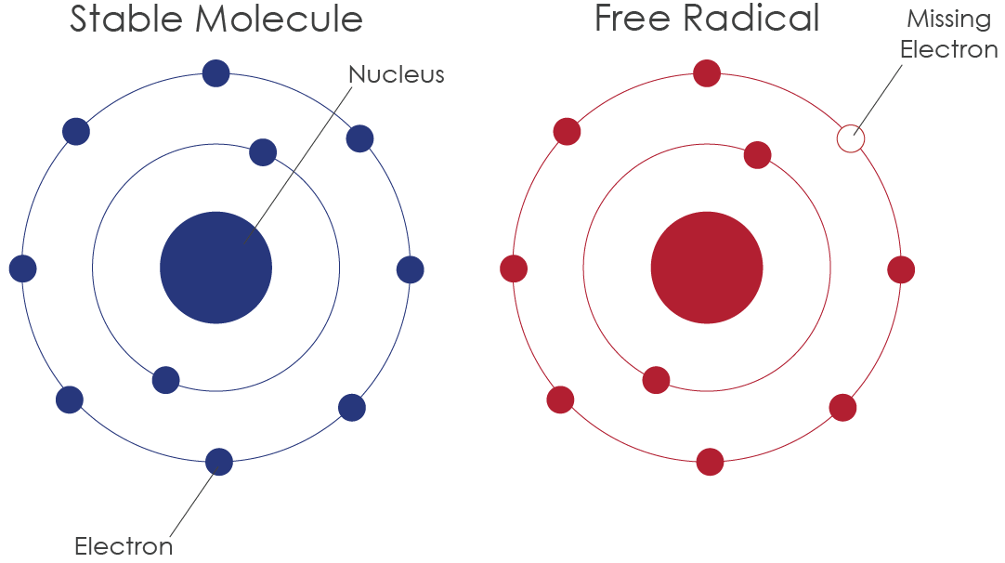
Free Radicals
Source: http://primoh2.com/what-is-a-free-radical/
Notes:
Free radicals are atoms with an unpaired valence electron.
They allow for oxidative coupling with other radicals.
Unstable therefore, they react quickly.

Slide 8
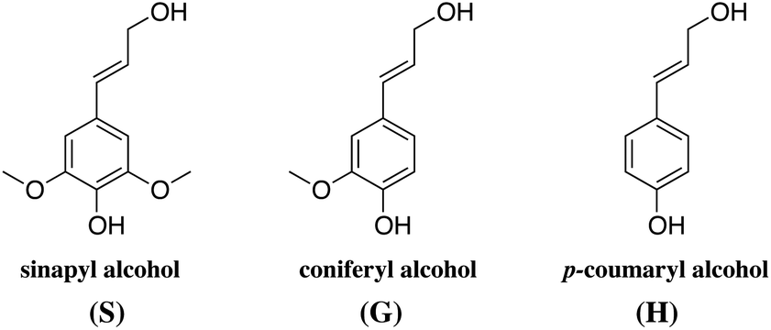
Our Focus
Notes:
The alcohol form of the monomers is the one that occurs most regularly in nature.

Slide 9
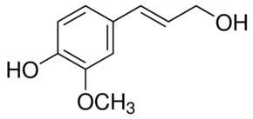
Ferulic Acid Coniferyl Alcohol
~$2.50
$336.00
*Sigma-Aldrich website
Notes:
While the alcohol form of this compound can be found through sigma, the others are harder to come by. But even the access of these compounds comes at a high price.

Slide 10
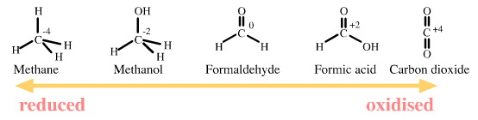
Oxidation states of Carbon
Reduced Oxidized
Notes:
Taking it from the carboxylic acid group that is found on ferulic acid to the alcohol group that is on coniferyl alcohol.
In the cell:
FERULATE: CoA LIGASE,
FERULOYL-CoA REDUCTASE
AND CONIFERYL ALCOHOL OXIDOREDUCTASE
I got to use DIBAL-H

Slide 11
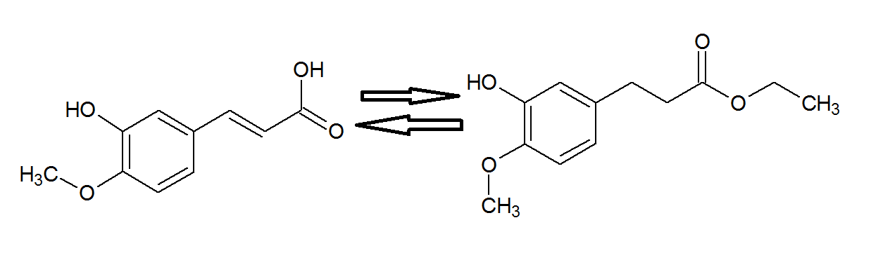
The Process
1
EtOH
Acetyl Chloride
Notes:
Broke the process down into two general separate parts. In the first step we are changing the acid group into an ester group.

Slide 12
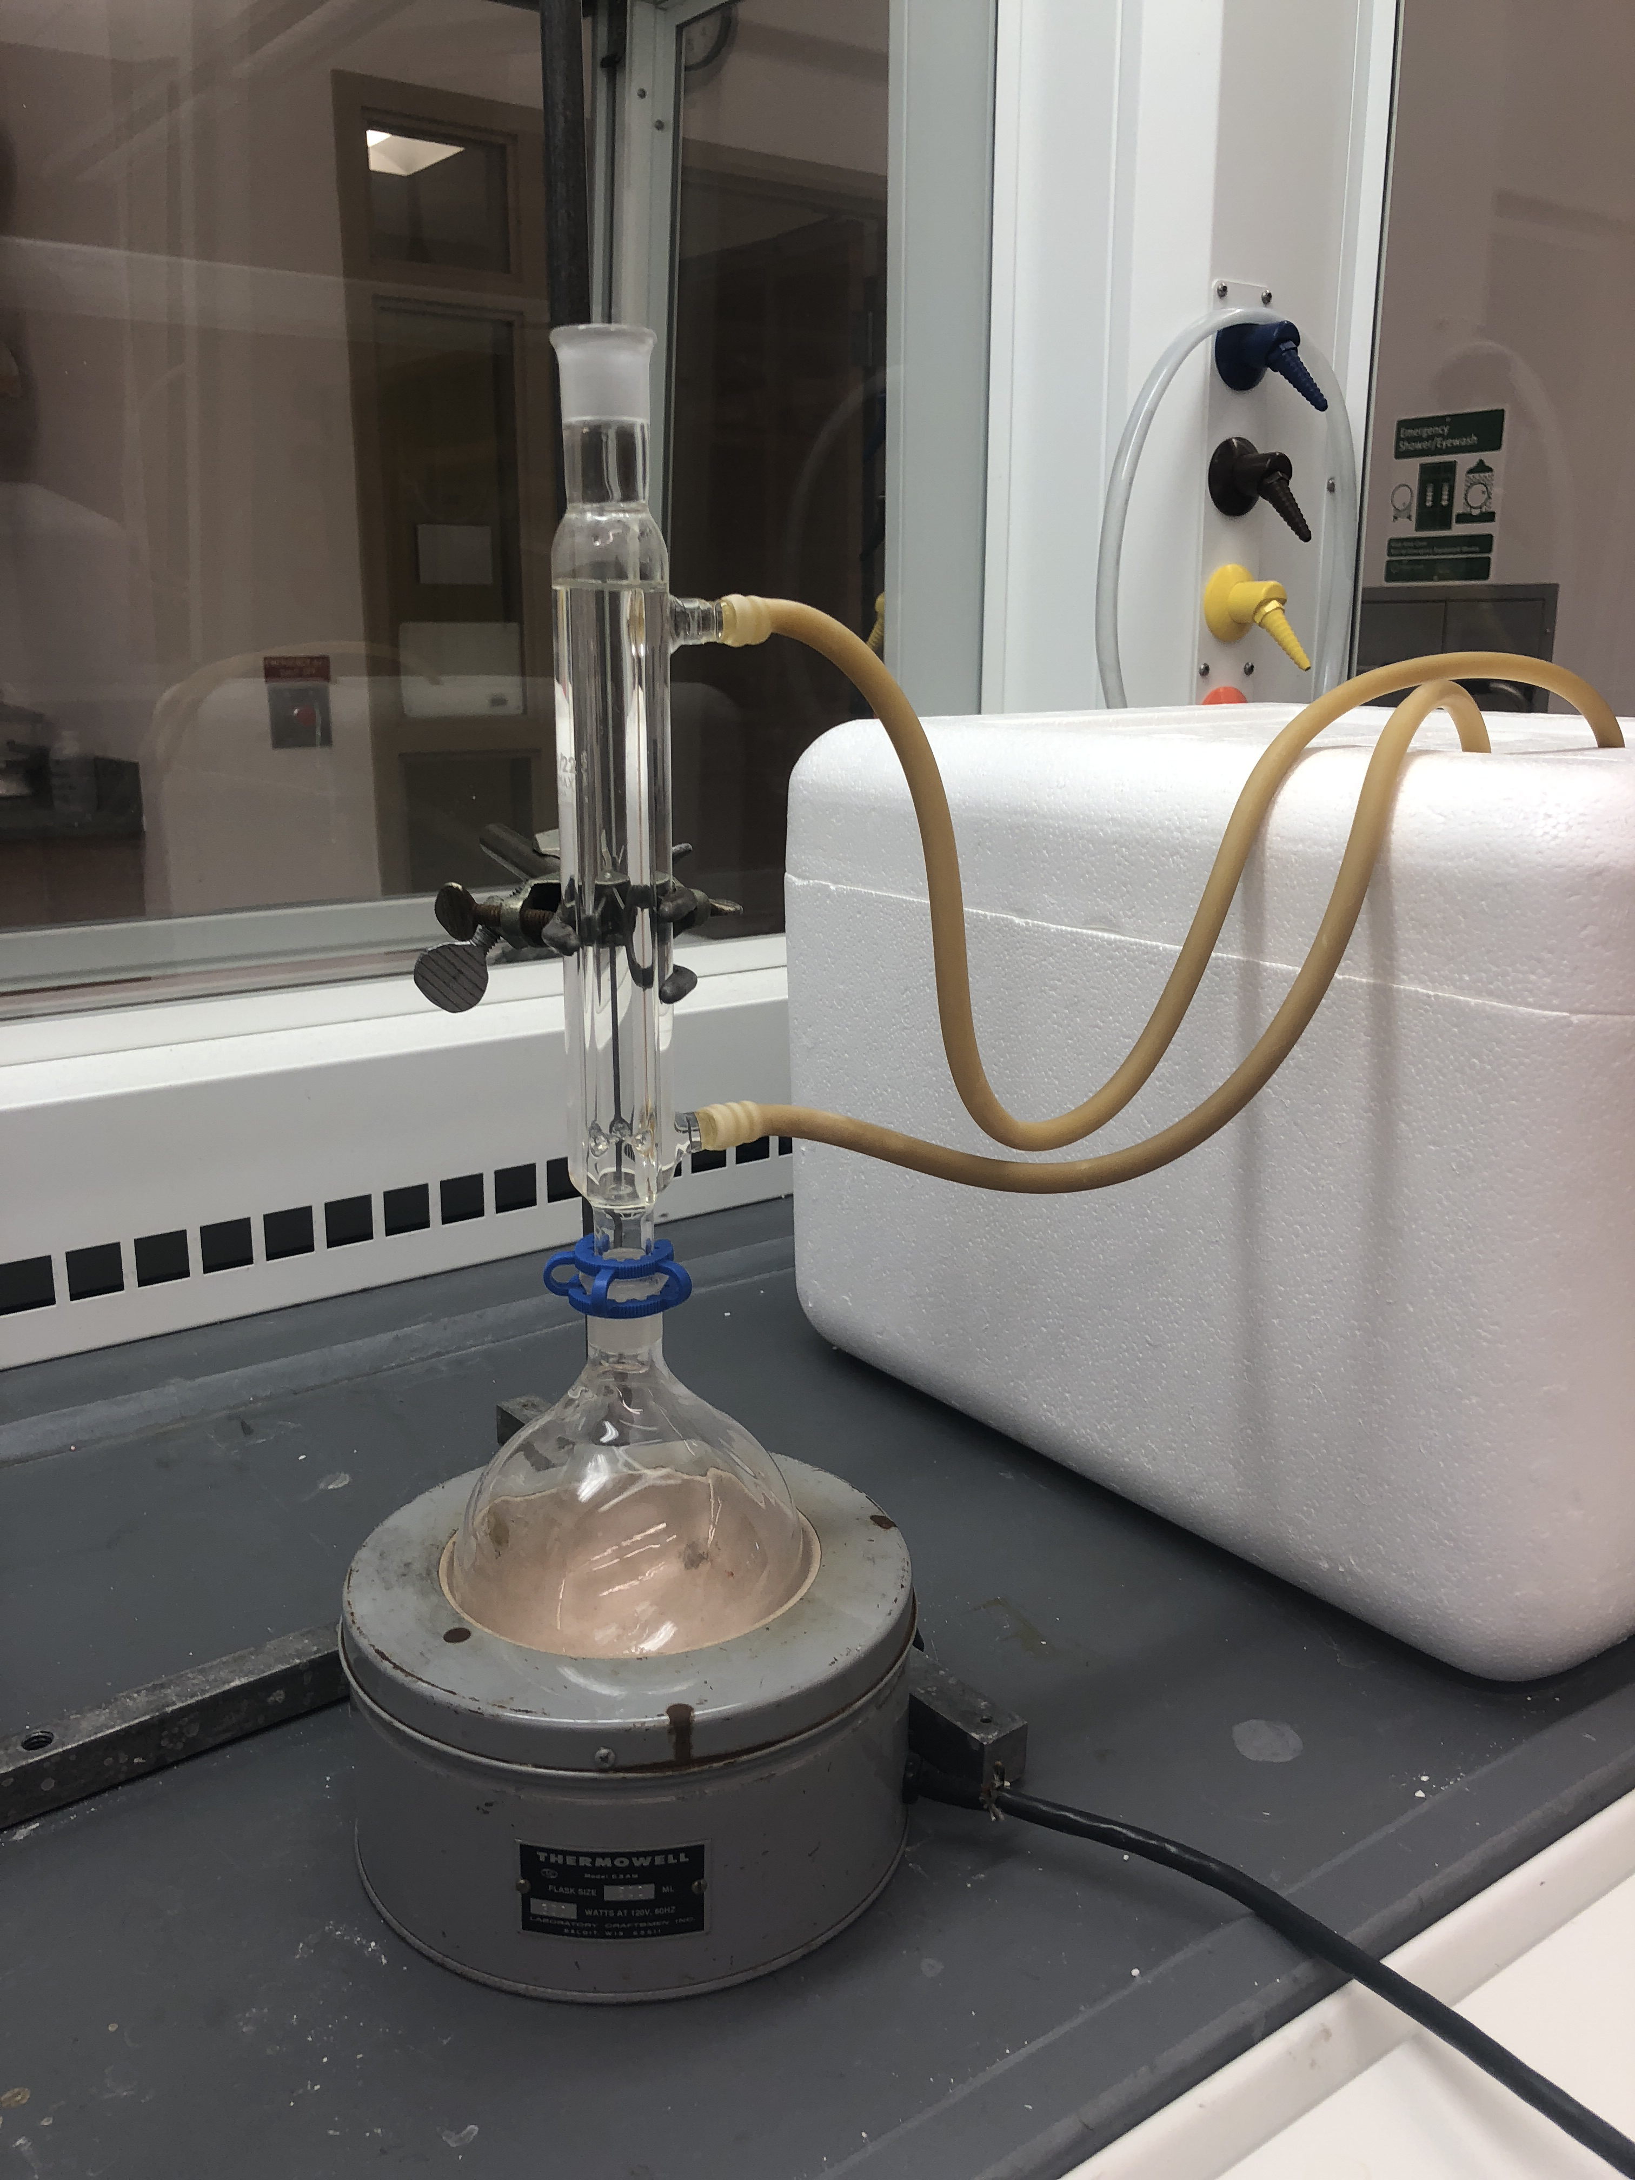
The Process
2 day Reflux
Extraction

Slide 13
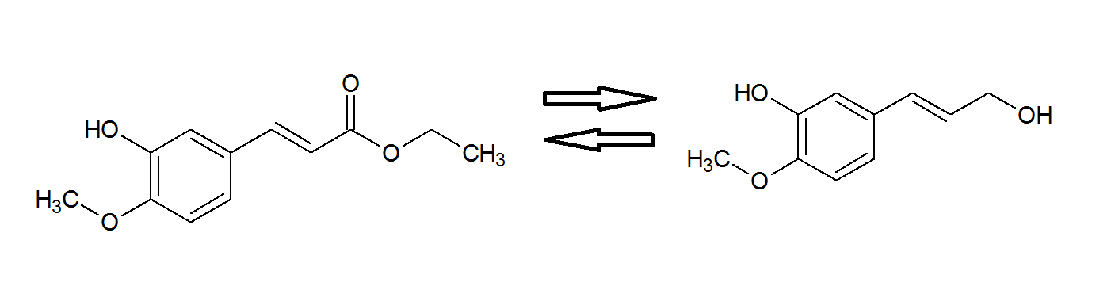


The Process
2
DIBAL-H
H₂O

Slide 14
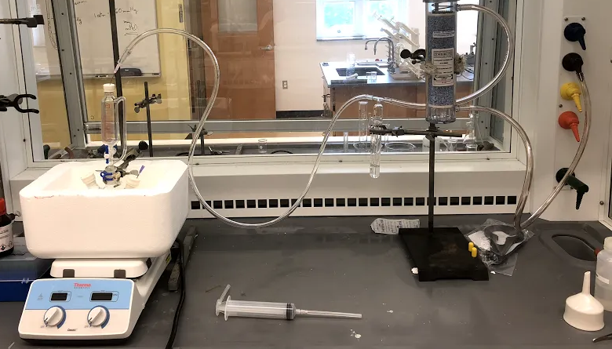
The Process
DIBAL-H
Extraction

Slide 16
Do it Again!

Slide 18
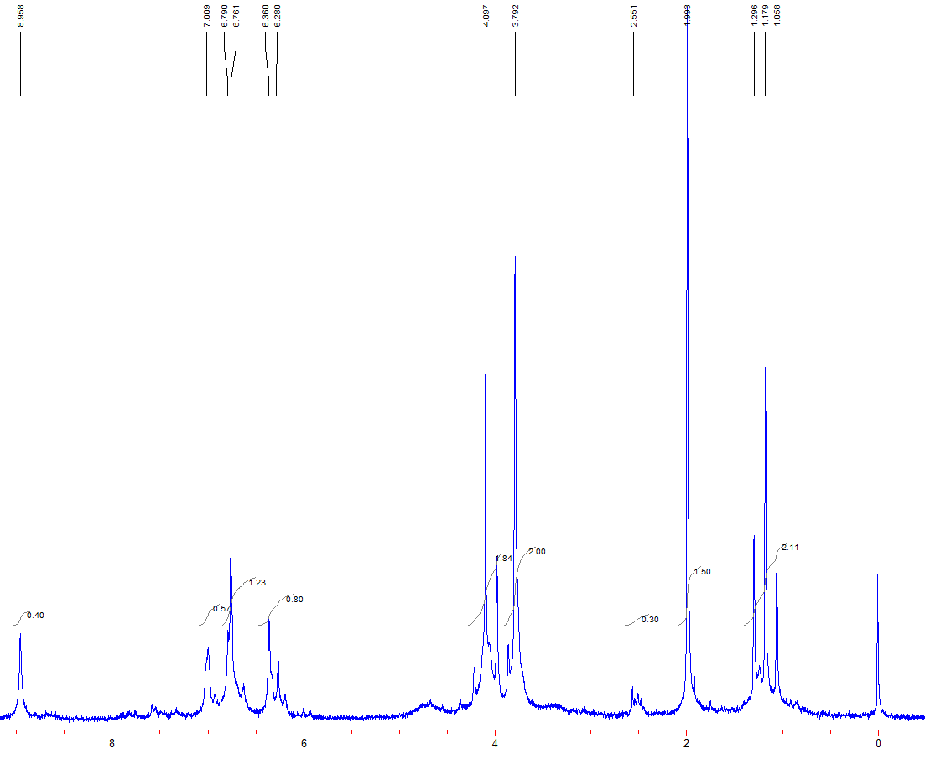

Slide 19
Do it Again…

Slide 21

Results
Production is Possible
%Yield?

Slide 22

Future Research
Synthesis of other lignin monomers
Test products in EPR for possible radicals
Synthesis of lignan

Slide 23
Monomers
Sinapic acid
Ferulic acid
P-coumaric acid
Source: Sigma Aldrich
Notes:
The three monomers of lignin I focused on were sinapic acid, ferulic acid, and p-coumaric acid.
These monomers also come in an alcohol form, but create a cost restriction.
Each has a phenol group
Contributes to stability in formed radicals
The only difference among the three is the number of methoxy groups present on the phenol.

Slide 24
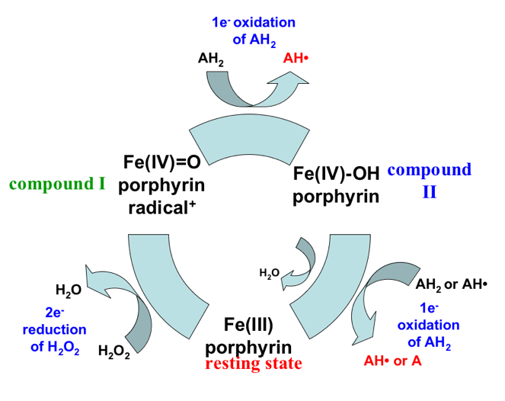
Peroxidase Cycle
Source: Chemistry Wiki
Notes:
-Showing the biological relevant use of monomers.
-Proposed to be radical intermediate formation in nature.
-Lexi is focusing on synthesizing the monomers using compounds because more biologically relevant.
-I’m focusing on the oxidation & coupling of the monomers.
-This is the way we oxidize the monomers
-I am focusing on the 1 e oxidation
-AH2 is ferulic acid
-subtract a H and 1 e & you’re left with the radical

Slide 25
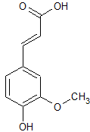
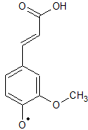
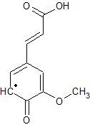
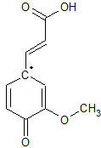
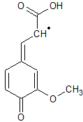
Ferulic Acid
monomer
O-4
C-5
C-1
C-β
Notes:
These are the radical intermediates formed from the peroxidase reaction I showed the previous slide.
Losing the H and 1 e from the alcohol group to form a radical.
Electrons moving around the molecule via bonds breaking and unpaired electron moving
As I will discuss later, I am trying to determine the coupling constants at these locations to determine which has a higher affinity for radical coupling.

Slide 26
Radical-Radical Coupling
Notes:
Simply returning to the lignin molecule we’ve showed previously
Showing coupling among the radical intermediates to form lignin

Slide 27
Objective
Oxidation reactions with monomers
  Determine oxidation products
Determine coupling constants for radical locations
  Allows us to predict likely coupling locations
  Predict potential structures and likelihoods

Slide 28
Beaker Reactions Performed
Used each monomer
  Focus was ferulic acid
Created solution of desired monomer, and mixed with varying concentrations of hydrogen peroxide and HRP (enzyme)
Analyzed findings via HPLC
Substrate
+
H₂O₂
+
HRP
Notes:
Sinapic acid was the only monomer to not produce oxidation products in the presence of dioxane
Dimers form, which then can be oxidized as well which could explain the less obvious product peaks for p-coumaric acid
A standard of the monomer was made, and then mixed with varying concentrations of hydrogen peroxide & a set amount of HRP
The findings were then analyzed using HPLC, which will be shown on the next few slides.

Slide 29
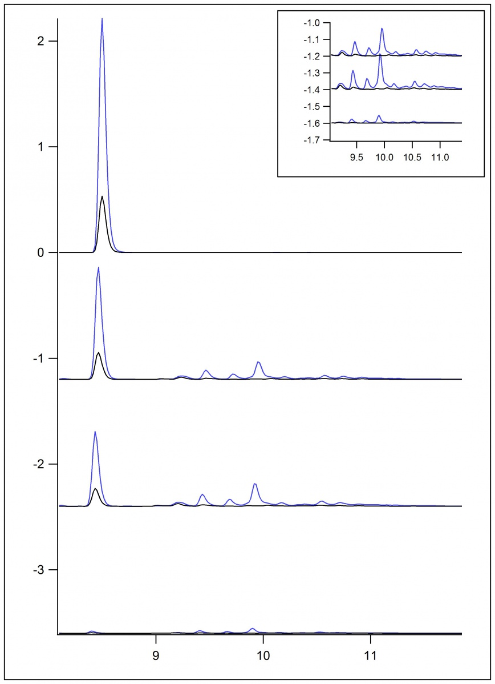
High Performance Liquid Chromatography
Determine whether oxidative products have been produced from reaction with H₂O₂ & enzyme
The more standard that is consumed, then the more products expected
standard
0.25 mM
0.50 mM
1.00 mM
Notes:
The tall first peak is the standard, & you can see this peak continues throughout each reaction, but the height decreases as the concentration of hydrogen peroxide increases
Second graph is 0.25 mM hydrogen peroxide
Third graph is 0.5 mM hydrogen peroxide
Fourth graph is 1 mM hydrogen peroxide
With the higher hydrogen peroxide concentration, the more standard should be consumed, therefore more products should be present
With this data, the peroxide consumed all of the ferulic acid standard, yet the products are not as apparent
Possible they were oxidized as well

Slide 30
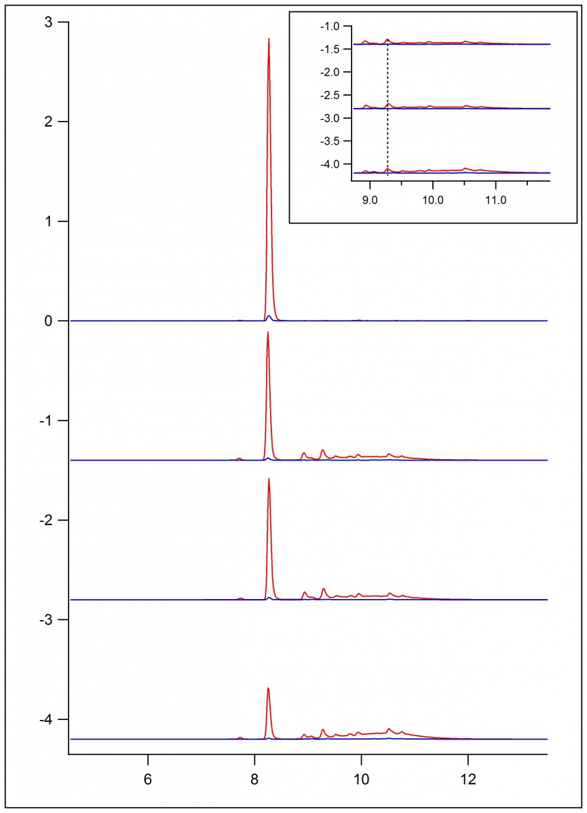
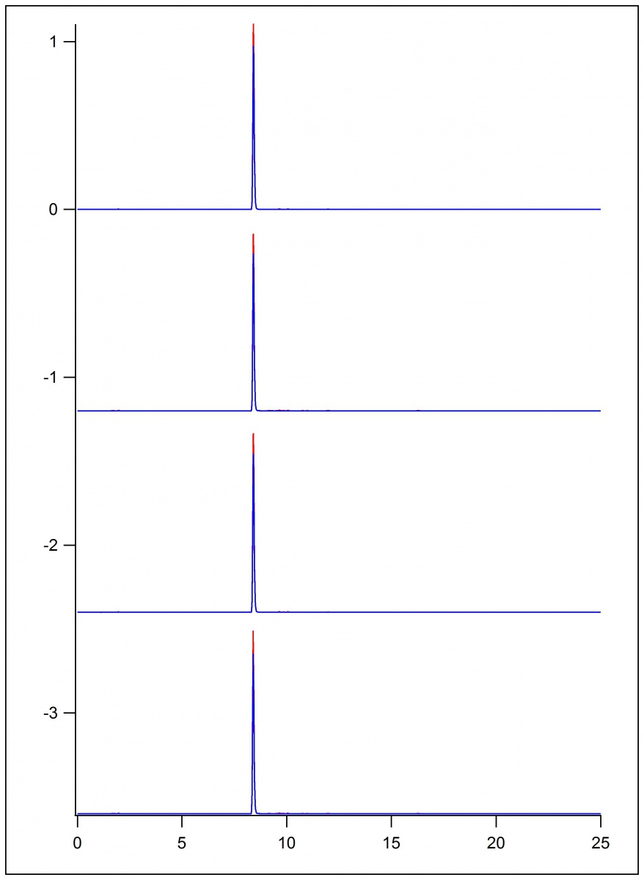
P-Coumaric Acid
Sinapic Acid
standard
standard
0.25 mM
0.25 mM
0.50 mM
0.50 mM
1.00 mM
1.00 mM
Notes:
Products are not as apparent
P-coumaric acid has the standard decreasing, but products aren’t really changing
Sinapic acid has no products in dioxane

Slide 31
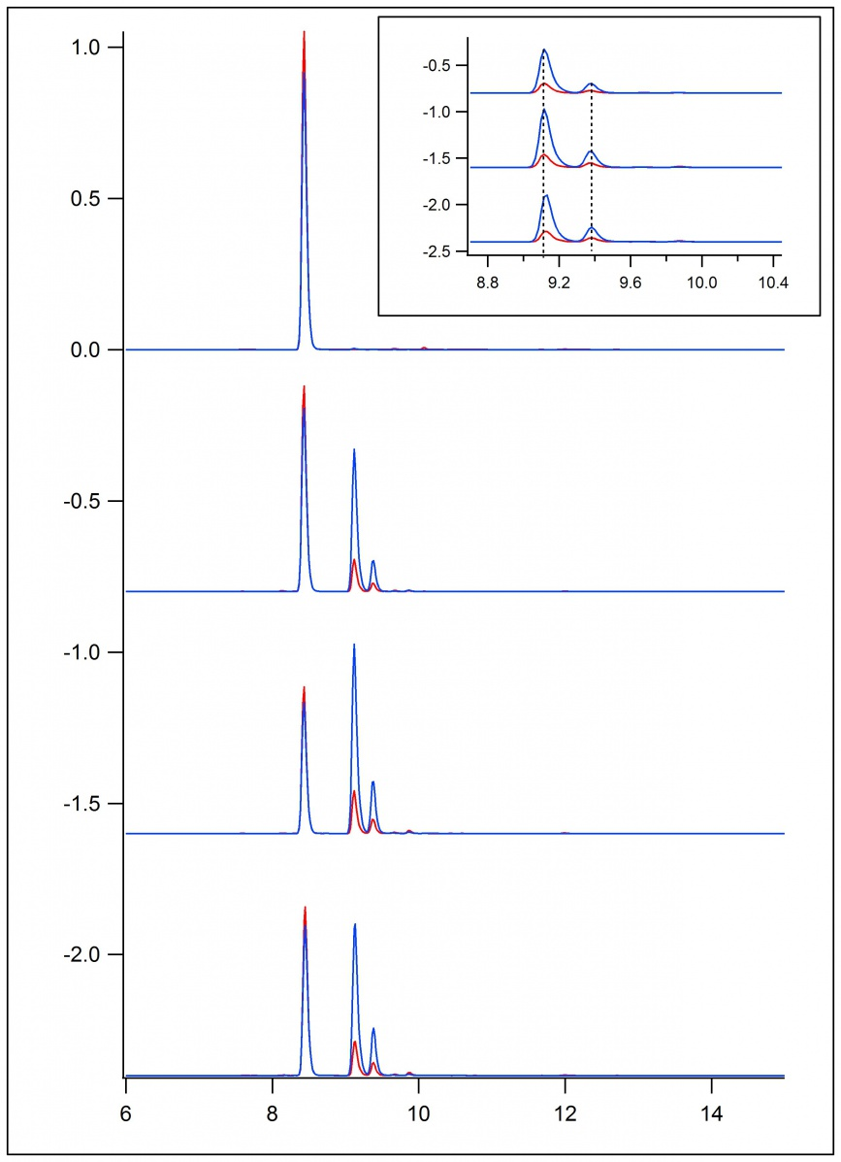
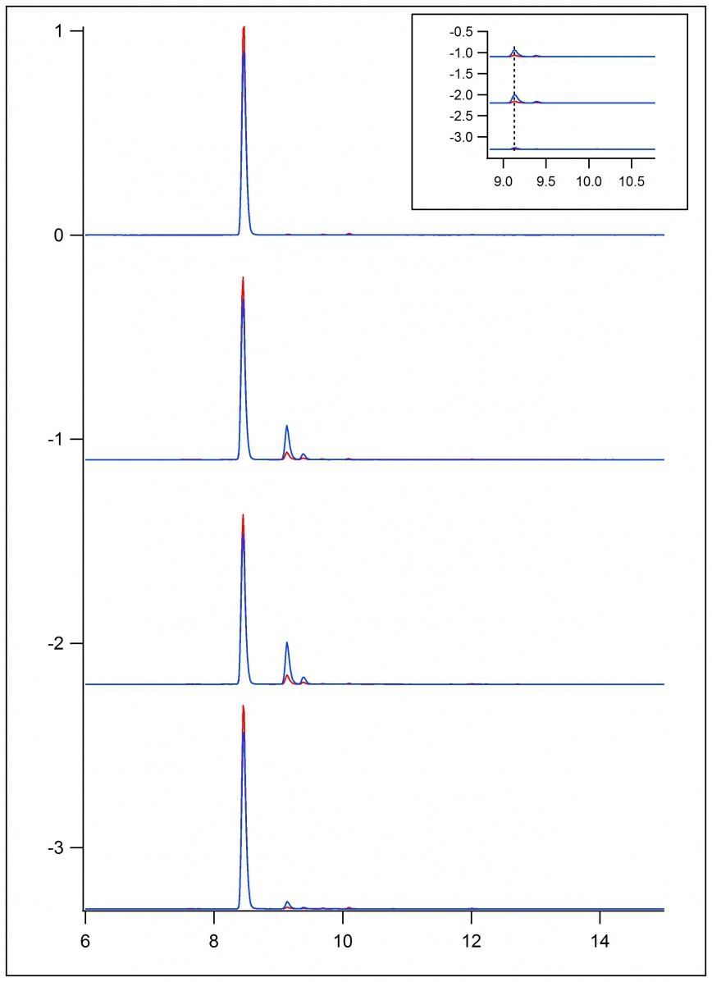
HPLC Findings
Sinapic Acid: HRP
Sinapic Acid: HRP_{i}
0.25 mM
0.25 mM
0.50 mM
0.50 mM
1.00 mM
1.00 mM
Notes:
Here is more data of sinapic acid
This data shows sinapic acid without the presence of dioxane
Compared to the previous data I presented, this data does in fact show product peaks with sinapic acid
It is believed the dioxane quenched the oxidation reaction

Slide 32
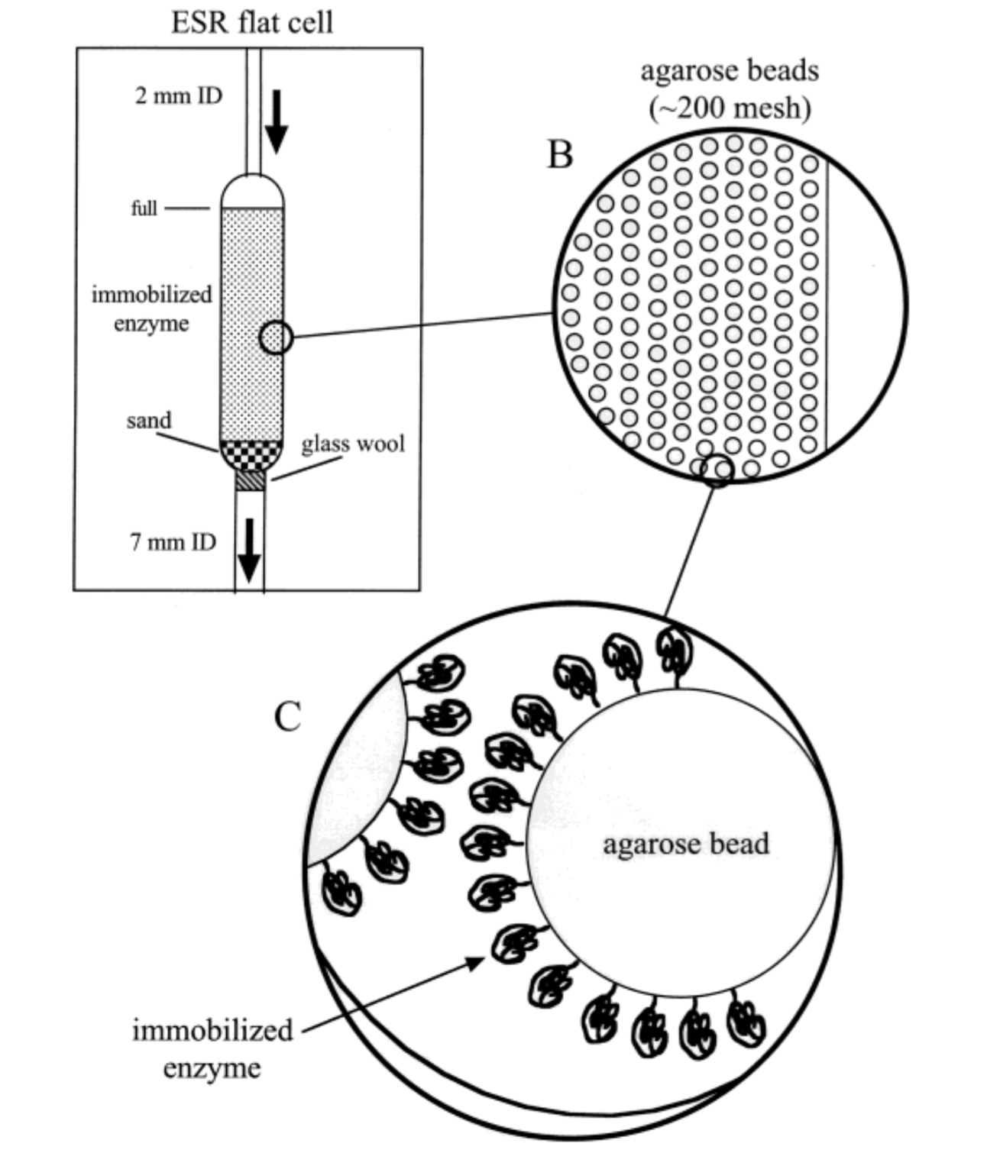
Enzyme Immobilization
Immobilized enzyme was used to run substrate over enzyme bonded on agarose beads
Short-lived radicals
Detection of radicals
  Beaker reactions might lose product
Notes:
So beaker chemistry is often how we do chemistry & how we think about chemistry.
But we explored other means of doing the oxidation of these lignin monomers.
This method provides more biological relevance & transforms the system into what we call a flow system.
Immobilized enzyme is enzyme attached to an agarose bead.
We used immobilized enzyme to fill the flat cell.
Then the substrate could be ran over the enzyme & a signal could be collected in the ESR.
Also the run off could be collected so that the sample could be analyzed on the HPLC & products could be detected
Immobilized enzyme is used because it allows for us to detect the short lived radicals within the ESR
With the beaker reactions being conducted, some radicals quickly dimerize, so its possible we did not see all products on the HPLC

Slide 33
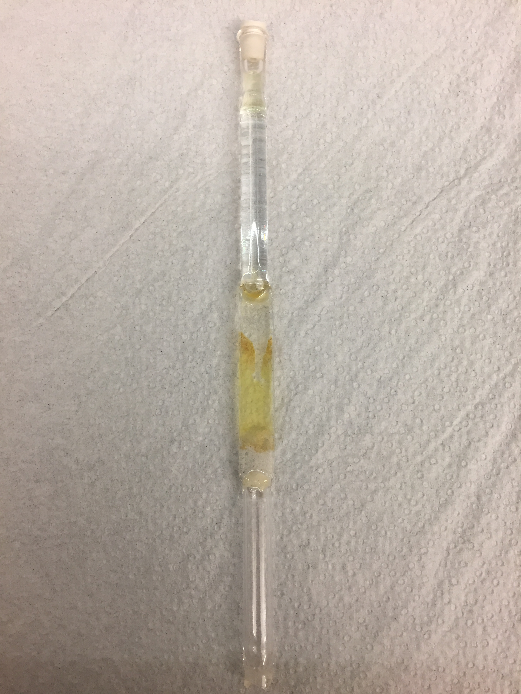
ESR Technique
Place glass wool, sand, and immobilized enzyme in flat cell
Flat cell is then placed in the ESR & substrate flows through cell
  Signal is collected while flow is running
Immobilized enzyme
sand
wool
Notes:
This is the flat cell used for the EPR.
It is loaded with glass wool, sand, and the immobilized enzyme
It is then placed in the ESR & substrate is ran through the cell and collected.
The EPR signal is being collected while the substrate is running.

Slide 34
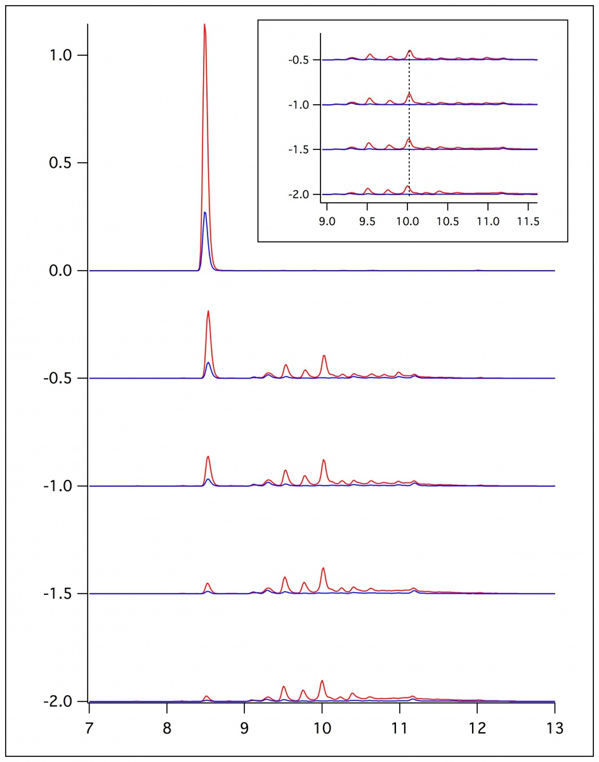
Flat-Cell Reactions
Use of dioxane vs. no dioxane
  Bead color
  Bead compaction
Flowed substrate through flat cell and collected samples at different flow rates
0.25 mL/min
0.50 mL/min
1.00 mL/min
2.00 mL/min
Notes:
Loaded the flat cell with wool, sand, and immobilized enzyme.
The flow off the cell was then collected with different flow rates and analyzed on the HPLC.
This data shows the substrate with dioxane
Without dioxane present, the radicals dimerize and stick to the beads.
The higher the flow, the more the beads become compacted as well.

Slide 35
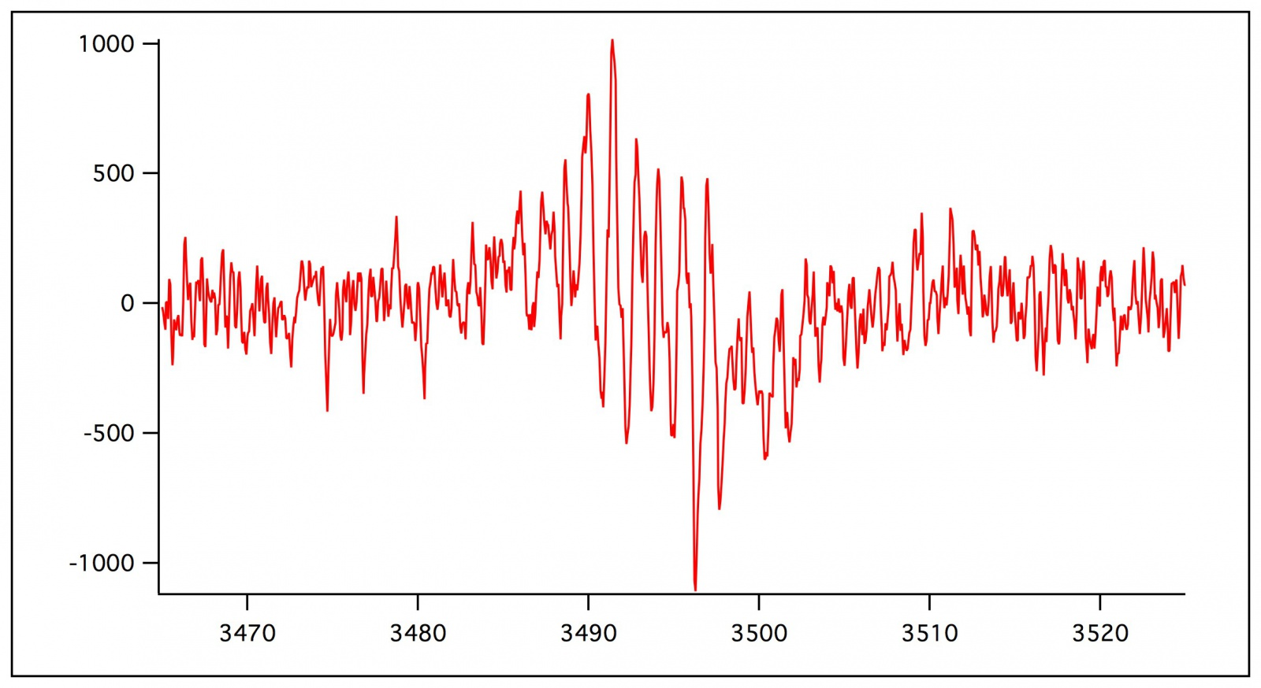
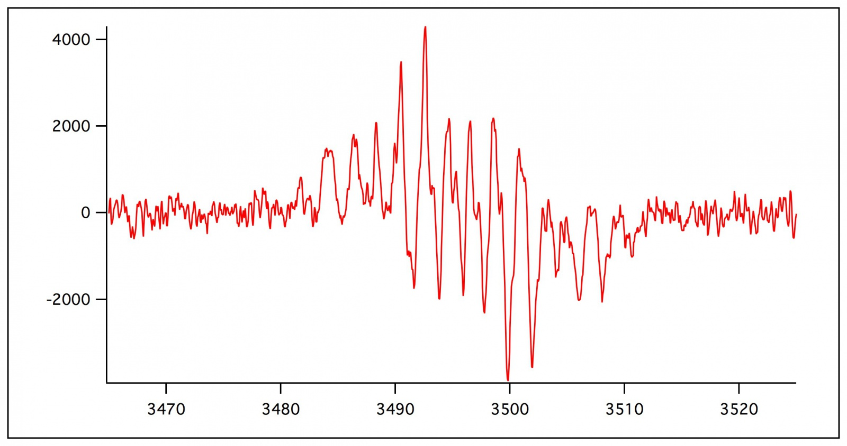
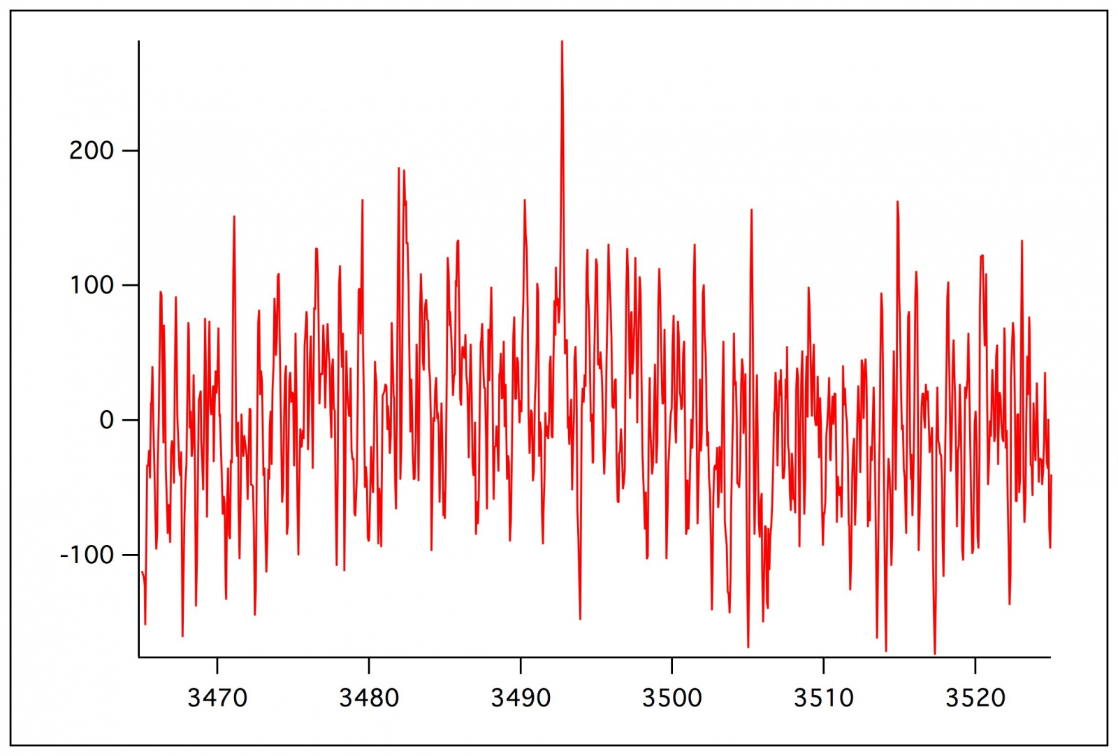
Preliminary ESR Data
1 mL/min
2 mL/min
No flow
Notes:
Here is preliminary ESR data collected using a 10 mM solution of ferulic acid and a 10 mM concentration of hydrogen peroxide in solution. These represent the spectrum
at different flow rates. As you can see, once the flow was turned off, there was no signal. Once the flow was turned back on, the signal returned. This shows that we are
identifying radicals that are short lived with the flow of substrate.

Slide 36
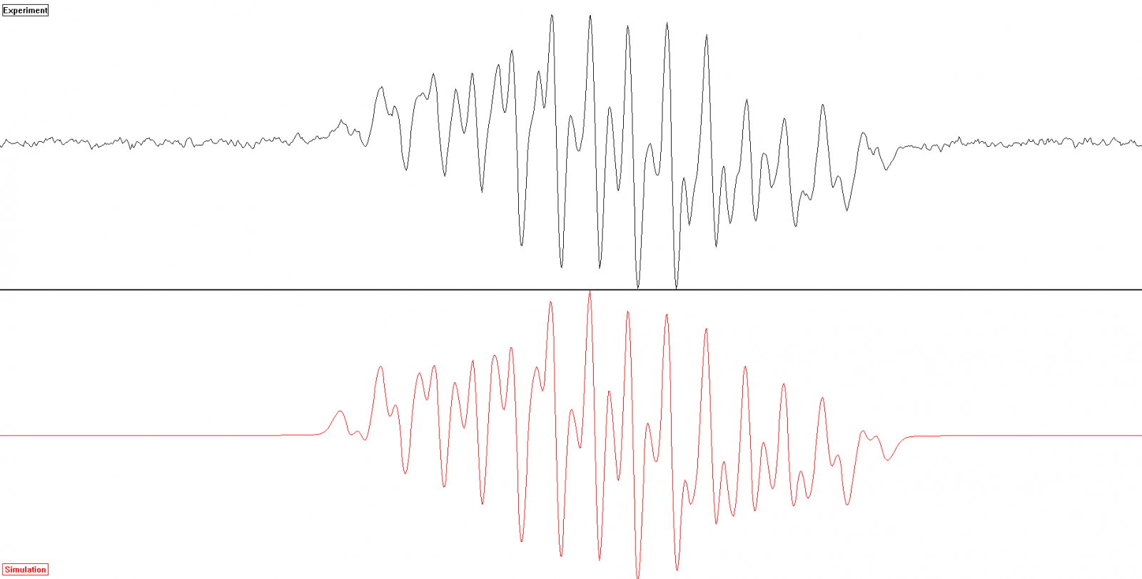
Ferulic Acid Spectrum
Notes:
This is the spectrum of ferulic acid collected at 2 mL/min for 20 scans that was simulated using WebMO Pro and WINSIM. The bottom spectrum is the simulated spectrum, as the
top is the collected spectrum. THE PURPOSE OF SIMULATION

Slide 37

Gaussian Coupling Constants
Location | Web M.O. Pro | WINSIM Simulation
C-2 | 2.46 | 0.55
C-5 | 4.99 | 4.09
C-6 | 1.90 | 1.87
C-α | 2.71 | 2.62
C-β | 5.87 | 5.39
H-(OMe) | 1.89 | 1.36
6
α
5
1
γ
β
2
4
3
Notes:
In accordance with the past spectrum, these coupling constants correspond to the simulated spectrum. The WebMO Pro values were calculated, and then entered
into the WINSIM program. The values were altered so that the spectrum correlated with the collected spectrum. The only location that has a large difference between the
calculation and simulation value is the C-2 location. This could be due to _______________. According to this data, the C-β and C-5 location have the highest value for
coupling affinity, therefore meaning radical-radical coupling is more likely at these locations.

Slide 38
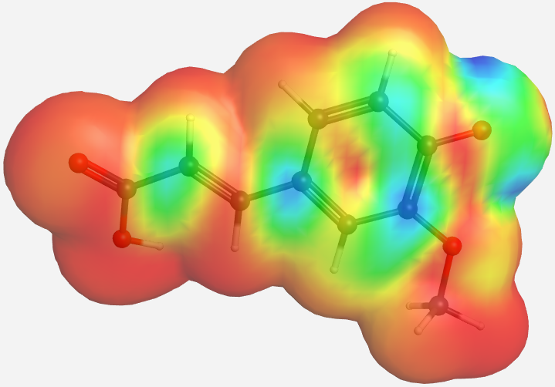
Radical Frontier Density
Notes:
Showing radical spin density at different radical locations on the molecule

Slide 39
ESR Findings
The higher the coupling constant, the greater affinity for radical coupling at that location
Values in article as starting point
Simulate via Web MO pro
Notes:
The affinity for radical coupling is measured by the coupling constant at that location.
To calculate & simulate these values, a spectrum was collected using the ESR.
Then the molecule was inserted into a program called WebMO Pro that calculates these isotropic coupling constants at each atom
These values are then starting points for the simulation using WINSIM.

Slide 40
Conclusions
Coupling is more likely at C-5 & C-β position
HRP_{i} is more effective means to identify radicals
Notes:
The main conclusions made from this research are:
Coupling is more likely at the C-β and C-5 positions
HRP_{i} is a more effective means to identify radicals
Without immobilizing the enzyme, we would not be able to identify the signal in the ESR as effectively.
With immobilizing the enzyme, we were able to detect short lived radicals that we weren’t able to detect using the beaker reactions and HPLC.

Slide 41
Future Work
Focus on ESR and collecting more spectra
Analyze spectra of p-coumaric acid and sinapic acid
Notes:
In the future, I plan on collecting more ESR data, especially with the other two monomers. I also plan on simulating this data to compare the coupling constants between
the three monomers at each location. The methoxy groups on the molecules have potential to provide interesting coupling constant differences between the molecules.

Slide 42

Acknowledgements
Richard “Doc” Kieft Summer Research Program
Dr. Bradley Sturgeon
Dr. Michael Prinsell
Monmouth College Chemistry Department
Stephanie Saey
Notes:
I would like to thank the Richard “Doc” Kieft Summer Research Program, my adviosr Brad Sturgeon, and Stephanie Saey, who trusted me enough to take over her research once she graduated.

