Slide 1
The Analysis of Fatty Acid Content in Various Oils
Josie Welker ‘21
Chemistry Department

Slide 2
Overview
Fatty acid methyl ester structures
Significance of fatty acids
Transesterification
Sample preparation
Instrumentation
Data collection
Data analysis

Slide 3
Fatty Acid Methyl Ester Structures
Palmitic Acid Methyl Ester (16:0)
Parent Ion: 270 m/z
Stearic Acid Methyl Ester (18:0)
Parent Ion: 298 m/z
Notes:
first chemical characterisation of organosulfates in the upper Midwestern US and the first investigation of their stability on archived filter substrates

Slide 4
Fatty Acid Methyl Ester Structures
Oleic Acid Methyl Ester (18:1)
Parent Ion: 296 m/z
Notes:
first chemical characterisation of organosulfates in the upper Midwestern US and the first investigation of their stability on archived filter substrates

Slide 5
Fatty Acid Methyl Esters Structures
Linoleic Acid Methyl Ester (18:2)
Parent Ion: 294 m/z
Linolenic Acid Methyl Ester (18:3)
Parent Ion: 292 m/z
Notes:
first chemical characterisation of organosulfates in the upper Midwestern US and the first investigation of their stability on archived filter substrates

Slide 6
The Significance of Fatty Acids
Edible Fat/Oil | 16:0 (Palmitic by %) | 18:0 (Stearic by %) | 18:1 (Oleic by %) | 18:2 (Linoleic by %) | 18:3 (Linolenic by %)
Safflower Oil | 4.3 | 1.9 | 14.4 | 74.6 | 0.0
Maize Oil | 15.6 | 2.9 | 34.7 | 43.6 | 1.6
Cow Fat (tallow) | 24.9 | 18.9 | 36.0 | 3.1 | 0.6
Olive Oil | 11.3 | 2.0 | 71.3 | 9.8 | 0.8
Rapeseed Oil | 4.3 | 2.1 | 61.7 | 19.0 | 9.1
Soybean Oil | 10.5 | 4.4 | 22.6 | 51.0 | 6.8
Grapeseed Oil | 6.7 | 2.7 | 15.8 | 69.9 | 0.1
Salema Fish Oil | 31.4 | 6.3 | 10.1 | 1.1 | 0.6
Reference: Harper, Clare S., Macdonald, Faith V., and Braun, Kevin L. Lipid Residue Analysis of Archaeological Pottery: An Introductory Laboratory Experiment in Archaeological Chemistry. 2017.
Notes:
Climate- radiative forcing the difference between insolation (sunlight) absorbed by the Earth and energy radiated back to space. health – respiratory illnesses They are primarily formed through the acid-catalysed reactive uptake of gas-phase epoxides onto sulfate aerosol (Surratt et al. 2010), but have also been found to form by the nucleophilic substitution of organic nitrate by sulfate.

Slide 7
Transesterification
+
+
MeOH
Base Catalyst
(KOH)
Linoleic Acid
Linoleic Acid Methyl Ester
Notes:
first chemical characterisation of organosulfates in the upper Midwestern US and the first investigation of their stability on archived filter substrates

Slide 8
Sample Preparation
Combined 200 ul of the sample with 40 ul of anhydrous methanol into a microcentrifuge tube
Added 4.3 ul of 5 M KOH to the top methanol layer (catalyst)
Sonicated the tubes in an ultrasonic bath for 30 minutes
Added 200 ul of 0.1 M acetic acid (neutralize the base catalyst)
Centrifuged the solution at 6,000 rpm for 5 minutes
Transferred 40 ul of the top layer to a GC vial and diluted with pentane
Notes:
first chemical characterisation of organosulfates in the upper Midwestern US and the first investigation of their stability on archived filter substrates

Slide 9
Instrumentation
Sample Injector
Ion Source
Mass Analyzer
Filament
Detector
Column
Output and Data Analysis
Vacuum System
Carrier Gas (Mobile Phase)
Transfer Line
Notes:
included an organic eluent of ammonium acetate buffer (10 mM, pH 9) in acetonitrile and ultrapure water (95 : 5 v/v) and an aqueous eluent of ammonium acetate buffer (10 mM, pH 9) in ultrapure wate. MassLynx and Quanlynx software

Slide 10
Data Collection
The samples were analyzed with a Griffin 450 GC-MS
Internal electron ionization
Cylindrical (quadrupole) ion trap analyzer
-
+
+
-
Notes:
included an organic eluent of ammonium acetate buffer (10 mM, pH 9) in acetonitrile and ultrapure water (95 : 5 v/v) and an aqueous eluent of ammonium acetate buffer (10 mM, pH 9) in ultrapure wate. MassLynx and Quanlynx software

Slide 11
Grapeseed Oil Sample
Linoleic Acid Peak
Total Ion Chromatogram (TIC)
Time (minutes)
Notes:
Methyltetrol sulfate is the most common organosulfate observed in ambient samples worldwide and this may arise from differences in meteorology

Slide 12
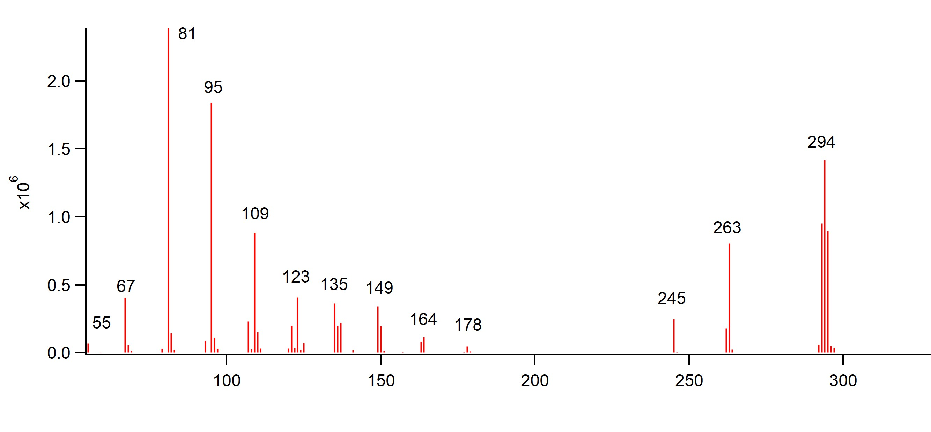
Linoleic Acid
(5.4 minutes)
Intensity
M/Z Ratio
Notes:
Methyltetrol sulfate is the most common organosulfate observed in ambient samples worldwide and this may arise from differences in meteorology

Slide 13
Grapeseed Oil Sample
Linoleic Acid Peak
Total Ion Chromatogram (TIC)
Palmitic Acid Peak
Oleic Acid Peak
Time (minutes)
Notes:
Methyltetrol sulfate is the most common organosulfate observed in ambient samples worldwide and this may arise from differences in meteorology

Slide 14
The Significance of Fatty Acids
Edible Fat/Oil | 16:0 (Palmitic by %) | 18:0 (Stearic by %) | 18:1 (Oleic by %) | 18:2 (Linoleic by %) | 18:3 (Linolenic by %)
Safflower Oil | 4.3 | 1.9 | 14.4 | 74.6 | 0.0
Maize Oil | 15.6 | 2.9 | 34.7 | 43.6 | 1.6
Cow Fat (tallow) | 24.9 | 18.9 | 36.0 | 3.1 | 0.6
Olive Oil | 11.3 | 2.0 | 71.3 | 9.8 | 0.8
Rapeseed Oil | 4.3 | 2.1 | 61.7 | 19.0 | 9.1
Soybean Oil | 10.5 | 4.4 | 22.6 | 51.0 | 6.8
Grapeseed Oil | 6.7 | 2.7 | 15.8 | 69.9 | 0.1
Salema Fish Oil | 31.4 | 6.3 | 10.1 | 1.1 | 0.6
Reference: Harper, Clare S., Macdonald, Faith V., and Braun, Kevin L. Lipid Residue Analysis of Archaeological Pottery: An Introductory Laboratory Experiment in Archaeological Chemistry. 2017.
Notes:
Climate- radiative forcing the difference between insolation (sunlight) absorbed by the Earth and energy radiated back to space. health – respiratory illnesses They are primarily formed through the acid-catalysed reactive uptake of gas-phase epoxides onto sulfate aerosol (Surratt et al. 2010), but have also been found to form by the nucleophilic substitution of organic nitrate by sulfate.

Slide 15
Acknowledgements
Dr. Bradley Sturgeon
The Monmouth College Chemistry Department
Notes:
Methyltetrol sulfate is the most common organosulfate observed in ambient samples worldwide and this may arise from differences in meteorology

Slide 16
Questions

Slide 17
References
Harper, Clare S., Macdonald, Faith V., and Braun, Kevin L. Lipid Residue Analysis of Archaeological Pottery: An Introductory Laboratory Experiment in Archaeological Chemistry. Journal of Chemical Education 2017 94 (9), 1309-1313 DOI: 10.1021/acs.jchemed.7b00225
Notes:
Methyltetrol sulfate is the most common organosulfate observed in ambient samples worldwide and this may arise from differences in meteorology

Slide 18
Instrumentation
Sample Injection Port
Detector
Column
Computer Data
Column Oven
Carrier Gas (mobile phase)
Notes:
included an organic eluent of ammonium acetate buffer (10 mM, pH 9) in acetonitrile and ultrapure water (95 : 5 v/v) and an aqueous eluent of ammonium acetate buffer (10 mM, pH 9) in ultrapure wate. MassLynx and Quanlynx software

Slide 19
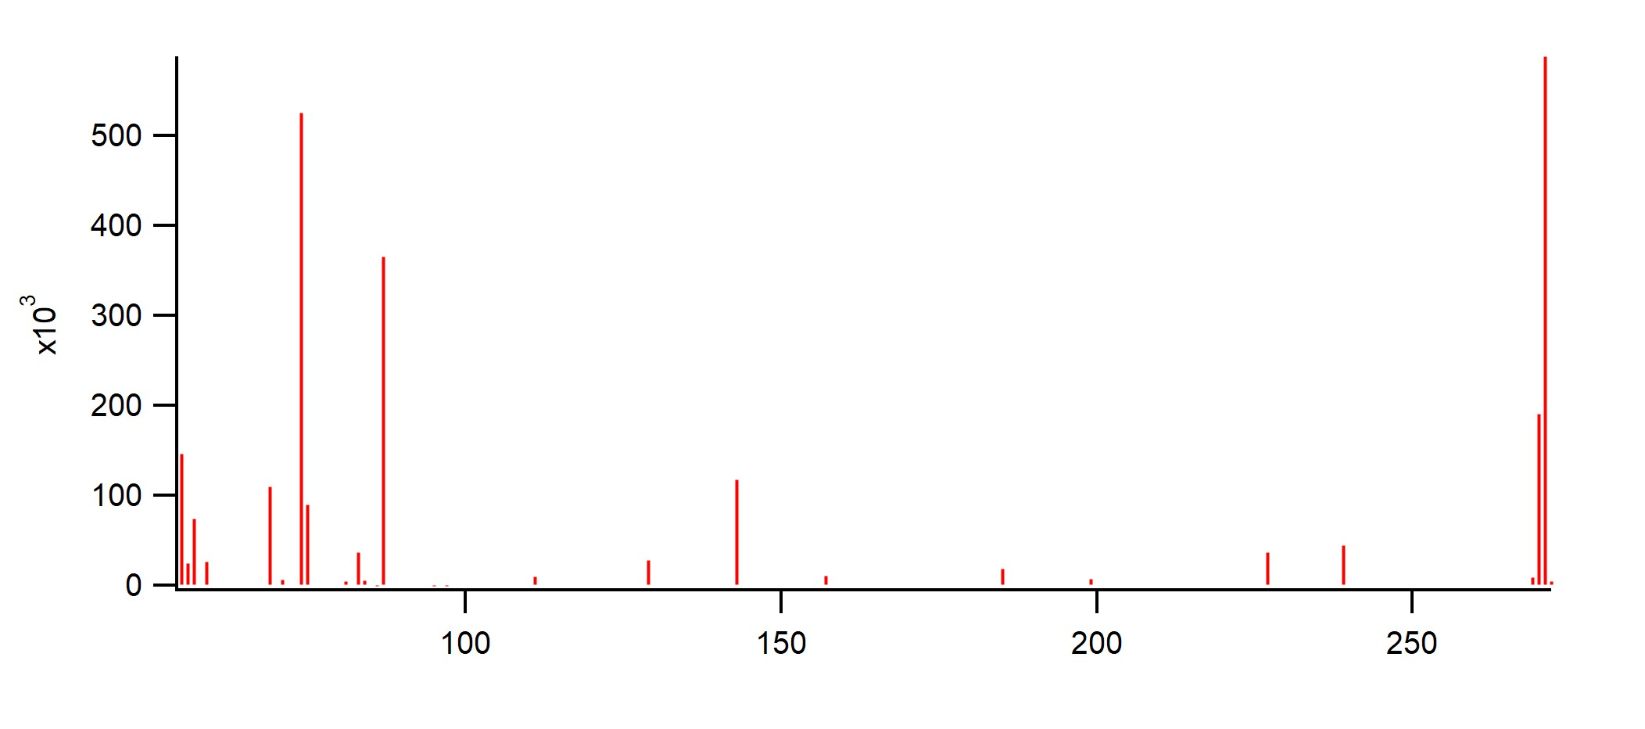
Palmitic Acid (Grapeseed Oil)
(~4 minutes)
271
74
87
55
Intensity
69
143
83
129
227
239
111
157
185
199
M/Z Ratio

Slide 20
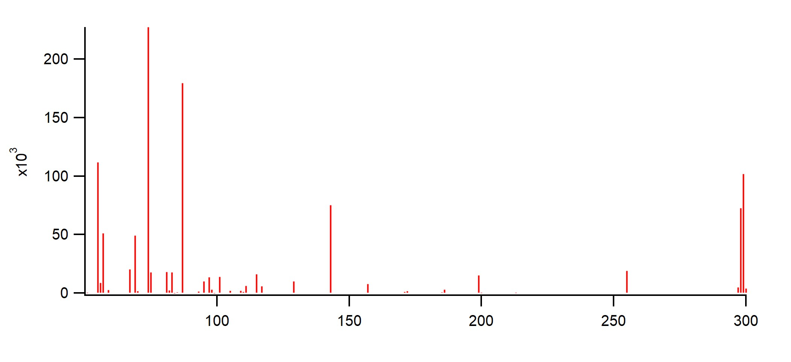
Oleic Acid
(Grapeseed Oil)
(~5.7 minutes)
74
87
55
299
143
Intensity
69
101
115
199
255
129
157
M/Z Ratio

Slide 21
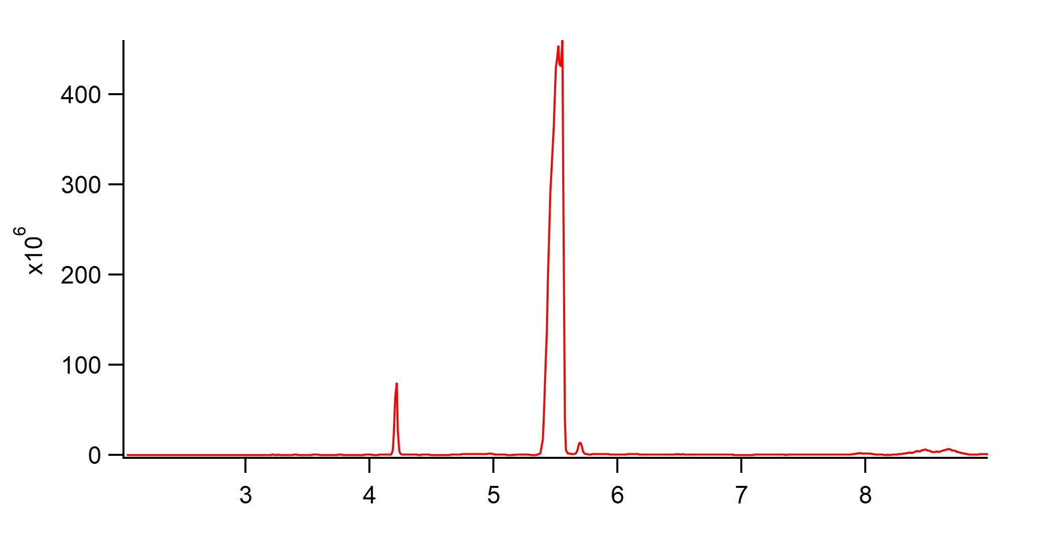
Sunflower Oil Sample
Oleic Acid Peak
Total Ion Chromatogram (TIC)
Palmitic Acid Peak
Stearic Acid Peak
Time (minutes)

Slide 22
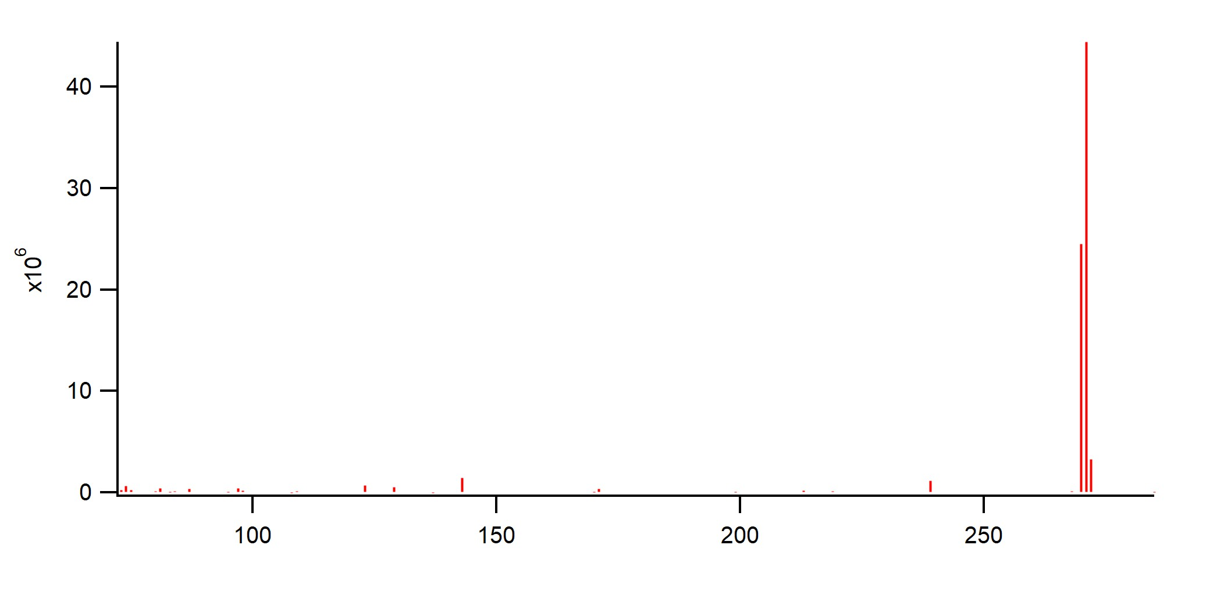
Palmitic Acid
(Sunflower Oil)
(~4.2 minutes)
271
Intensity
74
143
81
97
123
129
171
239
M/Z Ratio

Slide 23
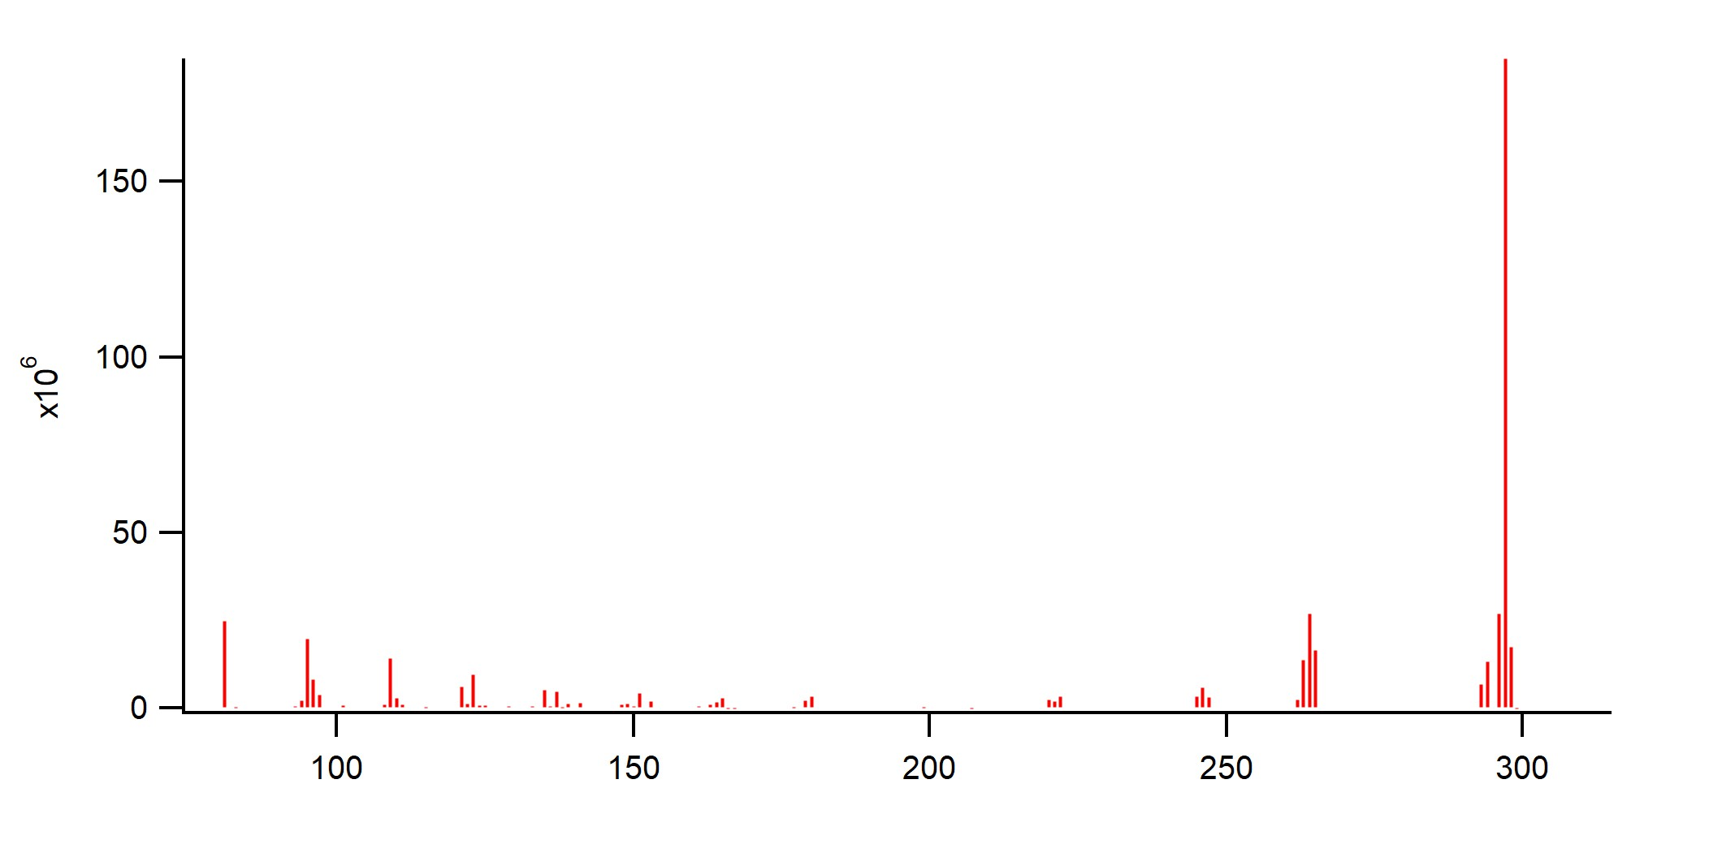
Oleic Acid
(Sunflower Oil)
(~5.5 minutes)
297
Intensity
81
95
264
109
123
135
151
180
122
246
165
M/Z Ratio

Slide 24
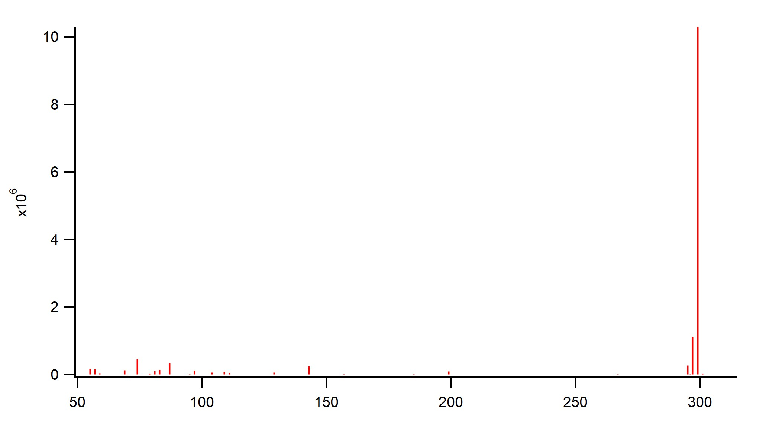
Stearic Acid
(Sunflower Oil)
(~5.8 minutes)
299
Intensity
55
74
87
143
199
97
109
129
M/Z Ratio

Slide 25
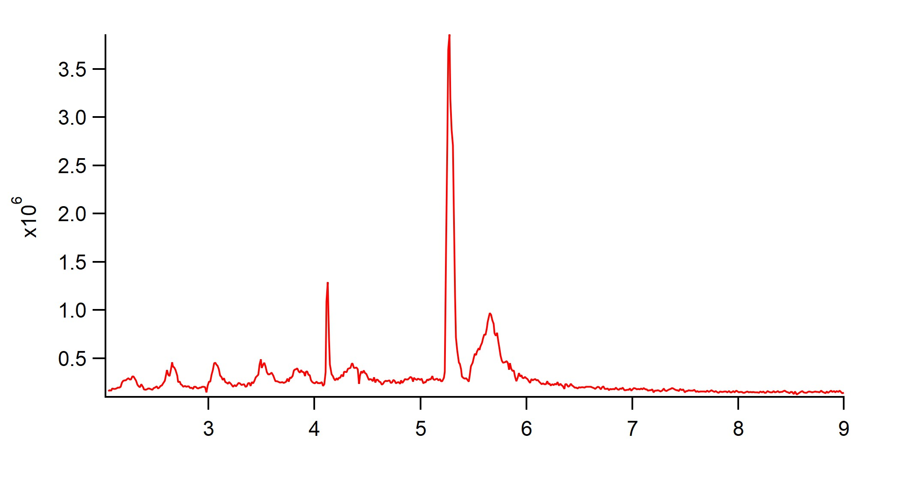
Corn Oil Sample
Linoleic Acid Peak
Total Ion Chromatogram (TIC)
Palmitic Acid Peak
?
Time (minutes)

Slide 26
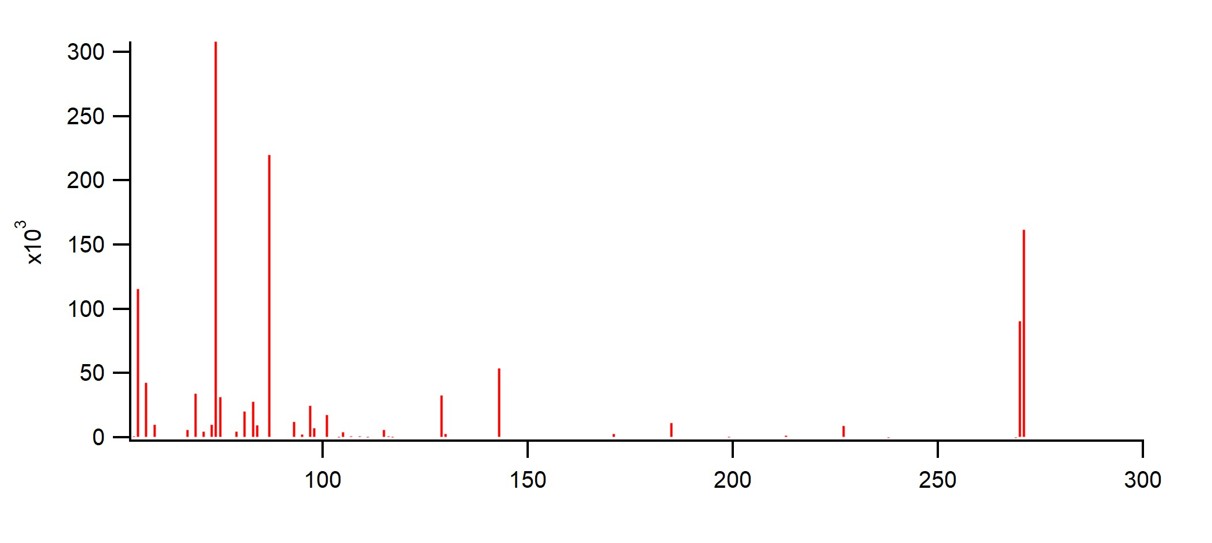
Palmitic Acid
(Corn Oil)
(~4.2 minutes)
74
87
271
55
Intensity
143
69
97
129
101
227
115
171
185
M/Z Ratio

Slide 27
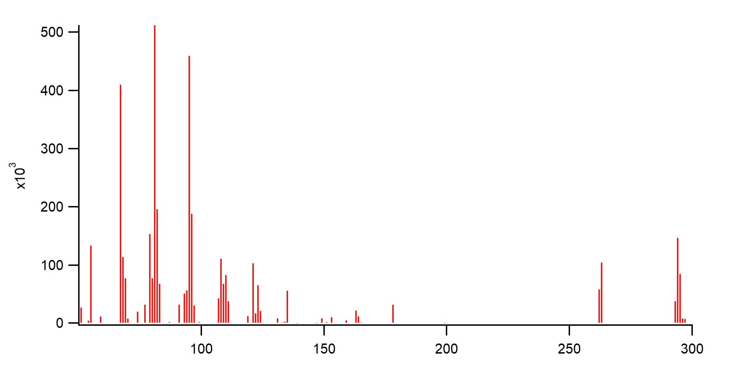
Linoleic Acid
(Corn Oil)
(~5.3 minutes)
81
95
67
Intensity
55
294
108
121
263
135
178
149
163
M/Z Ratio

Slide 28
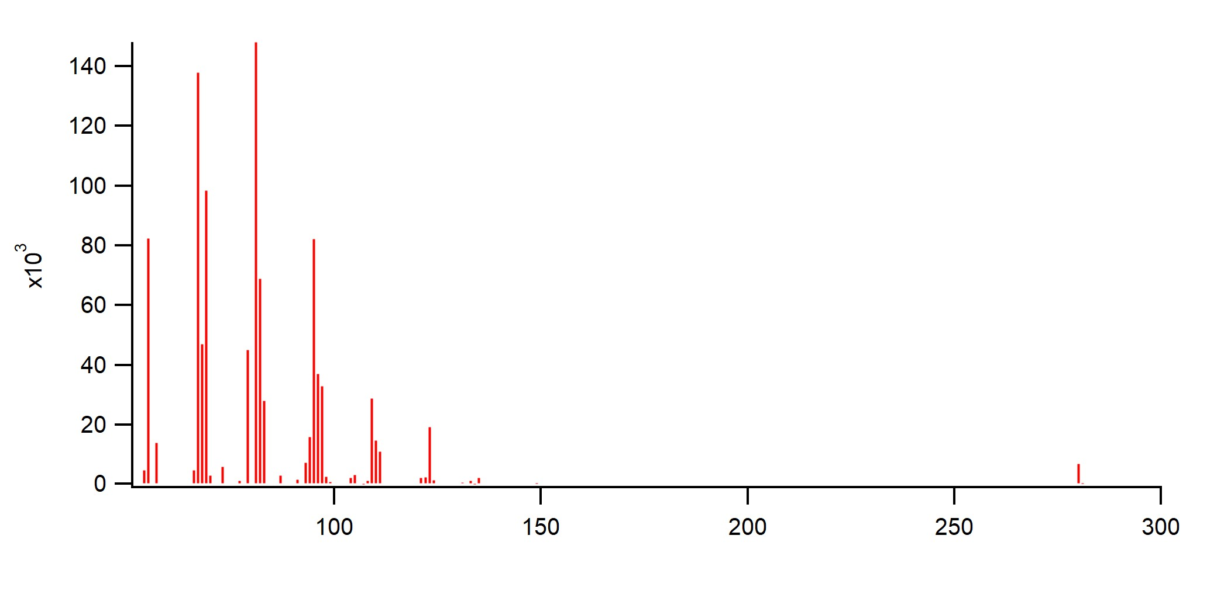
Unknown Acid
(Corn Oil)
(~5.8 minutes)
81
67
55
95
Intensity
109
123
135
280
149
M/Z Ratio

