Slide 1
Investigating the Microbial Makeup of Soil
Amanda Dybal

Slide 2
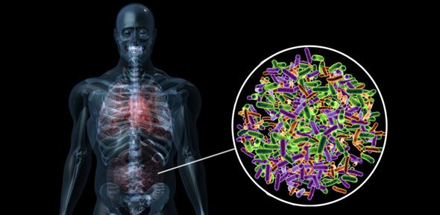
The Microbiome
Each environment has its own microbiome
Bacteria
Fungi
Viruses
Archaea
Soil
Water
Feces
Notes:
The microbiome is made up of ^^^ .
Different environments as well as different parts of your body posses different microbiomes. These microbes can tell us a lot about our health and the health of the environment. Bacteria is what I will be focusing on in my research.
Some are even being used to improve of health. Riley will talk more about that in her talk today.

Slide 3
What do we know about the soil microbes?
Nitrogen use by plants
Samples 1 and 4
Lack of manure, which contains Nitrogen that is already converted into a form that can be used by the plant
DNA, Amino acids, Protein
Pathogenic Microbes
Phytophthora spores- kills plant tissues from the root up
https://nph.onlinelibrary.wiley.com/doi/full/10.1002/ppp3.10167
https://scielo.conicyt.cl/scielo.php?pid=S0718-95162017000400008&script=sci_arttext
https://fungialert.com/what-are-good-and-bad-soil-microorganisms/
Notes:
Phytophthora spores can survive in plant debris or soil for many years and can infect all parts of the plant, but it usually attacks the roots or stem base.
NITROGEN POINT what is an ideal microbiome fore best growth 1,4 no manure not growing as well (lack of nitrogen and microbes) healthy soil look like
Plant growth vs microbes inside
Temperature that we are annealing → where the primer latches on to the strand I am trying to amplify
Should be a 500 bp fragment

Slide 4
Plasmid vs Chromosomal DNA
Plasmids-
Independent
Self-Replicative
Non-essential
Benefits
Antibiotic Resistance
Chromosomal-
Nucleoid
Double stranded
Base pairs
Identification
Bacteria by Byjus
Notes:
Bacteria, Viruses, Fungi, Archaea can all be identified, some by RNA and some from DNA. Bacteria is identified by the DNA within it. There are two types of DNA in a bacteria.
The plasmid dna is circular independent and are self replicative. It is not essential for the survival of bacteria but can contain genes that benefit the bacteria. Including antibiotic resistance.
The chromosomal Dna is what allows the identification and what I will be focusing on. It is contained in the nucleoid. This contains all of the base pairs necessary to identify the bacteria. They can range from about 500,000- 10 million base pairs.

Slide 5
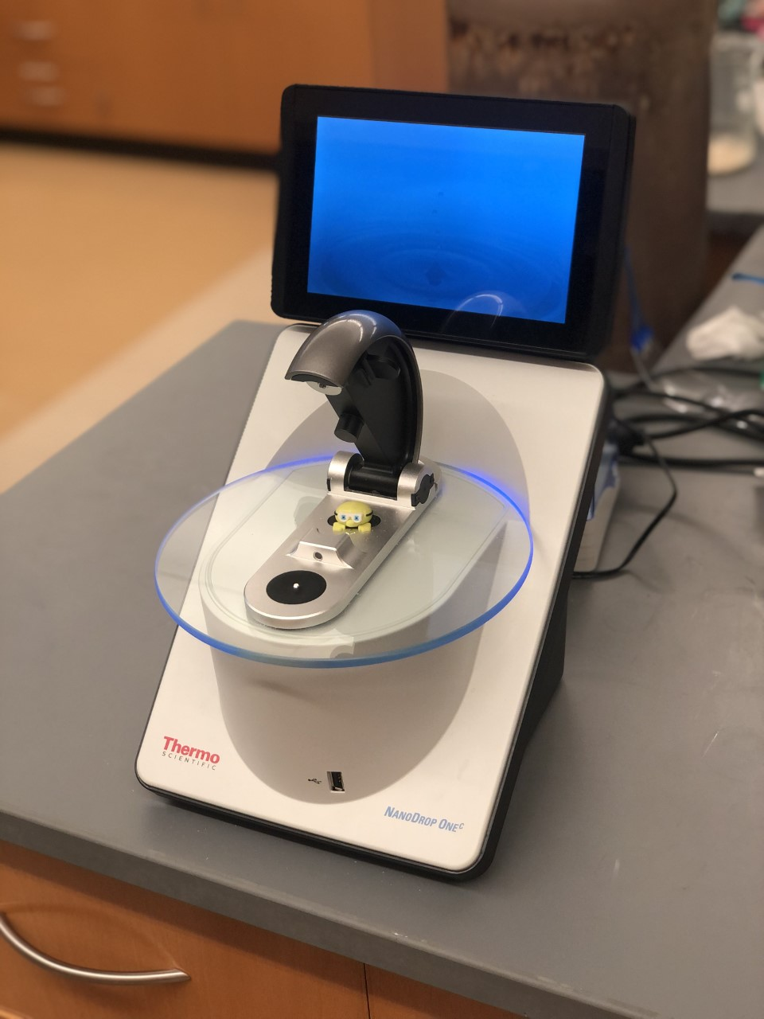
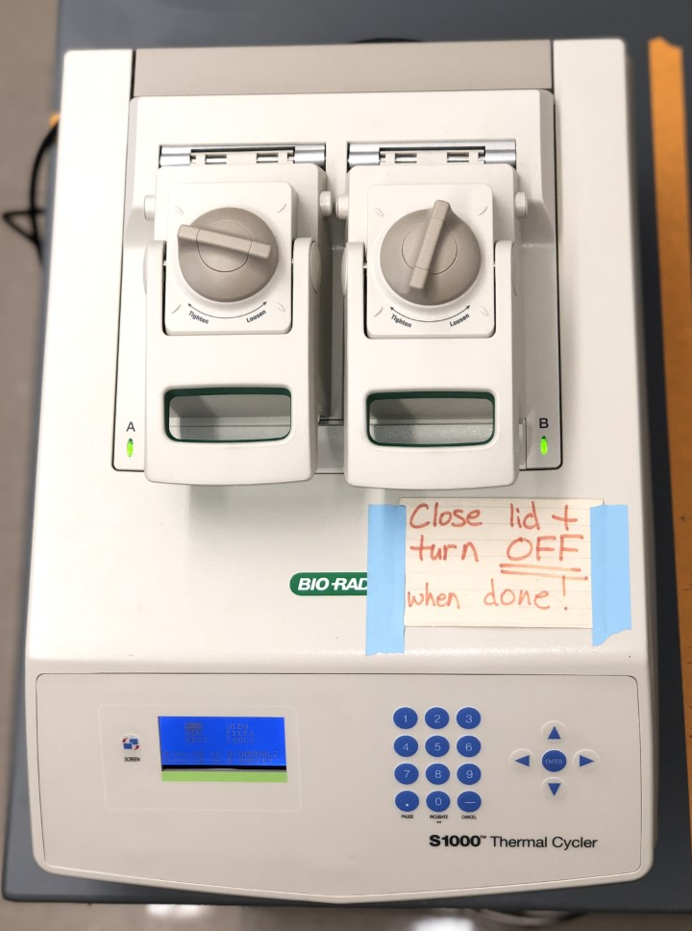
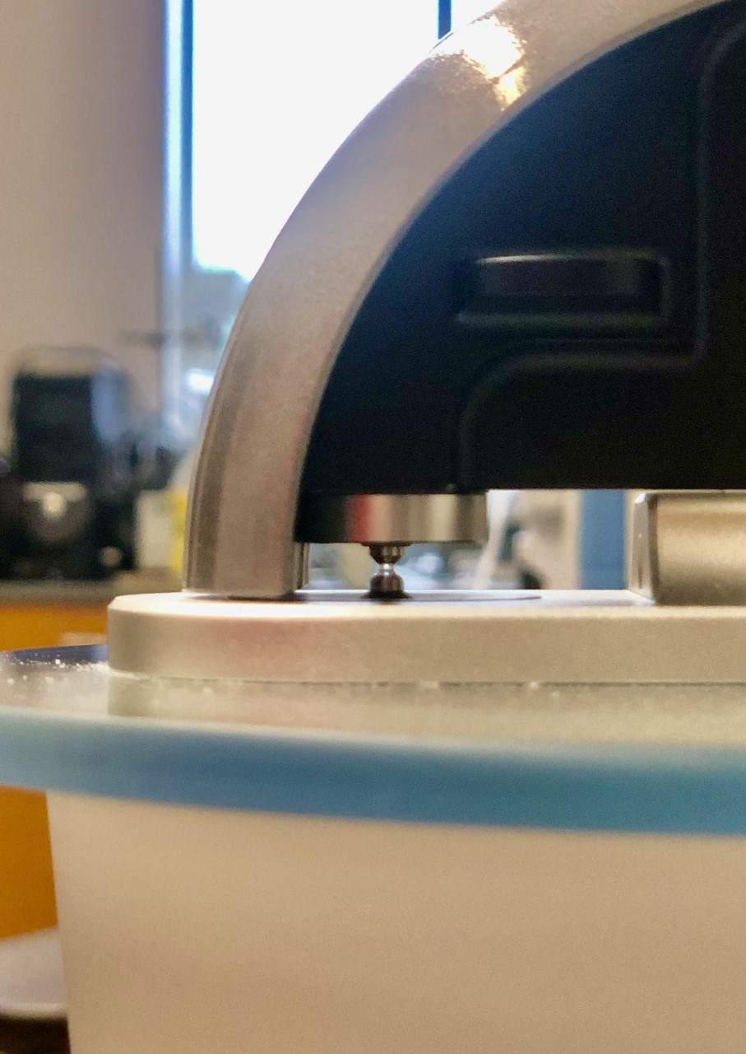
Instruments
PCR
Temperature Controlled Steps
Important for analyzing small samples of DNA and isolating desired sequences​
Nano-Drop
Measuring the absorbance and concentration of DNA in a sample
Notes:
Nano Drop displays a reading of concentration of DNA so that we can determine whether the isolation was effective.
PCR is used to amplify DNA in sample. Using primers, we can make millions of copies of the region we want to amplify. This will then allow us to send this sample in for sequencing. This will let us then identify the bacteria.

Slide 6
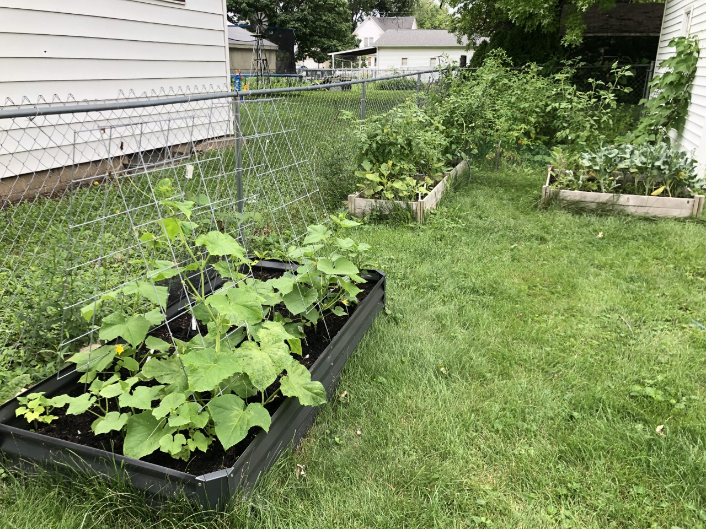
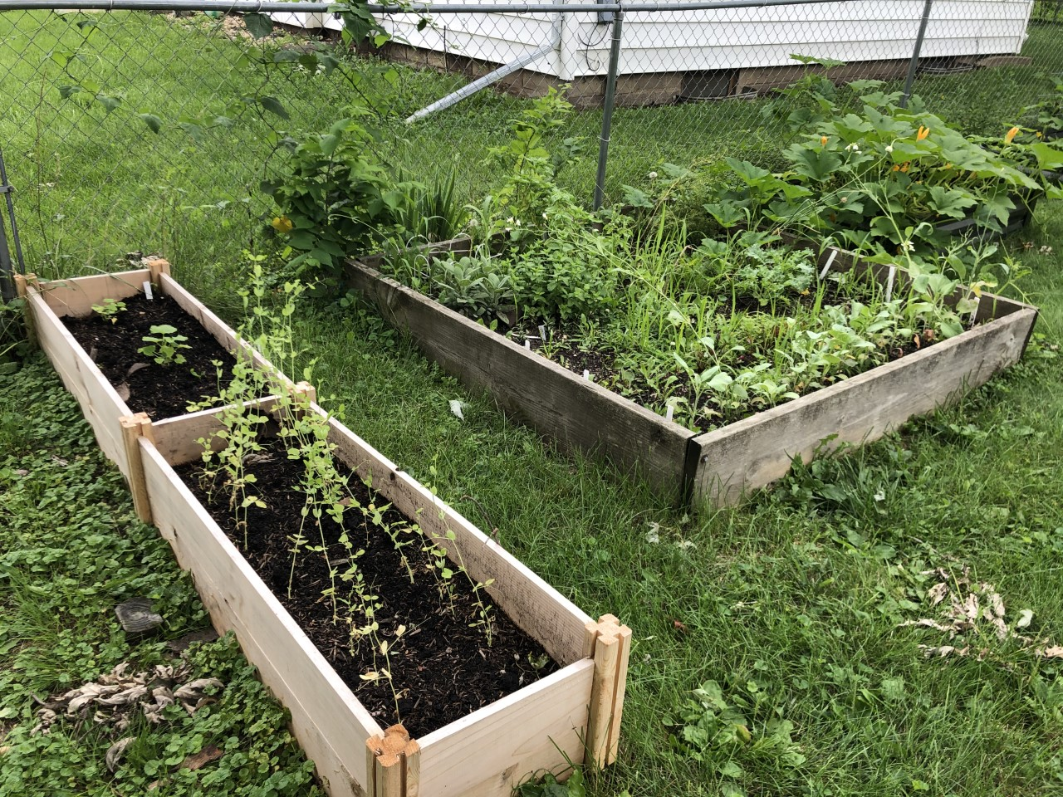
Where did the samples come from?
7
5
2
6
1
4
3
Notes:
Look at bacteria to see why some boxes are growing better than others.

Slide 7
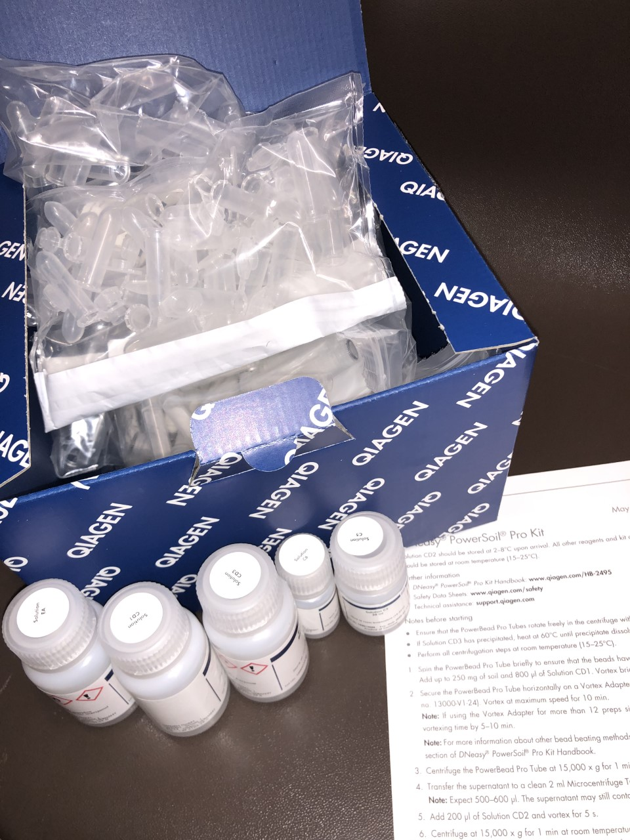
Soil Kit
Purpose: isolate DNA at a high purification level
DNeasy Soil Isolation kit
Brown color and humic removal
Remove PCR inhibitors
Homogenization
Cell lysis
Silica Membrane
Notes:
In a tube with power beads, I vortexed the sample to break up the particles. Then added a series of solutions repeating the vortex. This is done to start eliminating all of the unwanted matter including the PCR inhibitors in the sample as well as making the cells easier to get to in order to preform lysis. A series of centrifuging and solutions create the lysis process and a homogenous mixture. Lysis means that is breaking up the cell wall to get to the dna. The last step is to filter it through the silica membrane to obtain the dna into a micro centrifuge tube to then be prepared for pcr.

Slide 8
What is being amplified?
16S region
Found in all bacteria
Non-variable and Variable regions
V3 and V4
V3 -> variable regions <- V4
Non-Variable
Region
Non-Variable
Region
Non-Variable
Region
Primer
Primer
Notes:
Section of genome in microbes 16s that codes for 16s rrna. Non variable regions bond pcr primers and variable regions are amplified between the non variable regions

Slide 9
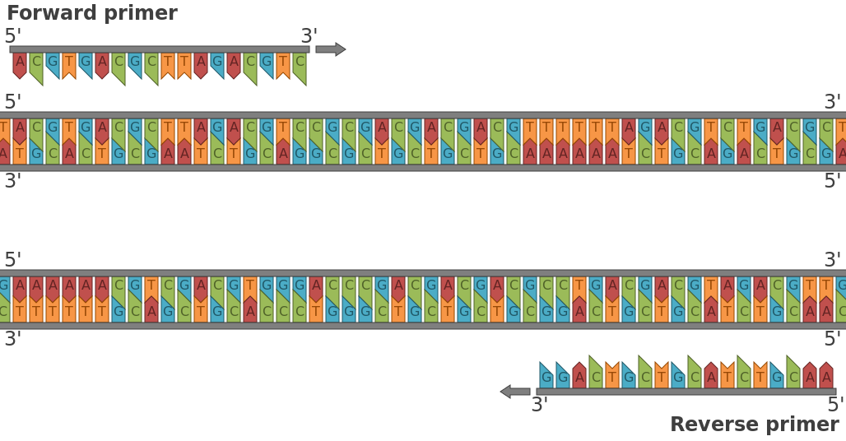
Primers and PCR
2 steps of PCR
Target specific primers (V3 and V4)
http://wilearncap.asuscomm.com:81/wikipedia_en_all_novid_2017-08/A/Soil_microbiology.html
Notes:
PCR or polymerase chain reaction test is done to amplify DNA with a goal of it being sequenced in order to identify the bacteria. Before sequencing can be done, two PCR steps must be done to the sample so that it is ready. It amplifies the specific region that we chose with the primers we bought. In this case it is called the V3 and V4 regions. The first step is amplifying and making a plentiful of copies. The second step is important because it ensures that the product contains PE1 and PE2 adaptors. Polymerase.

Slide 10
How does PCR work?
1st step
Heat splits apart DNA
Annealing
Primers bind Non-variable
Amplify variable region between primers
Extension time
Expands with DNA polymerase (enzyme)
Expecting about 500 BP
2nd step
Same process
Different primers
Prepare for sequencing
Notes:
Splits apart
Bind non var
Amplify variable between
Annealing
Extension time– expands dna replification
Back the other direction
Certain length
Seeing what we expect at 512
2nd pcr
Same
Different primers
Same thing
Able to be sequenced

Slide 11
Gels
After PCR amplification-
Gel
Sample 3
Sample 2
Ladder: BP
500 BP
66° Celsius
1st Gel 7/8/21
2nd Gel 7/9/21
Annealing 50° C
Gradient 50°-70°
Notes:
Since none of the other samples worked, we had to go back to the drawing board.
We ran a temperature gradient to see if our PCR temperature was too low.
The gel we ran with the gradient showed us indeed our temperature was set 16 degrees too low.
We ran the same sample at 8 different temperatures ranging step 3 between 50-70 degrees to find out which temperature was most effective. Since well 3 was the brightest on the gel, we redid all of the remaining 5 samples at temperature 66 c in hopes that they will replicate. We did not have to redo sample 2 because it worked at 50.

Slide 12
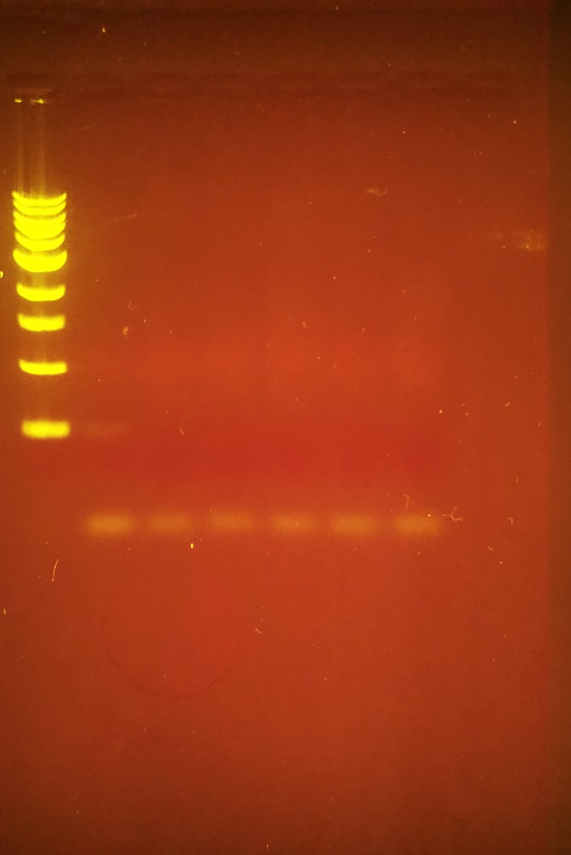
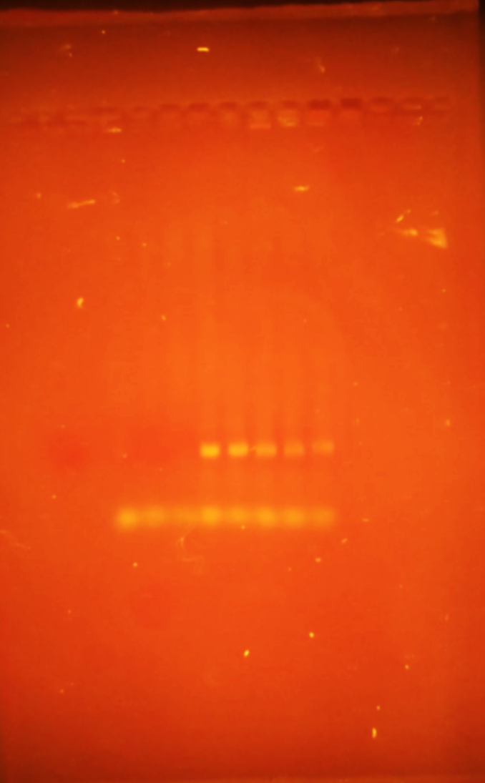
Gels
66° C
On Samples 1, 4-7
New Temperature Gradient
Sample 4
70° 68.5° 66° 62.5° 57.9° 54.5° 51.8° 50°
Notes:
This is the gel we ran all at 66 ° C and are results were not what we expected them to be. There were no indications that showed us that this worked for the other 5 samples. We must now go back and redo the temperature gradient on a different sample to see whether we will obtain results.

Slide 13
Next Steps
Temperature
PCR
Sequencing
Genome News Network
Notes:
Sequencing separates the pieces of DNA that differ by length in order to create a band that is easier to read so that we can identify the bacteria.
Multiple sequences. How much of each bacteria in it
Population of bacteria

Slide 14
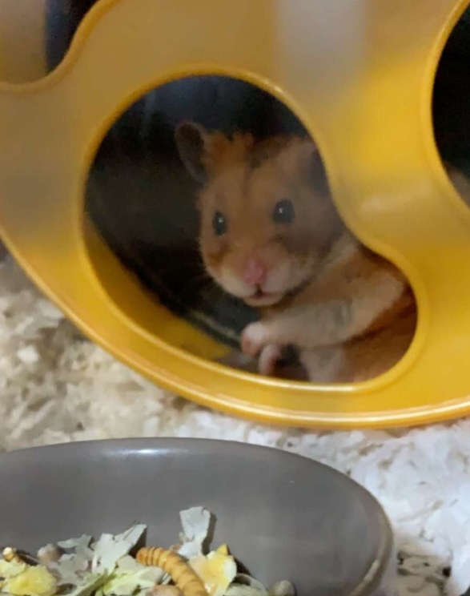
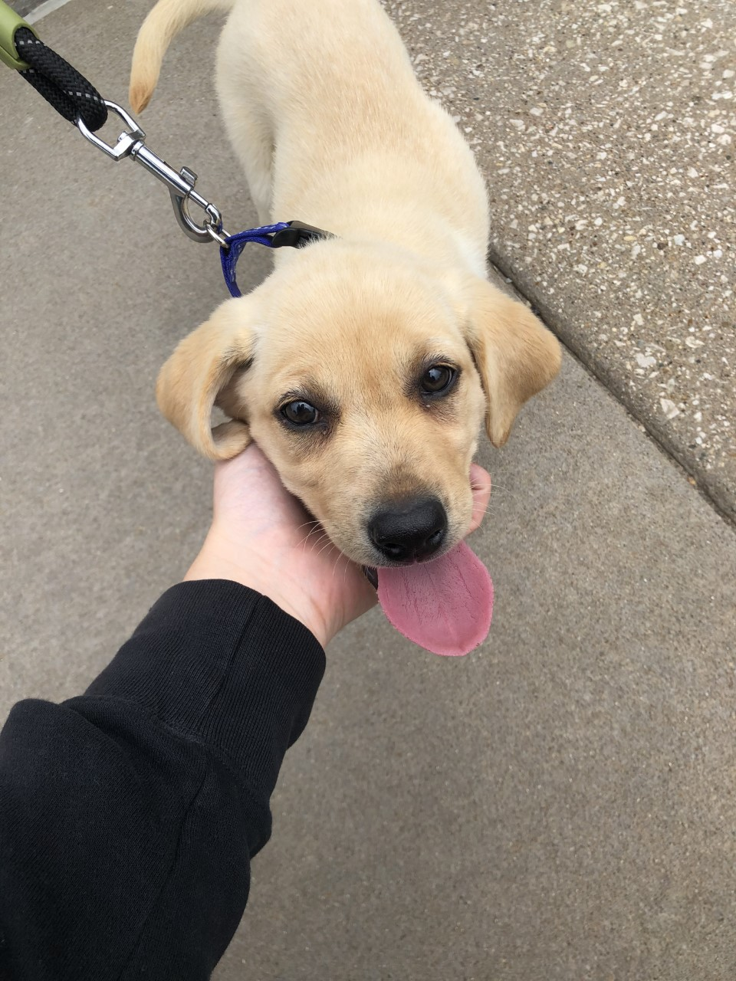
Other Isolations
Fresh (bio)
Dog
Hamster
Fecal
Dog
Hamster
Water
Fish Tanks
Fresh
Salt
Fresh (bio)
Notes:
Riley going over the water samples.

Slide 15
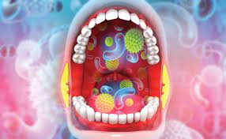
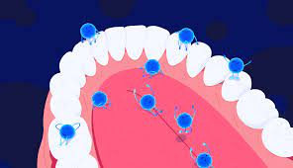
Oral Microbiome
2nd most diverse microbiome in human
Bacteria, fungi, viruses, archaea
Saliva Kit
A12 “Superman of the mouth”
Kills streptococcus mutans
Neutralizes acids
Protects from biofilms
Hydrogen peroxide
oral microbiome: unveiling the fundamentals
https://www.sciencenewsforstudents.org/article/newly-discovered-microbe-keeps-teeth-healthy#:~:text=probiotic%20A%20beneficial%20bacterium%20that,may%20lead%20to%20tooth%20decay.
Notes:
I want to further my study of the microbiome in the direction of the oral microbes present. I have an interest in pursuing dental school, so I think it would be interesting to study how the microbes in your mouth can affect your health and what you can do most efficiently to alter or increase your oral health.

Slide 16
Acknowledgements
Dr. Richard Kieft
Dr. Laura Moore
Dr. Brad Sturgeon
Monmouth College Chemistry Department
Talia Long
Riley Bigham

Slide 17
References
https://nph.onlinelibrary.wiley.com/doi/full/10.1002/ppp3.10167
https://scielo.conicyt.cl/scielo.php?pid=S0718-95162017000400008&script=sci_arttext
https://fungialert.com/what-are-good-and-bad-soil-microorganisms/
https://www.sciencenewsforstudents.org/article/newly-discovered-microbe-keeps-teeth-healthy#:~:text=probiotic%20A%20beneficial%20bacterium%20that,may%20lead%20to%20tooth%20decay.
oral microbiome: unveiling the fundamentals
Genome News Network
http://wilearncap.asuscomm.com:81/wikipedia_en_all_novid_2017-08/A/Soil_microbiology.html
Bacteria by Byjus

Slide 18
Questions?
Thank you!

