Slide 1
Lignin Dimers: pathway of Formation
Zelinda Taylor, Monmouth College

Slide 2
Overview
Significance
Monomers
Lignin vs lignan
Enzymatic Degradation
New process
Summary

Slide 3
Significance of Lignin Dimers (Lignan)
Bioactivity/Pharmacological properties
Anti-bacterial
Anti-microbial
Anti-oxidant
Potential drugs
Breast cancer
Universal occurrence and abundance of lignin in diet
Not readily available so little research
Source: https://www.sesres.com/blog/top-5-antioxidants-you-should-be-taking, Medical News Today

Slide 4
Monomers of Lignin and Lignan
Sinapyl alcohol
Coniferyl alcohol
p-coumaryl alcohol

Slide 5
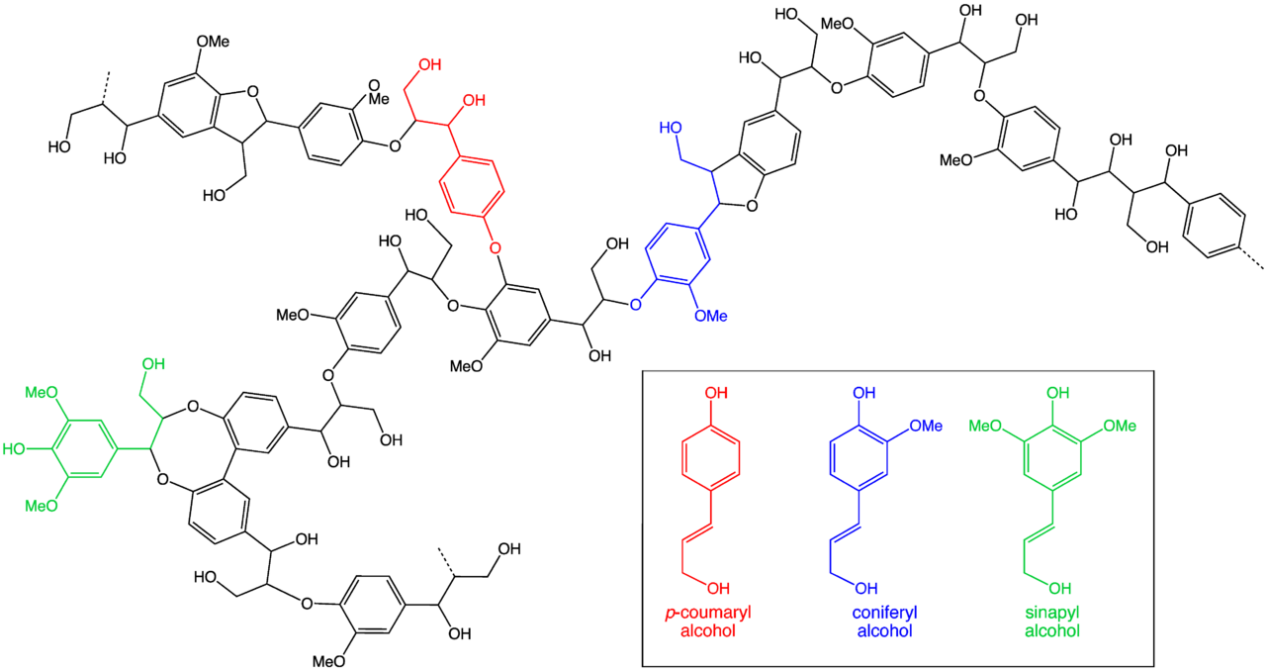
Lignin

Slide 6
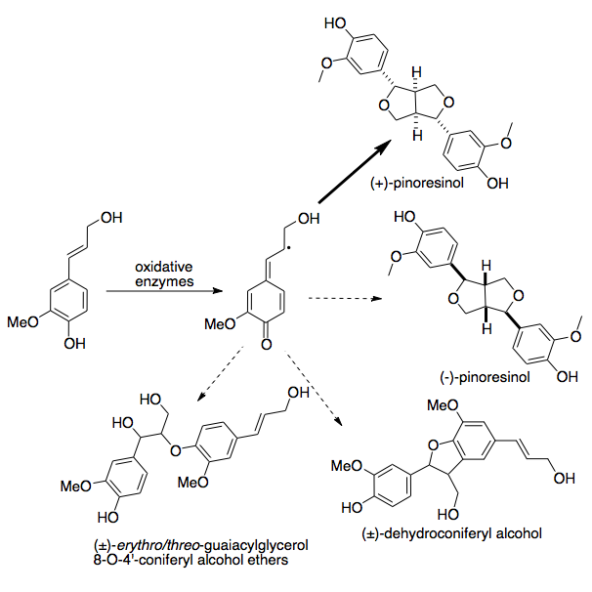
Lignan
Dimers of monomers
Coniferyl alcohol
Assumed these often formed during oxidation reaction of monomers
Radical-radical coupling
Biological activity importance
Source: Wikipedia

Slide 7
Previous Process
Wanting to determine process and identify of radical-radical coupling of monomers
Not as easy as oxidize and couple
Pathway was not determined
Monomers + HRP + hydrogen peroxide
Array of products unable to identify
HPLC analysis

Slide 8
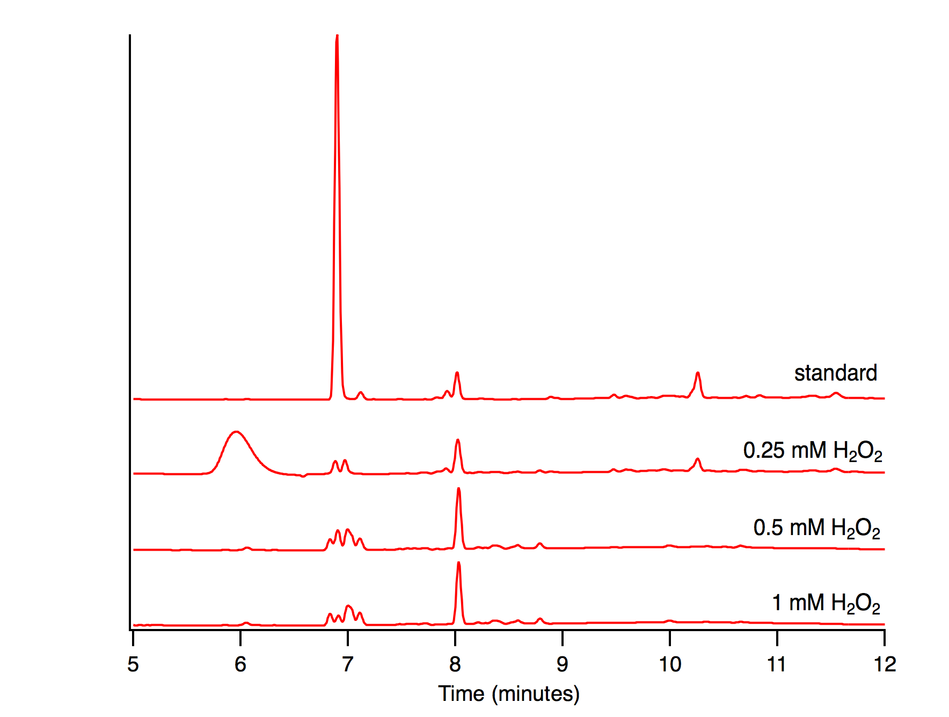
Enzymatic Oxidation of Coniferyl Alcohol

Slide 9
Enzymatic Oxidation of Coniferyl Alcohol

Slide 10
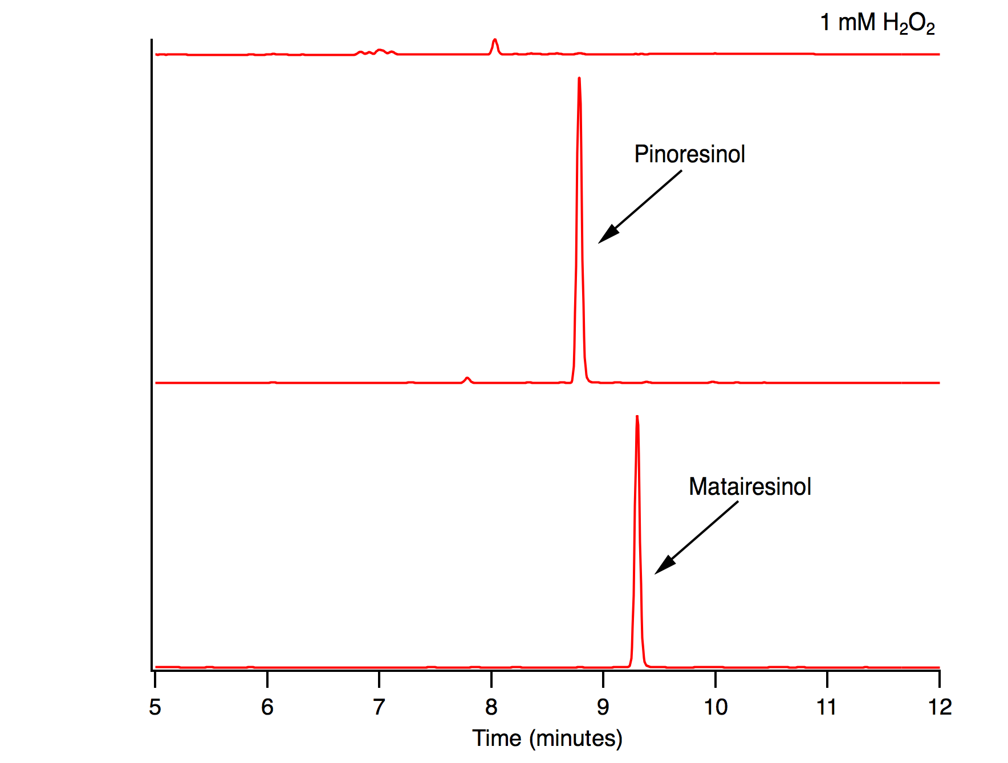
Standards of Dimers

Slide 11
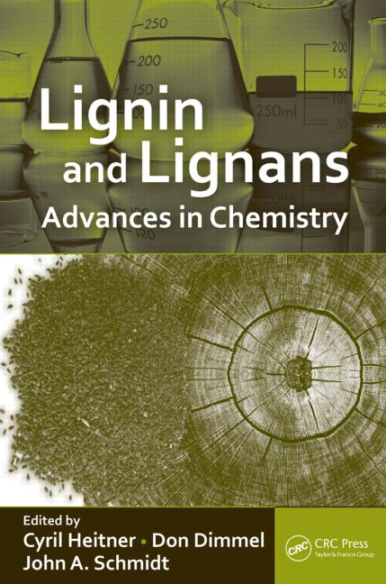
New approach…
Was not able to prove previous process’ assumptions
Tried to identify dimers via monomers
Now trying to identify via degradation of polymer
Reverse of 1st method attempted
Some method options:
Use of enzymatic degradations
lignan peroxidase, manganese peroxidase
Use chemical degradations
Source: Google Images

Slide 12
Lignin

Slide 13
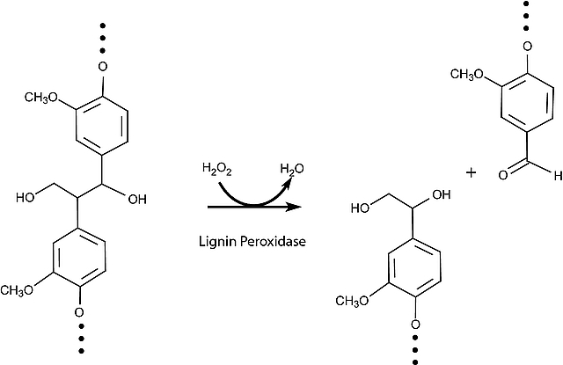
Enzymatic Degradation of Lignin
Typical in breakdown and restructuring of natural polymers
In lignin:
oxidative versus hydrolytic enzymatic degradation
heterogeneous and random with regards to degree of polymerization, branching, and monomer composition and sequence
Source: SigmaAldrich

Slide 14
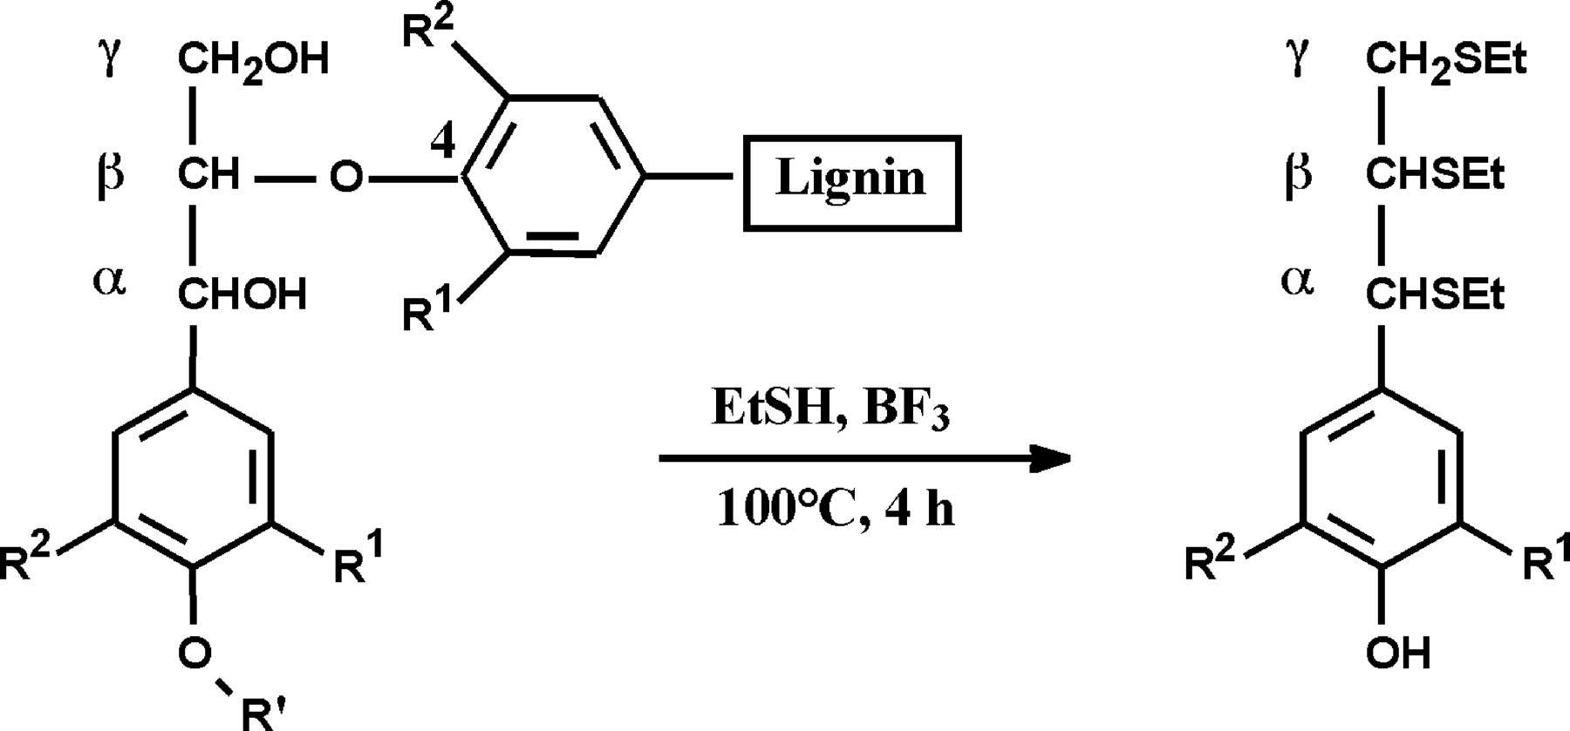
Chemical Degradations of Lignin
Thioacidolysis
Cleavage of B-O-4
Ether cleaving
Adapted from acidolysis
Simplicity and informative capabilities
Source: http://www.plantphysiol.org/content/134/2/586/tab-figures-data

Slide 15
Chemical Degradations of Lignin
Use of Nitrobenzene
Discovered 50 years ago
Most commonly used method
Benzaldehydes and benzoic acids produced
Difficulties in method reproducibility
Moderate experimental changes

Slide 16
Summarizing of Progress
Oxidation of Monomers
EPR analysis of radicals and coupling
Formation of lignans
Pathway of lignan formation

Slide 17
Acknowledgements
Bradley Sturgeon
Monmouth College Chemistry Department
Richard “Doc” Kieft Endowment
Stephanie Saey

Slide 18
General References
Lapierre, Catherine. Determining Lignin Structure by Chemical Degradations. Lignin and Lignans: Advances in Chemistry. Taylor and Francis Group, 2010, pp. 11-48.
Rodriguez-Garcia, Carmen et al. Naturally Lignan-Rich Foods: A Dietary Tool for
Health Promotion. Molecules, 2019, 24, pp. 1-25.
Questions?

