Slide 1

Analytical Testing of Cannabis
Robert C. Graeff, Alec Hayes and Bradley E. Sturgeon
Monmouth College Chemistry

Slide 2
Analytical Testing of Cannabis
Why is it important to test Cannabis?
Cannabinoids are bioactive
Correct dosages for medicinal uses
Validate THC is not present in products

Slide 3
Analytical Testing of Cannabis
Why is it important to analytically test Cannabis?
Farmers growing Hemp fibers
There are different laws for Marijuana and Hemp
Isolate standards and develop methods of analysis

Slide 4
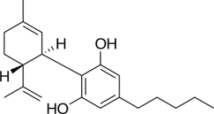
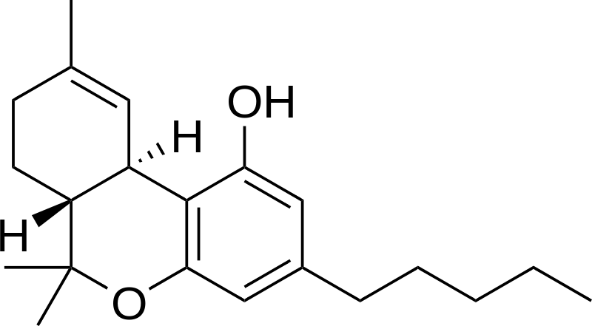
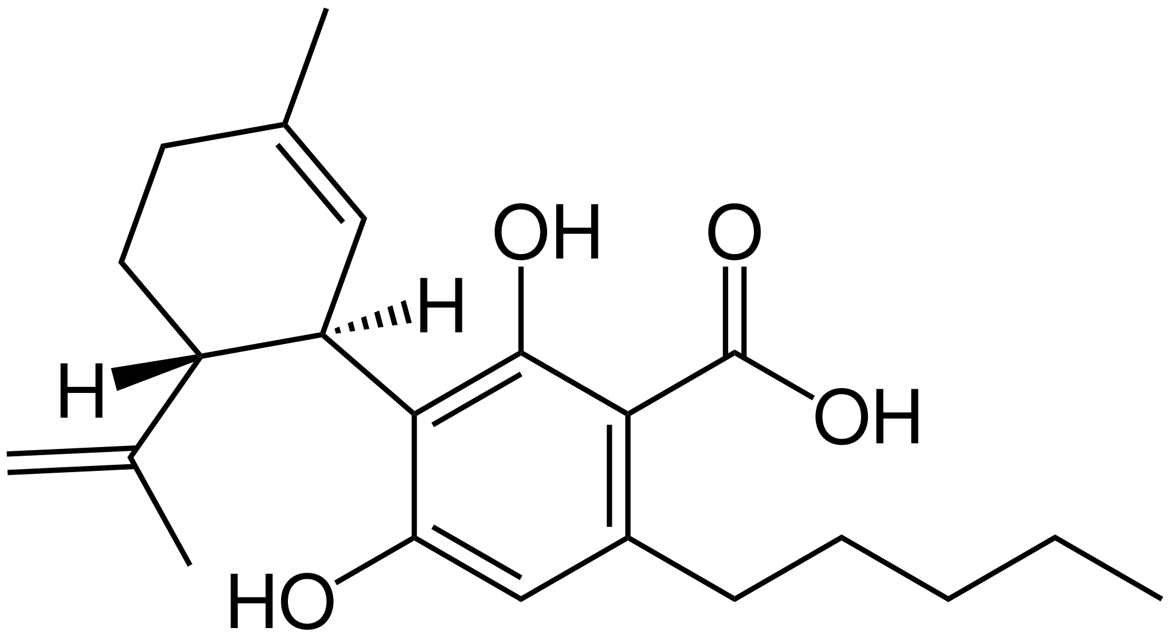
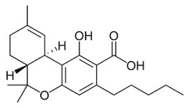
Structures of Cannabinoids
CBD
THC
Cannabidiol
Tetrahydrocannabidiol
CBDa
THCa
Cannabidiolic Acid
Tetrahydrocannabinol acid

Slide 5
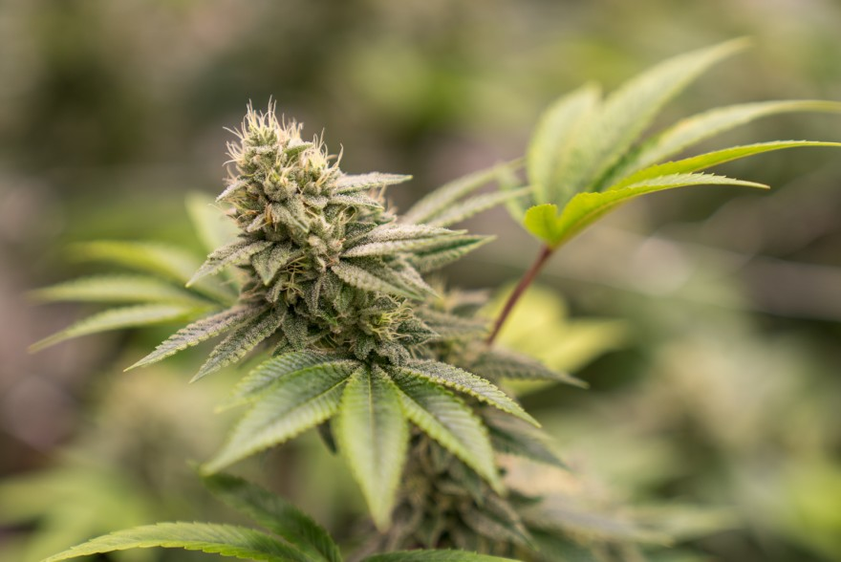
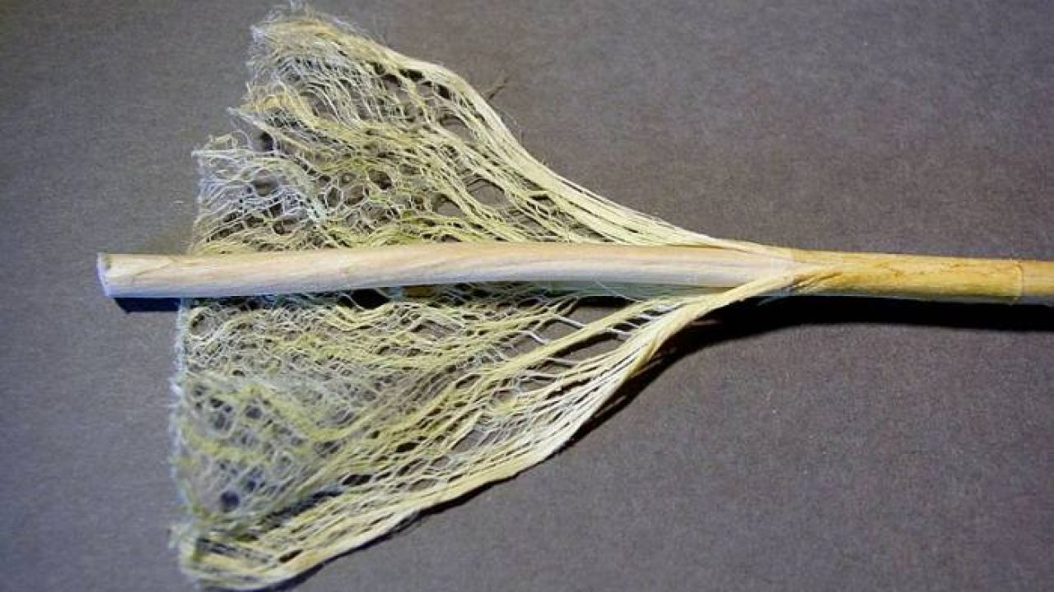
Hemp vs. Marijuana
if THC > 0.3 wt% Marijuana
Medicinal use:
THC > 0.3 wt%
CBD: THC < 0.3 wt%
CBG: THC < 0.3 wt%
CBN: THC < 0.3 wt%
Plant material use:
Hemp
if THC < 0.3 wt% Hemp

Slide 6
High Performance Liquid Chromatography
HPLC and Method Development

Slide 7
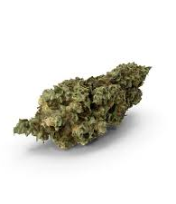
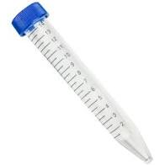
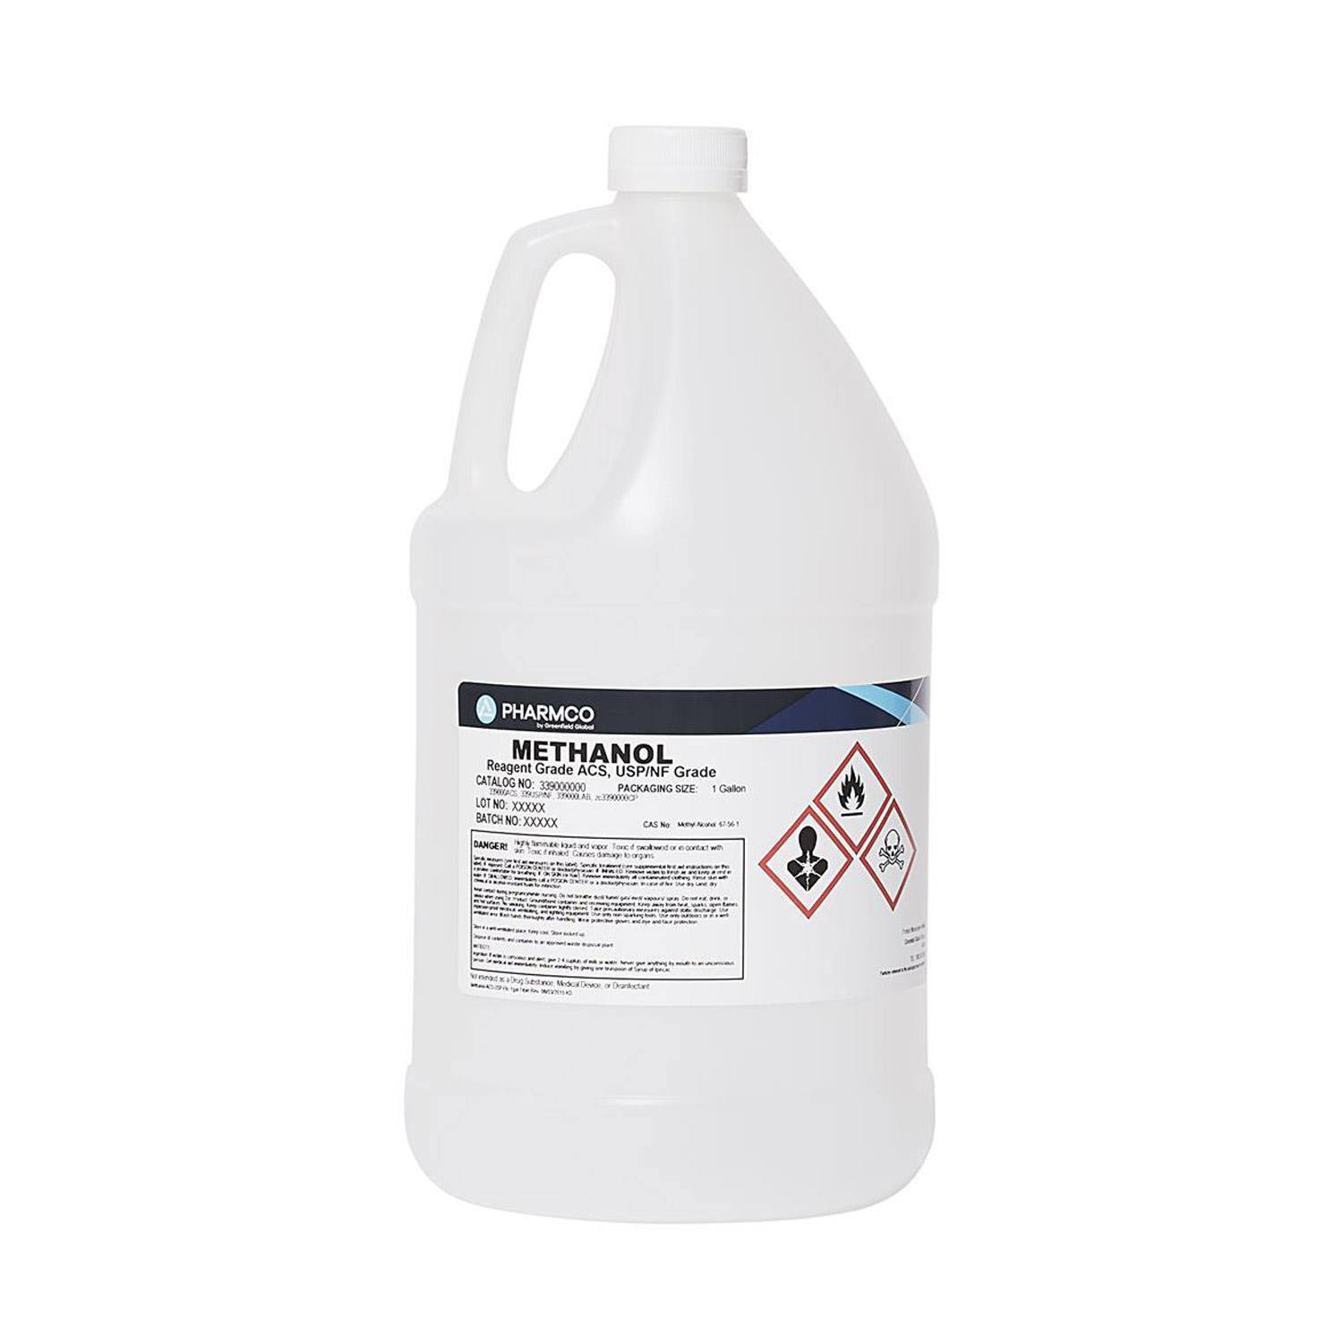
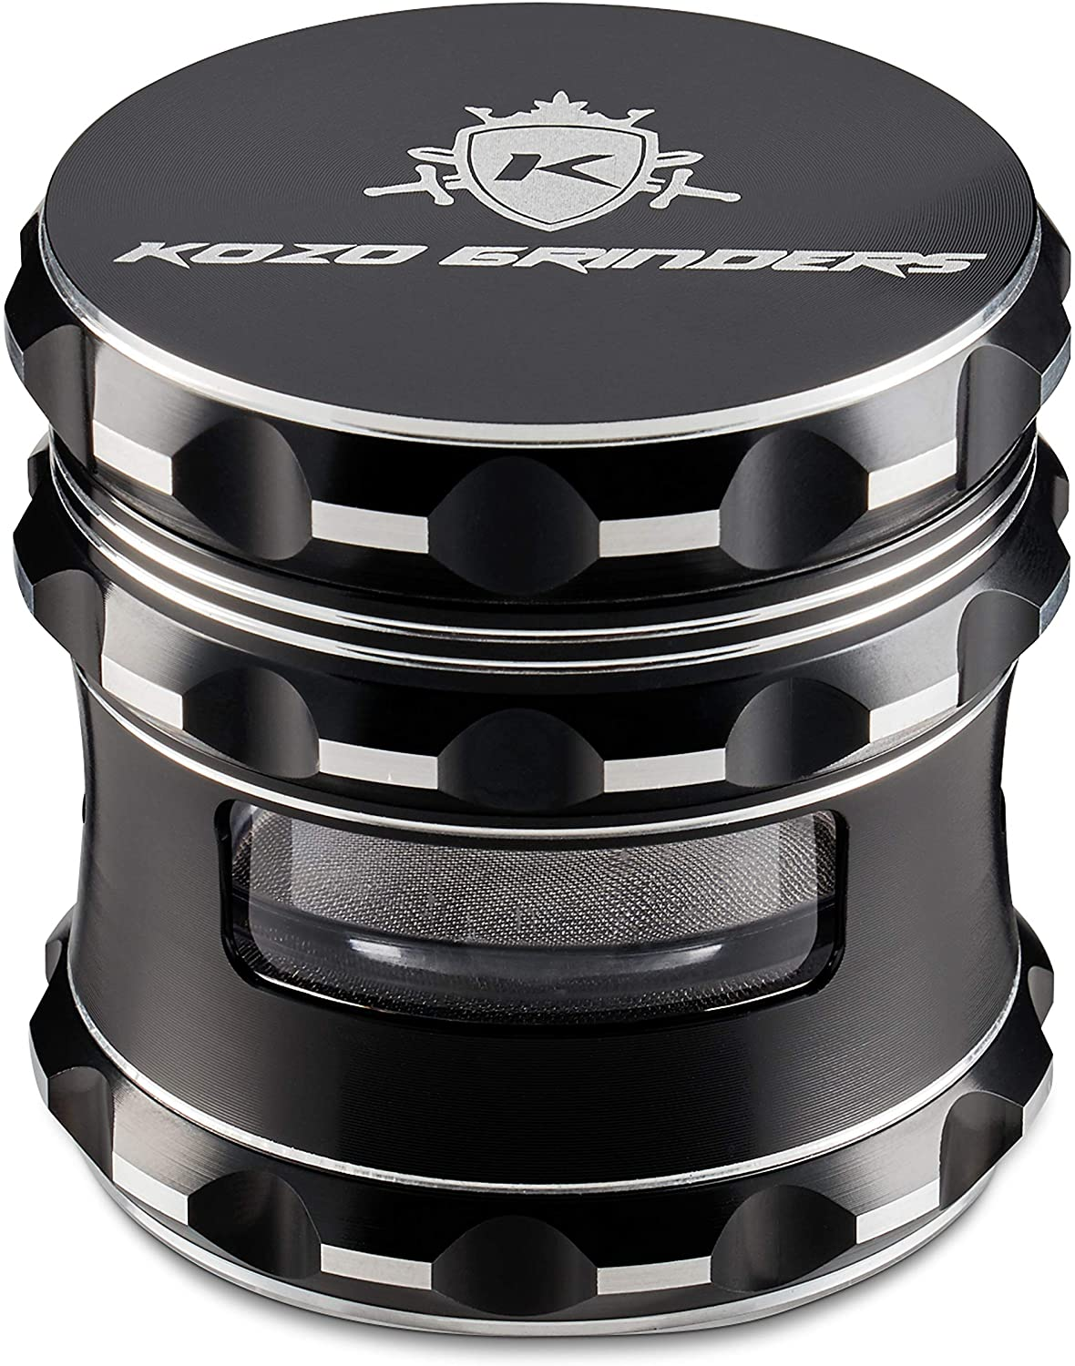
Method
“Analysis of 17 Cannabinoids in Hemp and Cannabis.” Sigma, www.sigmaaldrich.com.

Slide 8
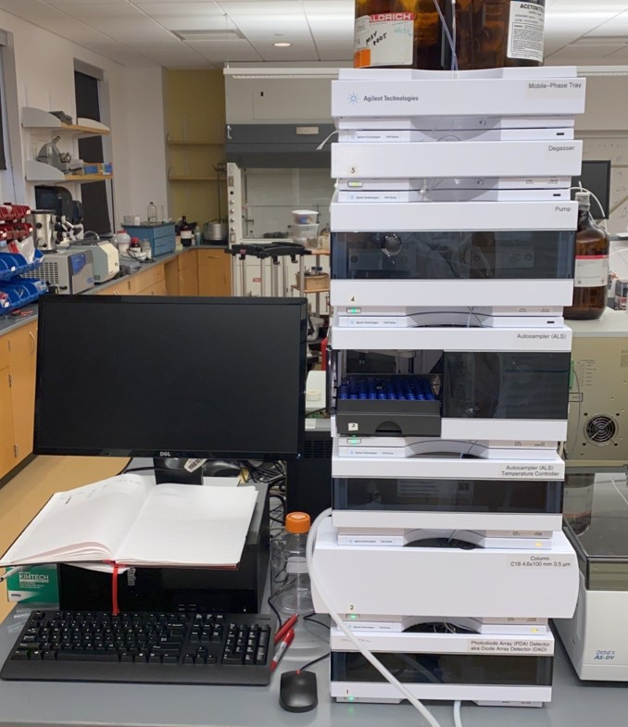
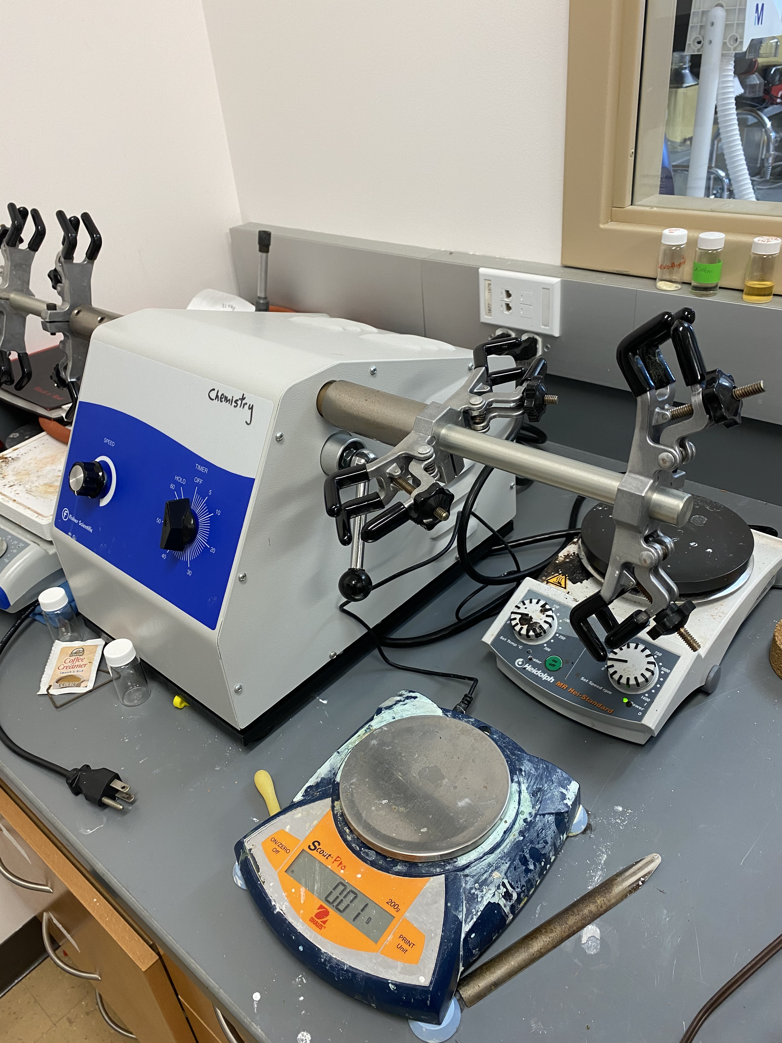
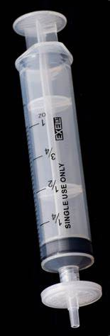
Method
“Analysis of 17 Cannabinoids in Hemp and Cannabis.” Sigma, www.sigmaaldrich.com/technical-documents/articles/analytical/food-beverage/analysis-of-cannabinoids.html?utm_campaign=AP_AA_MS_2020079018_50931_Cannabis-Potency-Workflow.

Slide 9
CBD Hemp sample (BS) Galena IL

Slide 10
Data
CBD Hemp sample (BS)
CBD_STD

Slide 11
Other Peaks

Slide 12
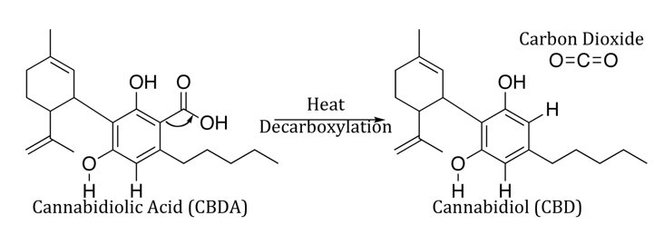
Research
The decarboxylation of CBDa to CBD
Method Development

Slide 13
Analytical Testing of Cannabis
Robert C. Graeff, Alec Hayes and Bradley E. Sturgeon
Monmouth College Chemistry

