Slide 1


Mechanistic Study of intermediates in the water oxidation pathway
By: Seth Croslow
Mentor: Chaochao Lang
PI: Dr. Dunwei Wang

Slide 2
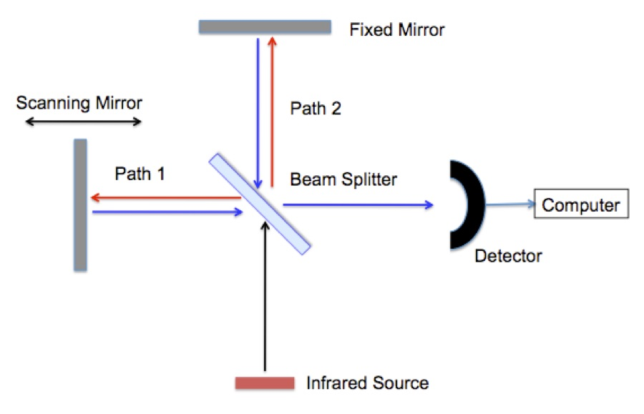
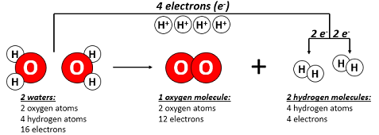
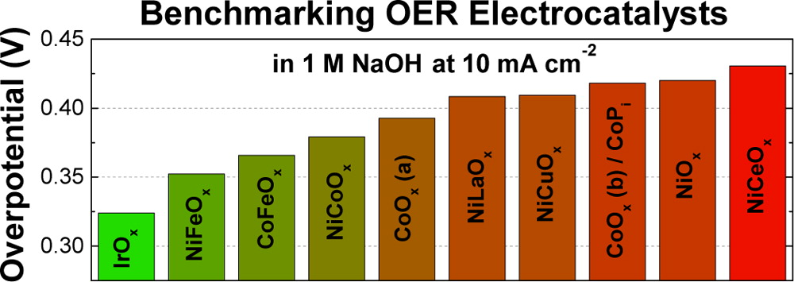
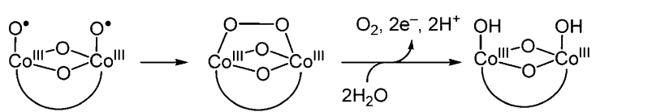
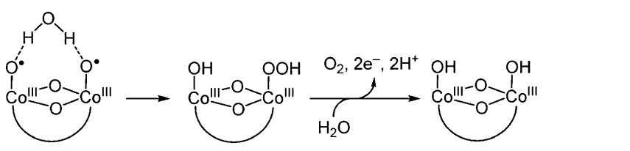
Project Overview
Electrochemical Tests
Water Oxidation
Cobalt Catalyst
O-O Bond Forming Intermediates
Methods
Fourier Transform Infrared Spectroscopy
Two proposed O-O bond formation mechanisms:
IMOC:
WHAA:
Sample
J. Am. Chem. Soc. 2016, 138, 4229−4236

Slide 3
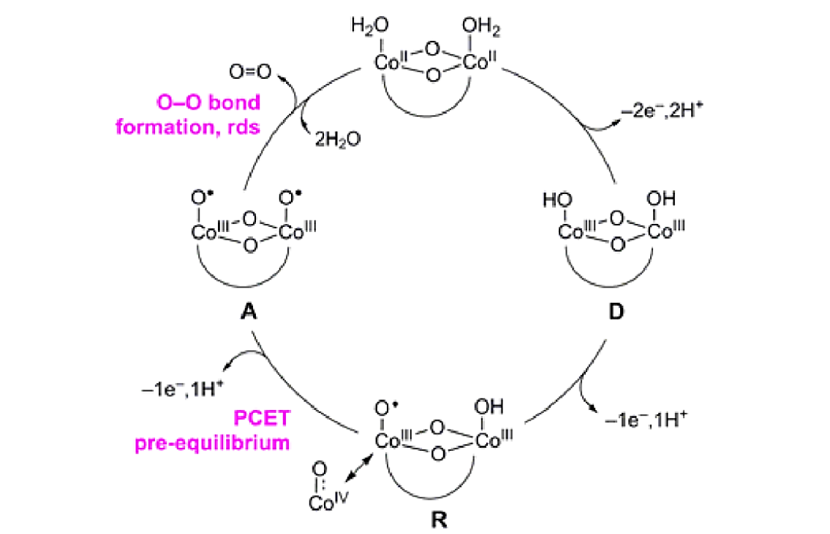
Oxygen Evolution Reaction Pathway
Two proposed O-O bond formation mechanisms:
O-O bond formation, rds
IMOC:
WHAA:
PCET
pre-equilibrium
J. Am. Chem. Soc. 2016, 138, 4229−4236

Slide 4
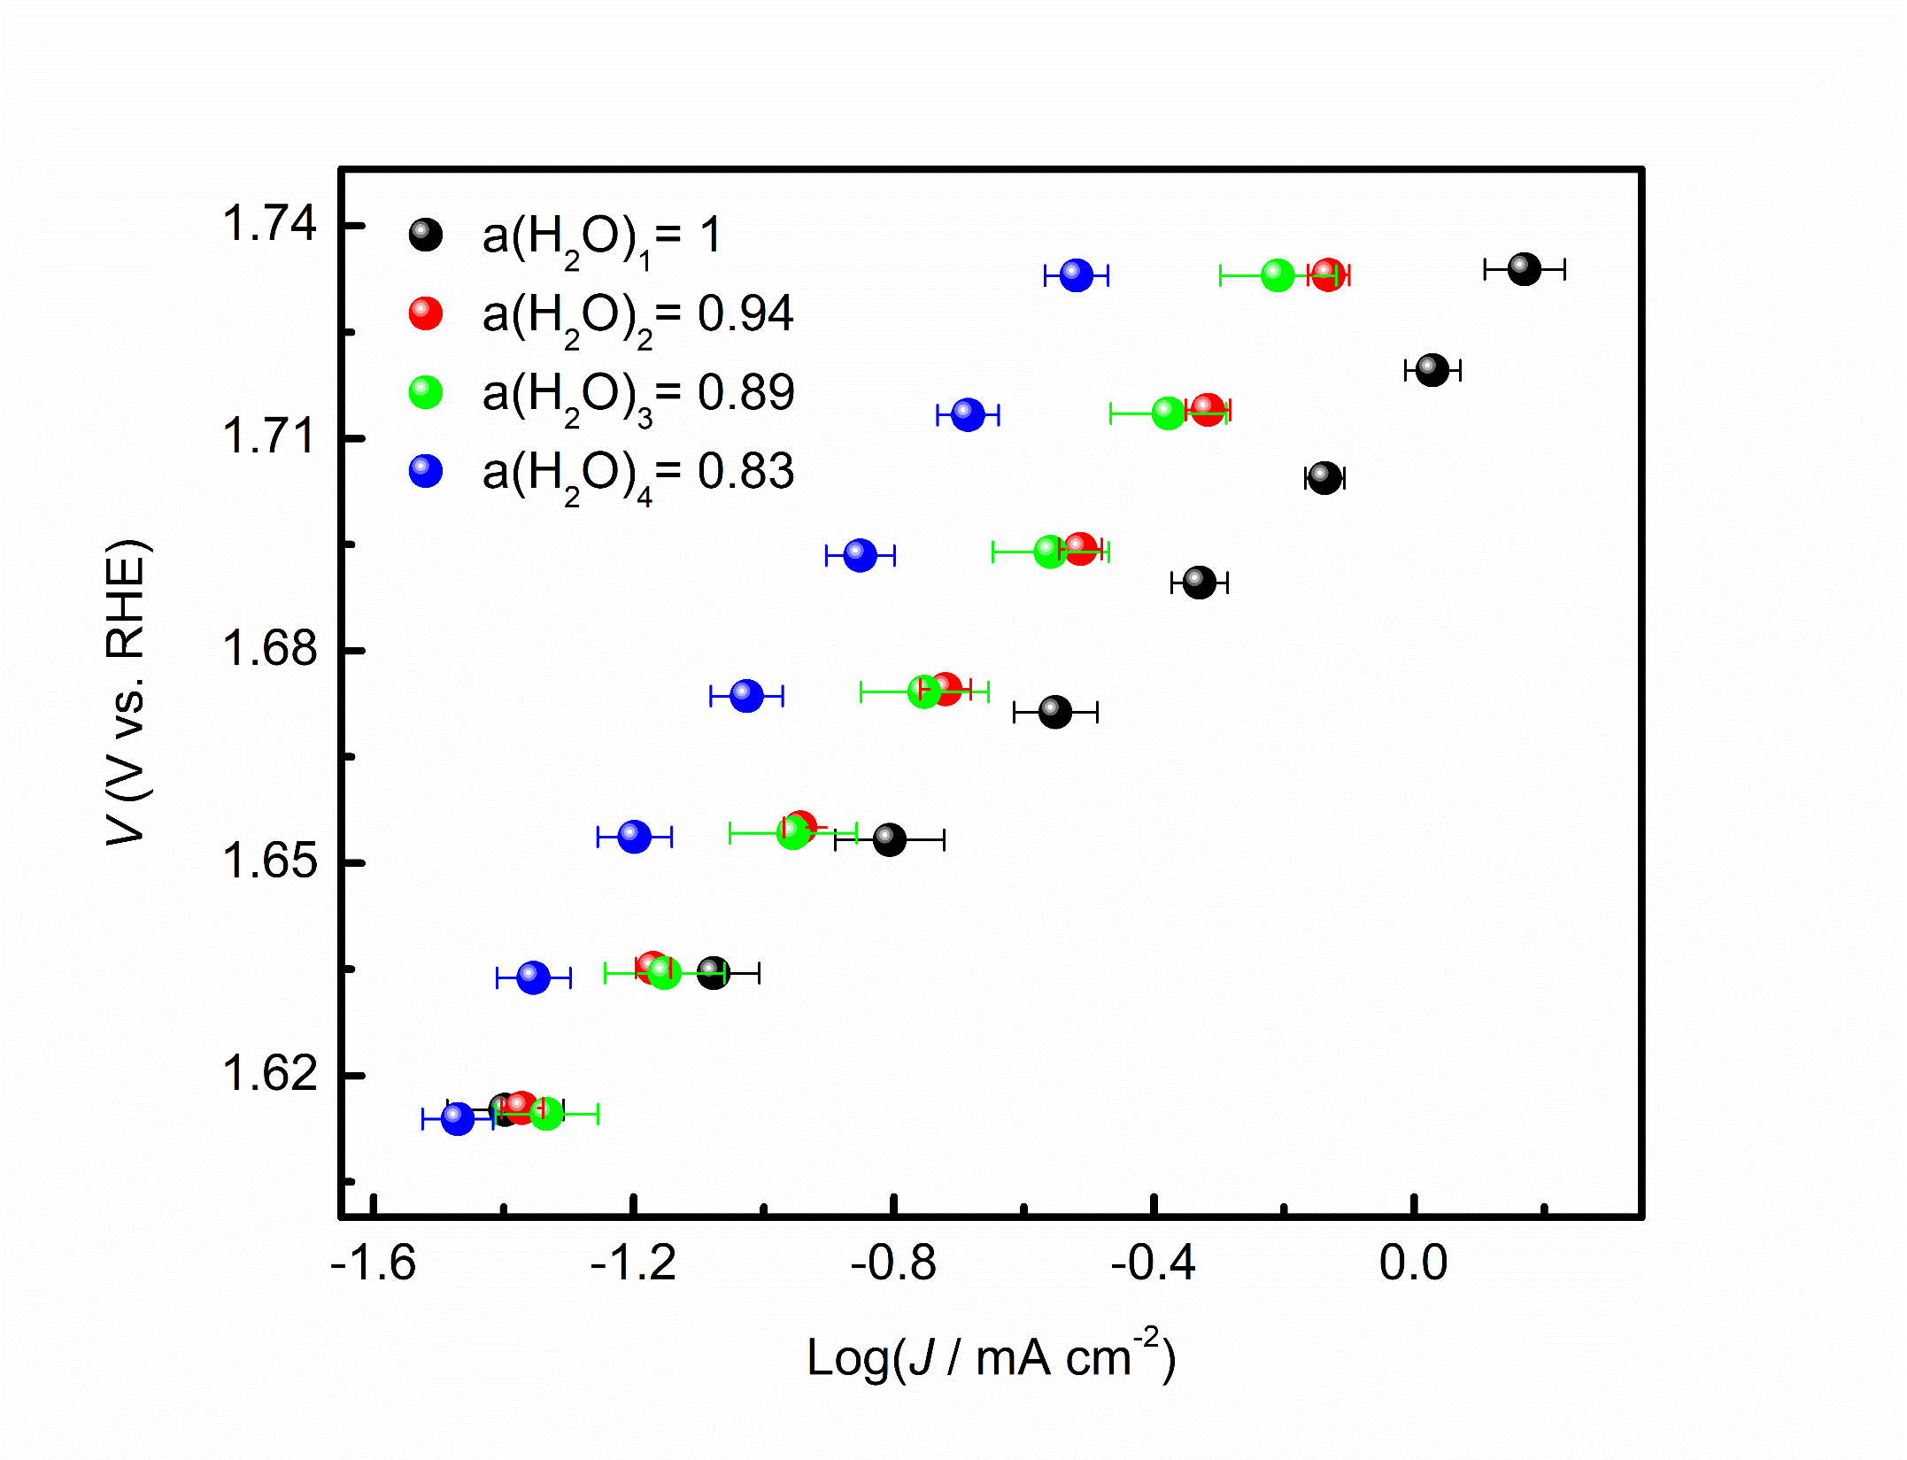
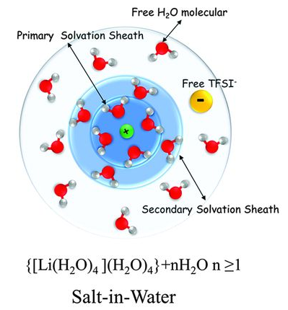
Steady state Tafel – Water-In-Salt
High Potential
WHAA:
IMOC:
Salt-in-Water
Low Potential
Science, 2015, 6263, 938-943

Slide 5
Fourier Transform Infrared Spectroscopy
Peroxide:
740-920 cm⁻¹
Sample
Superoxide:
1013 cm⁻¹
Nat. Chem., 2014, 6, 362-367

Slide 6


FTIR Configurations
Otto Configuration:
mutil-bounce ZnSe ATR crystal
Kretschmann Configuration:
micro-machined Si ATR wafer
WE
F
WE
ZnSe
Si
FTO working electrode with catalyst placed onto crystal
Large background interference
Catalyst deposited directly onto crystal
Small background interference

Slide 7
H₂O vs. D₂O vs. H₂¹⁸O
H₂O
D₂O
H₂¹⁸O
1,014 peak: potential reversible
820 peak: not potential reversible
  Maybe not an intermediate
1,014 peak: no shift
  No H in intermediate
820 peak: constant/unchanged
1,014 peak: shifted to 966
  Indication of ¹⁸O—¹⁸O bond

Slide 8
D₂O Confirmation/Comparison
Distinct peak in 0.1 M KCl D₂O
  Removes the 987 cm⁻¹ phosphate band
  Confirms the validity of the 1014 cm⁻¹ peak
  Test isotope effect
    H₂O
    D₂O
    H₂¹⁸O

Slide 9
Water-In-Salt - FTIR

Slide 10
Summary
Steady state measurements:
  Increased dependence on water as potential increased
  Mechanism switch from IMOC to WHAA?
FTIR data:
  Co-O-O-Co intermediate at high potentials
  No presence of the Co-O-OH intermediate
  Possible decrease in Co-O-O-Co peak in reduced water activity
FTIR data does not currently prove or disprove the mechanism switch hypothesis
Notes:
The two intermediates could be present simultaneously, but only see the one peak. In rebuttal to increase of peak intensity with increasing potential: as the potential increases, the rate also increases, so it could be that the rate of the superoxide intermediate just increases at a faster rate.

Slide 11
Future Plans
Electrochemical Quartz Crystal Microbalance
  Quantify water adsorption on catalyst during steady state
FTIR
  Perform additional water-in-salt experiments
  Try to reduce the effect of phosphate bands

Slide 12

Acknowledgements
Chaochao Lang
Jingyi Li
Dr. Dunwei Wang
Boston College REU Program

Slide 13

Questions
Project Overview
Oxygen Evolution Reaction Pathway
Steady state Tafel – Water-In-Salt
Fourier Transform Infrared Spectroscopy
FTIR Configurations
H₂O vs. D₂O vs. H₂¹⁸O
D₂0 Confirmation/Comparison
Summary
Thank You!

Slide 14
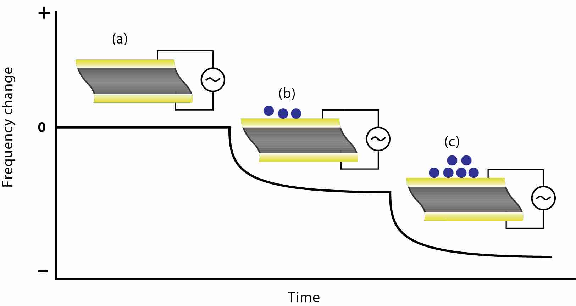
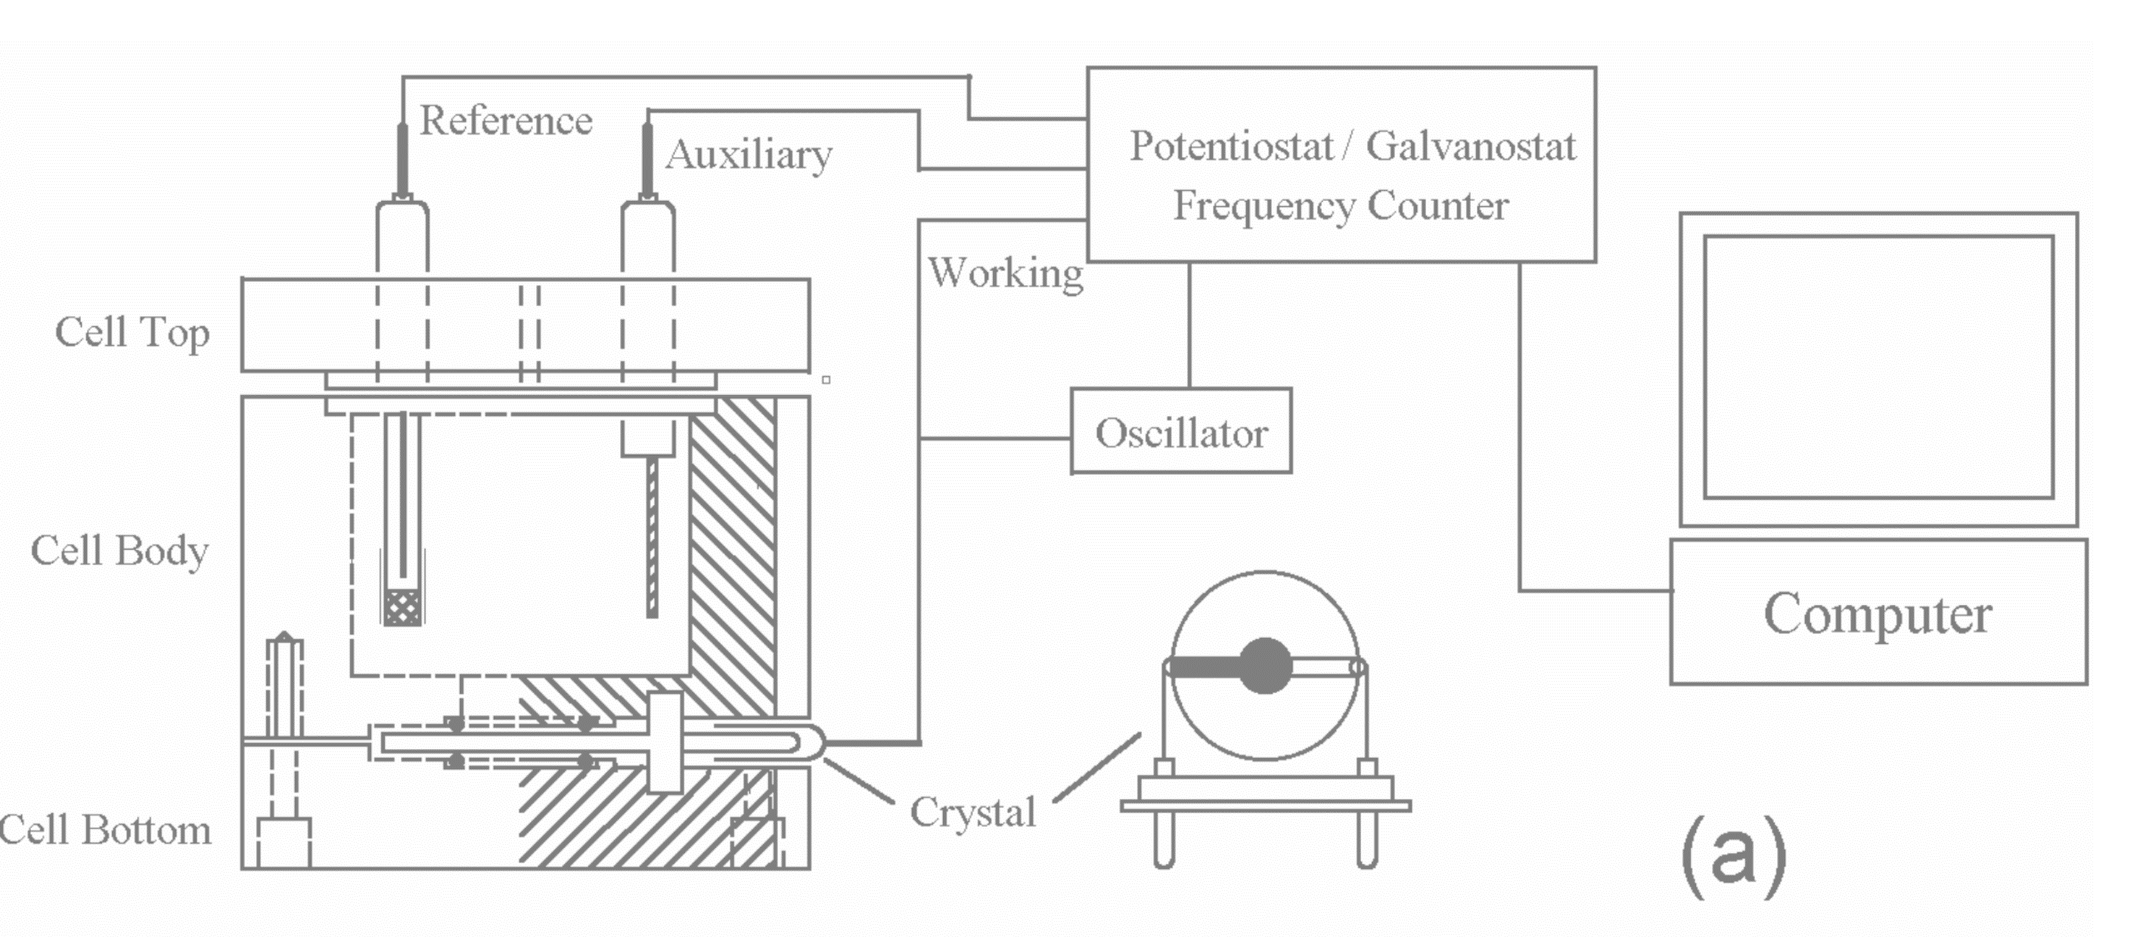
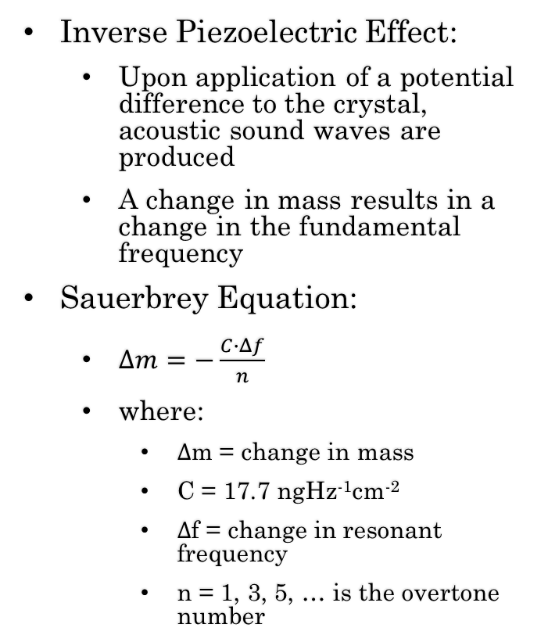
Electrochemical Quartz Crystal Microbalance
Inverse Piezoelectric Effect:
  Upon application of a potential difference to the crystal, acoustic sound waves are produced
  A change in mass results in a change in the fundamental frequency
Sauerbrey Equation:
  $Δm=−\frac{C∙Δf}{n}$
  where:
    $Δ$m = change in mass
    C = 17.7 ngHz⁻¹cm⁻²
    $Δ$f = change in resonant frequency
    n = 1, 3, 5, … is the overtone number

Slide 15
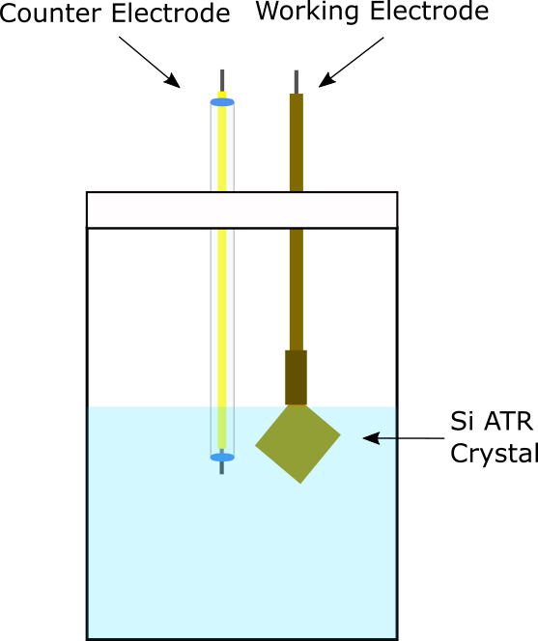
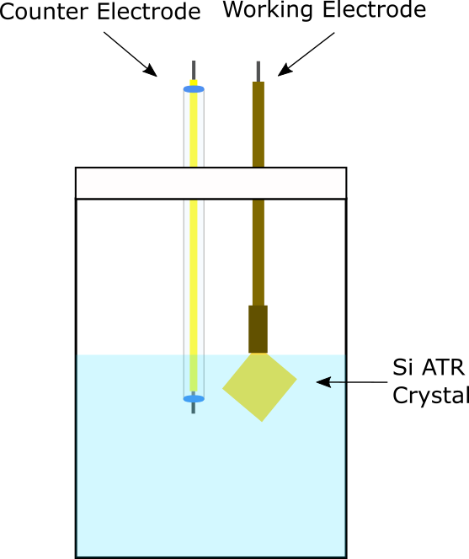
CoO_{x} Film Deposition
Utilizes two electrode system:
  Working Electrode
  Counter Electrode
Method:
  Solutions:
    0.01 M Co(NO₃)₂
    0.1 M NaCH₃CO₂
  Galvanostatic
    Constant current: 0.05 mA
    Duration: 322 s
Catalyst is used to facilitate oxygen evolution

Slide 16
H₂O vs. D₂O vs. H₂¹⁸O
H₂O
D₂O
H₂¹⁸O

Slide 17
Summary
Steady state measurements:
  Increased dependence on water as potential increased
  Mechanism switch from IMOC to WHAA?
FTIR peak at ~1014 cm⁻¹:
  Shifted to ~966 cm⁻¹ in H₂¹⁸O with no shift in D₂O
  Peak is most likely Co-O-O-Co intermediate
FTIR peak at ~820:
  Showed no potential reversibility in H₂O and no similar peaks in D₂O or H₂¹⁸O
  No confirmation of the Co-O-OH intermediate
FTIR data does not prove or disprove the mechanism switch hypothesis

Slide 18
D₂0 Confirmation/comparison
Distinct peak in 0.1 M KCl D₂O
  Removes the 987 cm⁻¹ phosphate peak
  Confirms the validity of the 1014 cm⁻¹ peak
Catalyst stability in 0.1 M KCl D₂O was worse
  Test isotope effect
    H₂O
    D₂O
    H₂¹⁸O
0.1 M KPi D₂O
0.1 M KCl D₂O
Notes:
Maybe just delete the CV comparison???

Slide 19

Fourier Transform Infrared Spectroscopy
Background:
  IR radiation is passed through sample which absorbs some of the light at specific frequencies
  Absorption is determined by:
    Mass of atoms
    Strength of bond
  Frequency shift due to isotopic effect can be calculated using the following equation:
Sample
$$v=\frac{1}{2π}\sqrt{\frac{k(m_{1}+ m_{2})}{m_{1} m_{2}}}$$

Slide 20
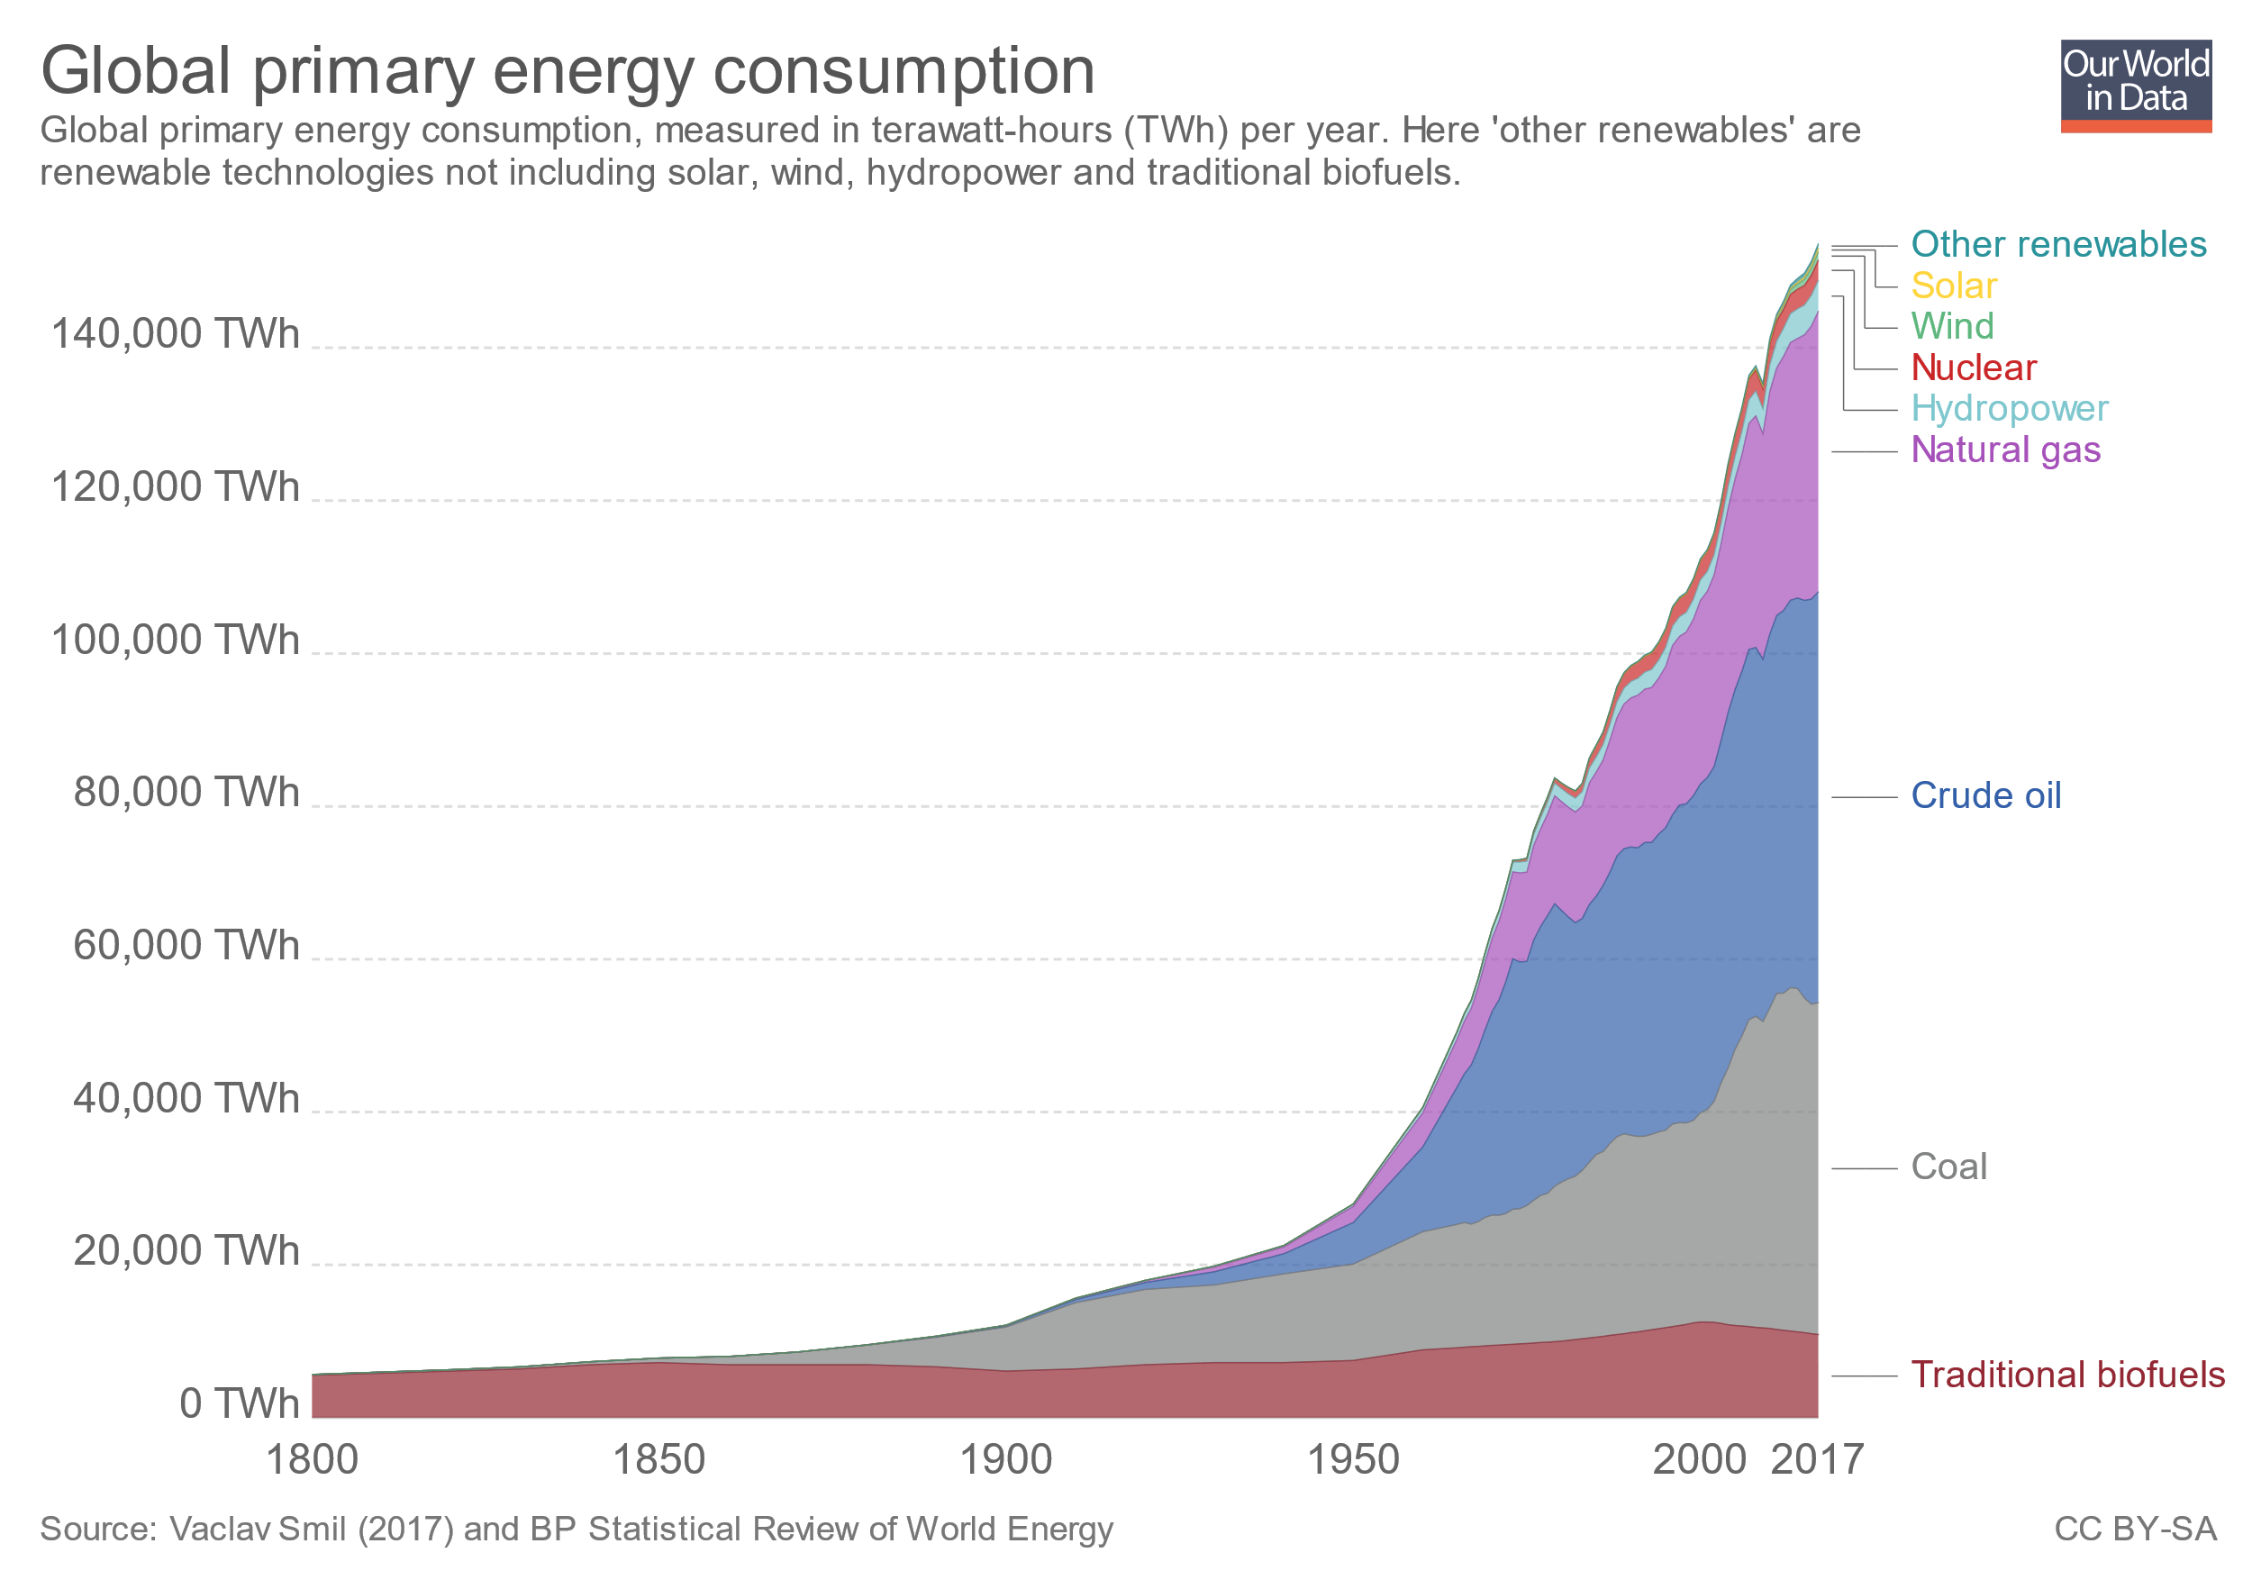
Motivation
Current Usage: 154,000 TWh/year
Expected Growth by 2040: 28% increase
  43,000 TWh/year
  17.2 Billion tons of coal
  8,600 new nuclear power plants
Water oxidation could be the key to solving this energy crisis
  Use sunlight to produce O₂ and H₂
  Burn O₂ and H₂ to get energy and water

Slide 21
Water-In-Salt - FTIR
0 M NaNO₃
7 M NaNO₃

