Slide 1
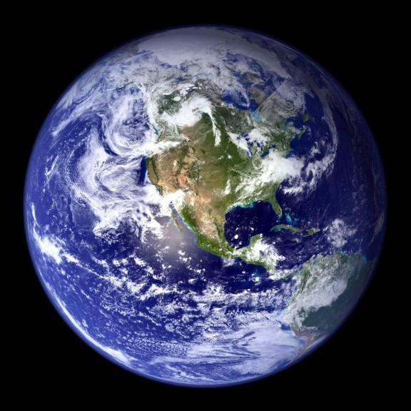

3%
Of all water on Earth is
Freshwater
1%
Human
Of water is available for
Consumption
20%
Approximately
of the World’s Available
Fresh Water Lies Within the
Great Lakes
Notes:
1

Slide 2
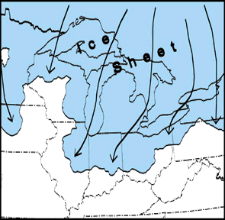
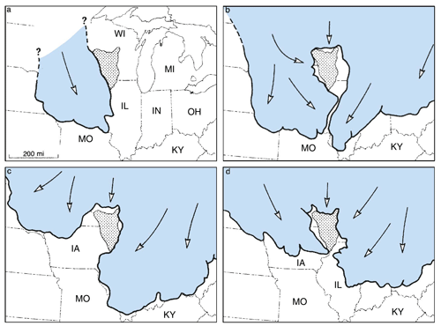

Slide 3
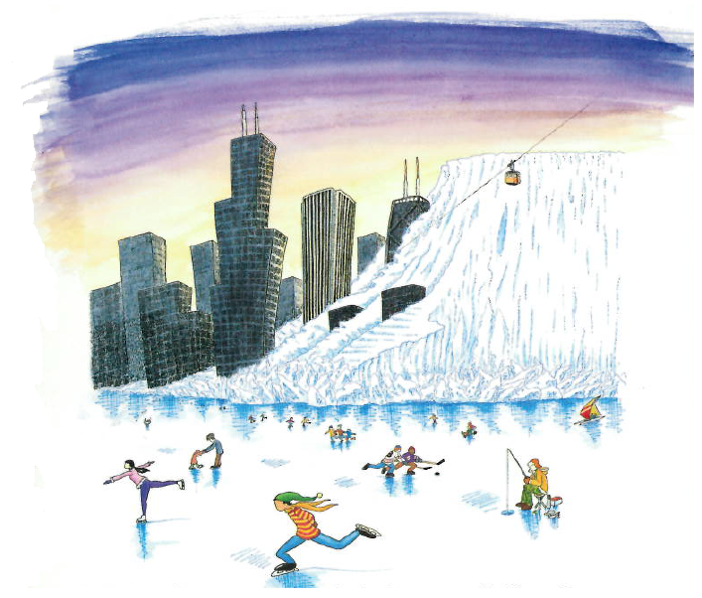

Slide 4
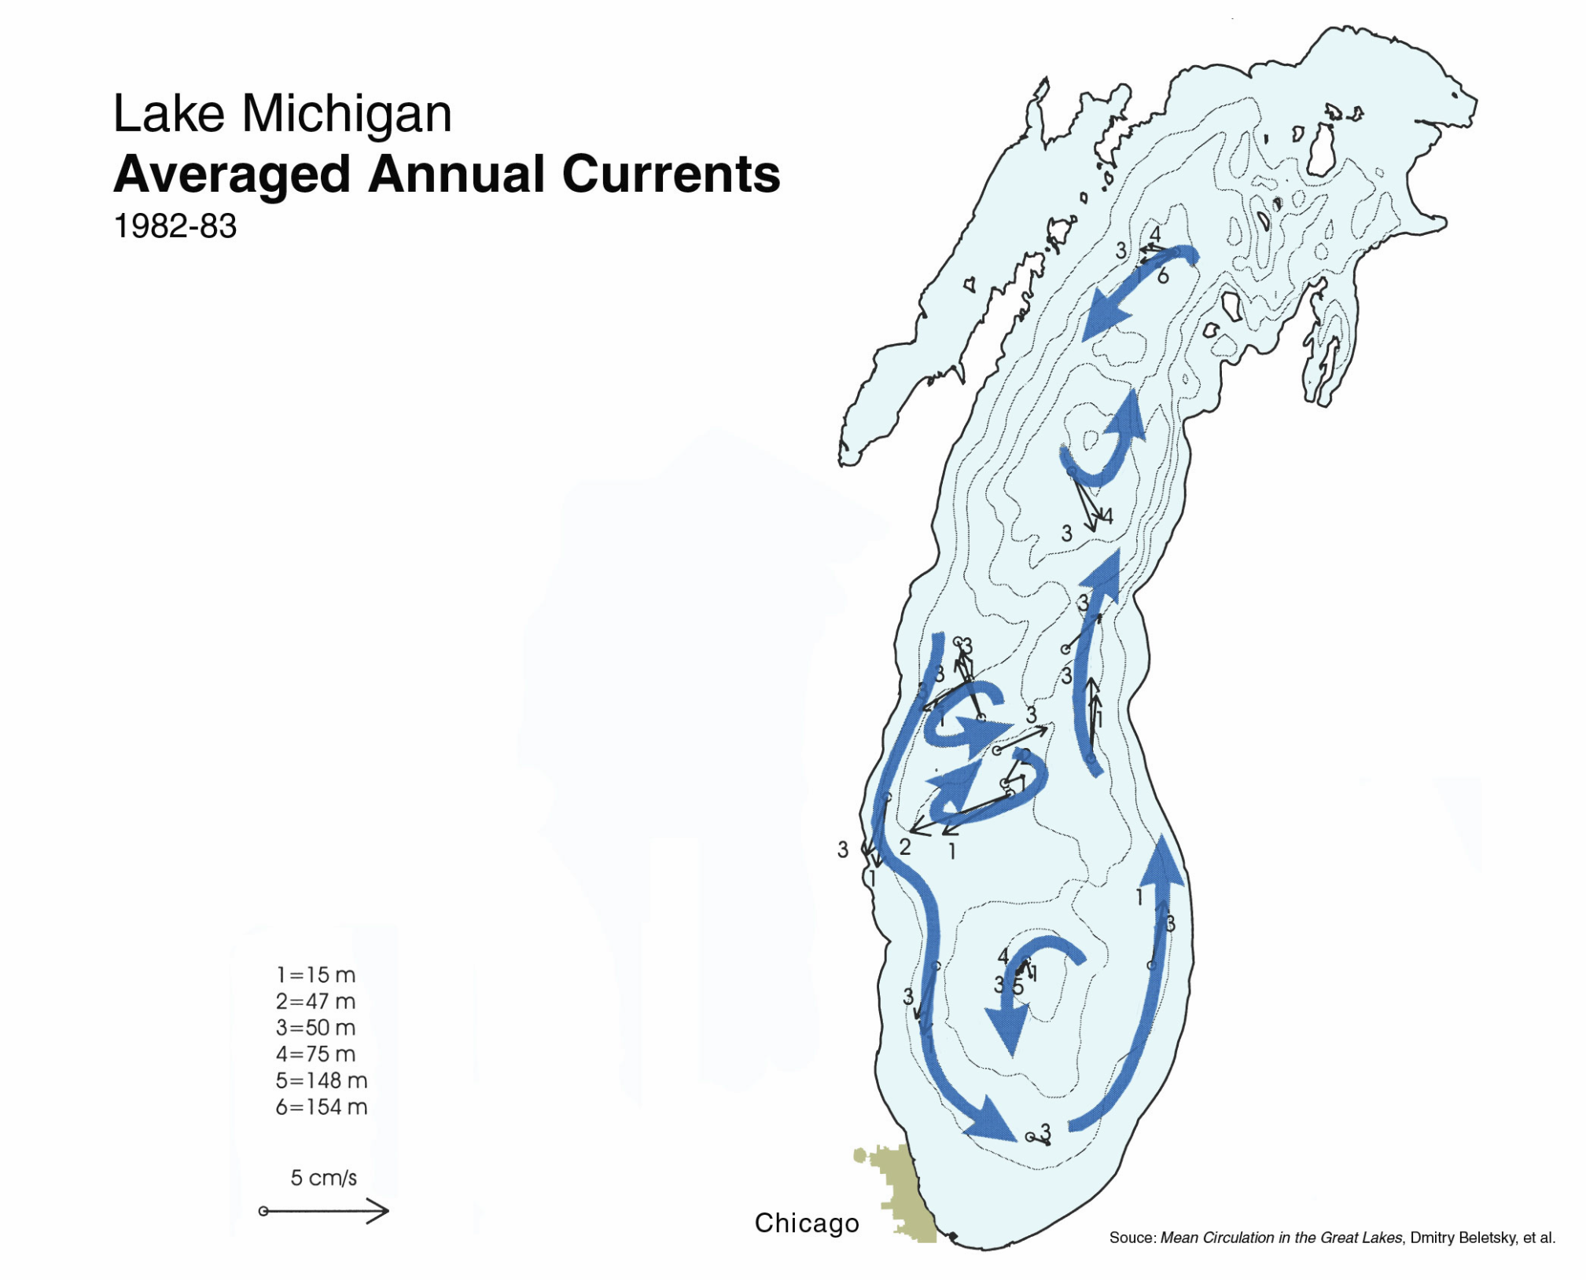
Lake Michigan
Average Annual Currents
1982-1983
Residence time in Lake Michigan:
99 Years
Source: Asian Carp and Separation of the Watersheds, Dick Lanyon Presenter
Original Source: Mean Circulation in the Great Lakes, Dmitry Beletsky, et al.

Slide 5
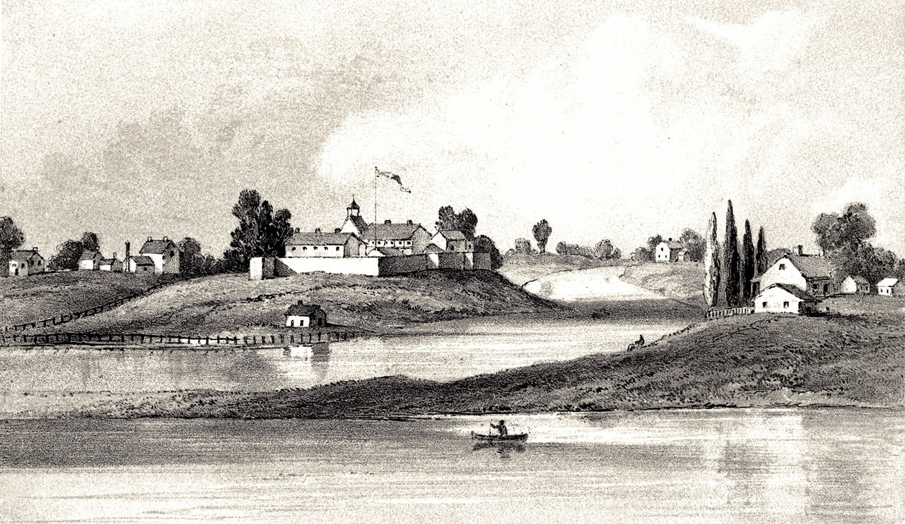
Fort Dearborn near the mouth of the Chicago River, 1831
https://en.wikipedia.org/wiki/Chicago_River#/media/File:Fort_Dearborn_1831_Kinzie.jpg

Slide 6
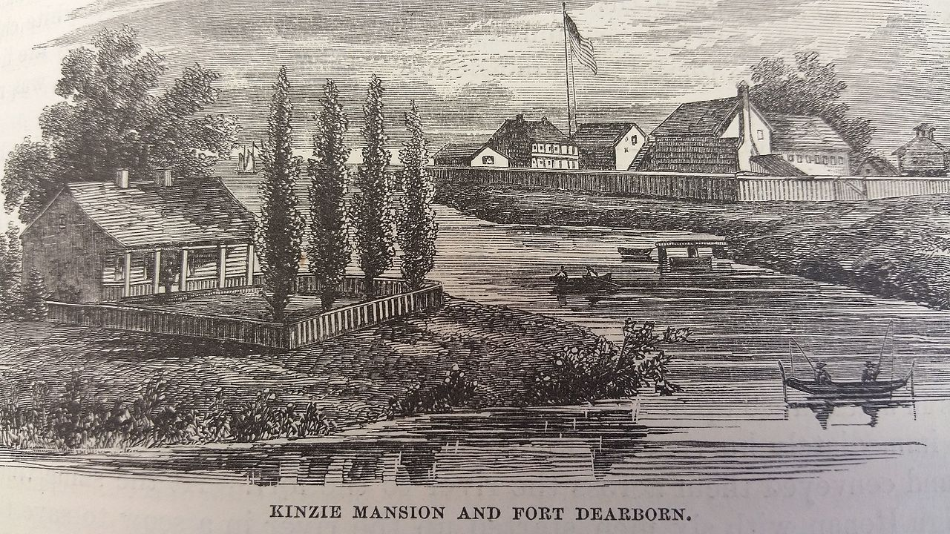
Kinzie Mansion (foreground) and Fort Dearborn (background).
From: The Pictorial Fieldbook of the War of 1812
https://en.wikipedia.org/wiki/Fort_Dearborn#/media/File:Fort_Dearbon.jpg

Slide 7
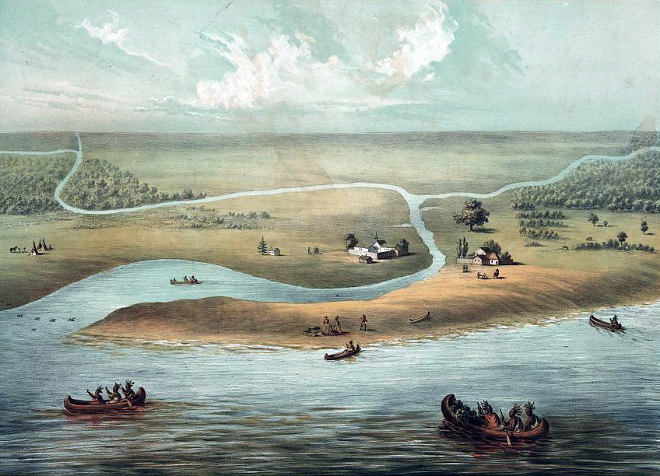
Chicago and Fort Dearborn in 1820
https://en.wikipedia.org/wiki/History_of_Chicago#/media/File:Chicago_in_1820.jpg

Slide 8
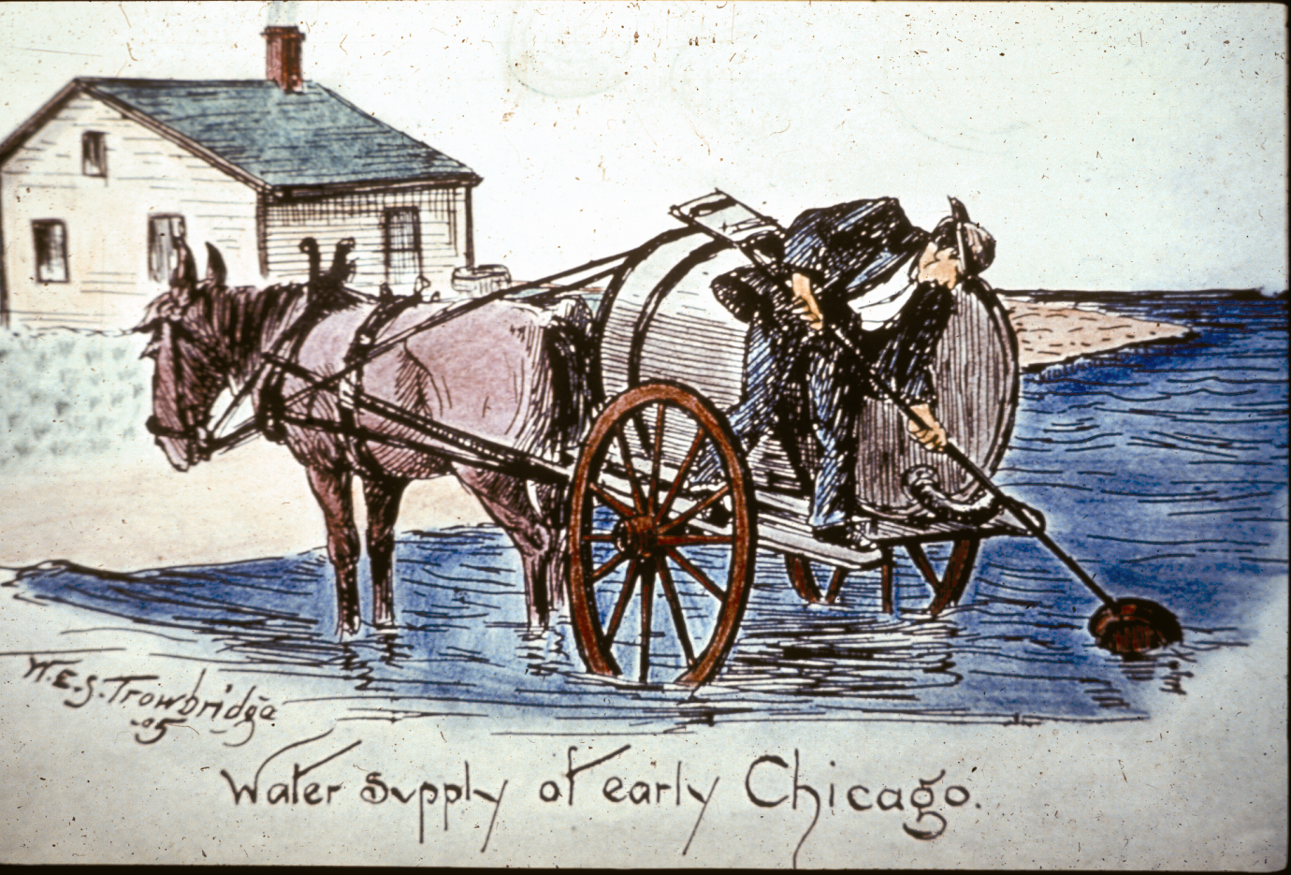
Lake Michigan Supply Replaces
Polluted River Supply

Slide 9
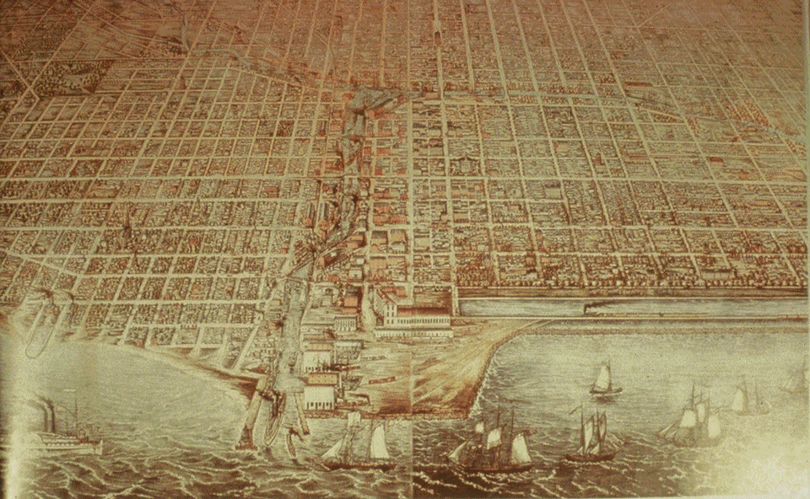
Rapidly Growing City
Courtesy of Chicago Historical Society
Notes:
Industry was booming. The Union Stockyards opened in 1865. While industry and the city grew, public health was deteriorating. Water-born illnesses like cholera, typhoid fever and dysentery caused thousands of deaths.

Slide 10
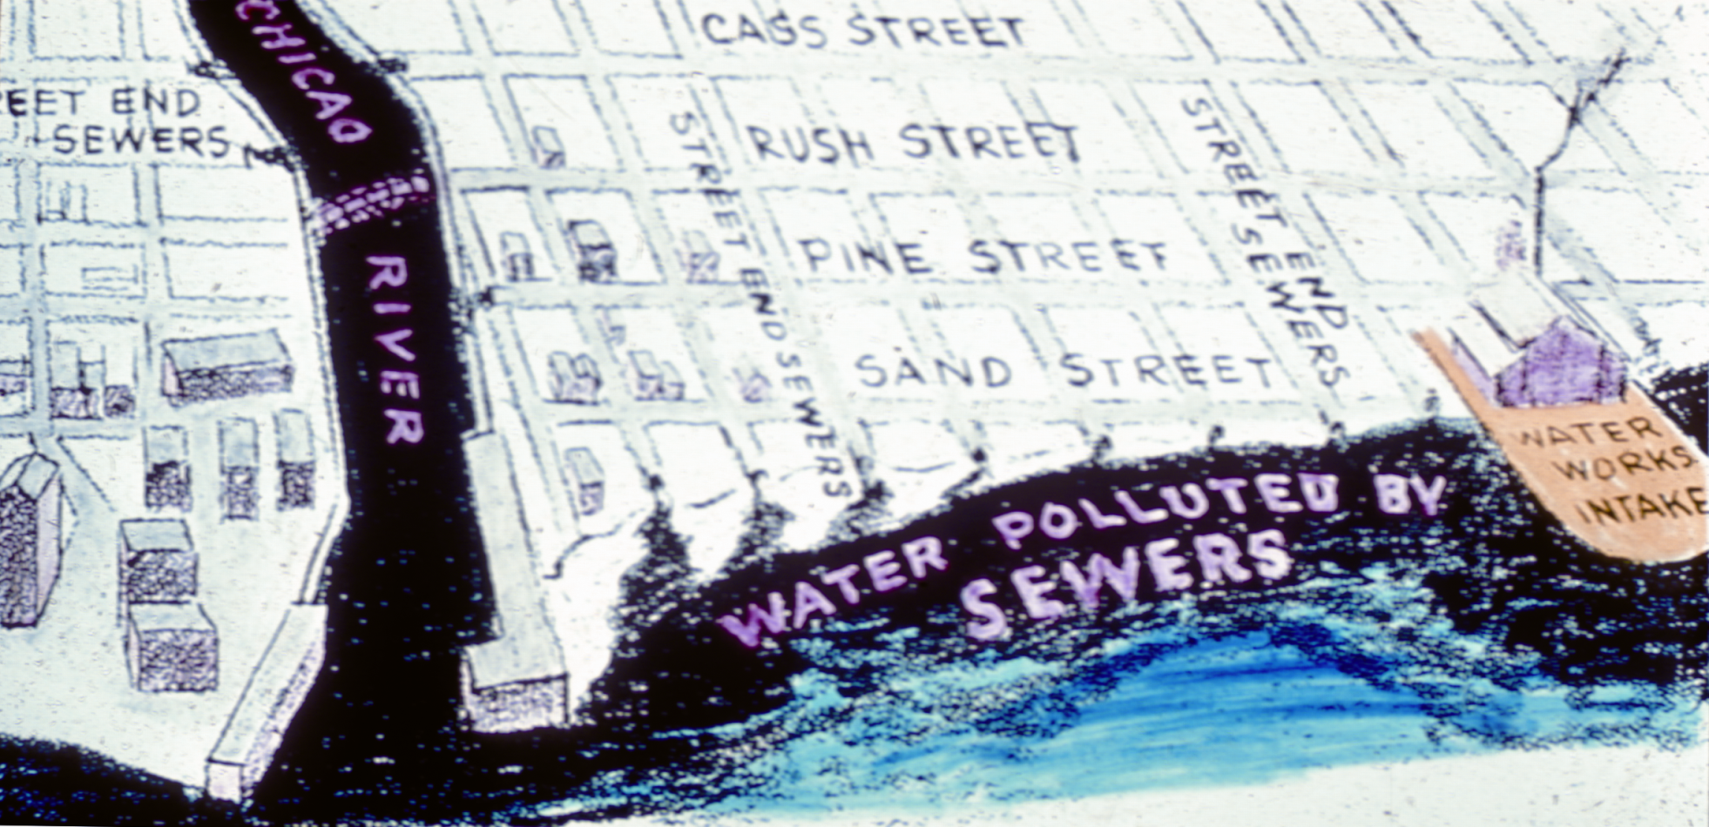
Inherent Conflict
Need a Solution

Slide 11
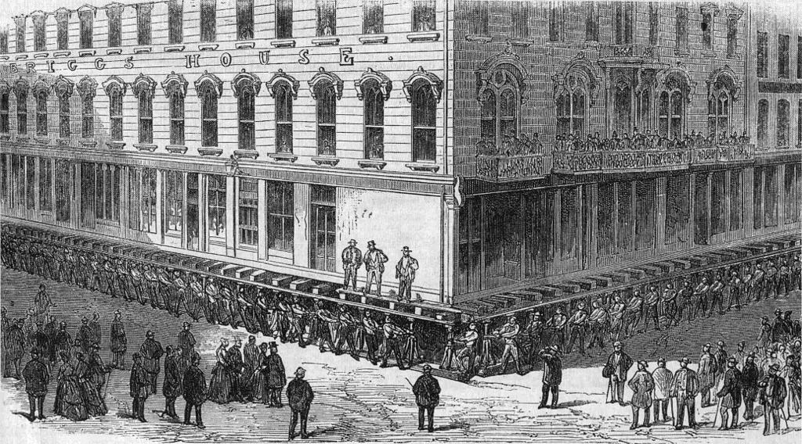

Slide 12
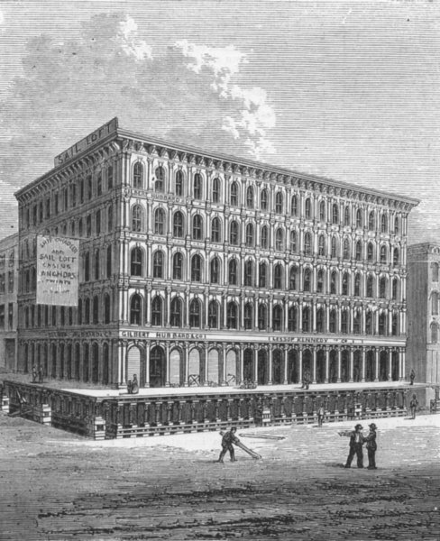

Slide 13
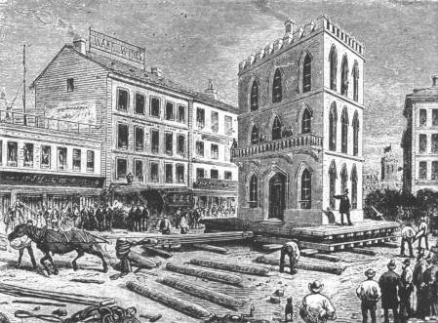

Slide 14
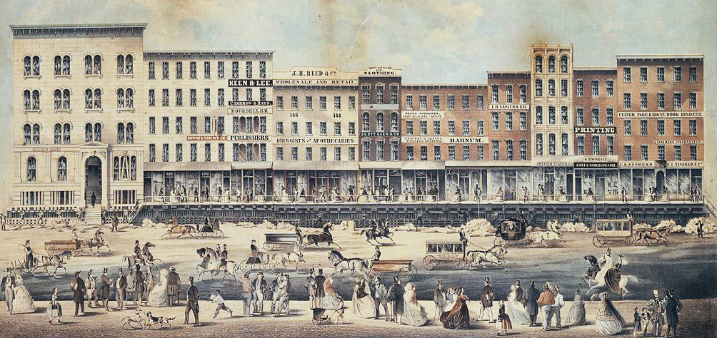

Slide 15
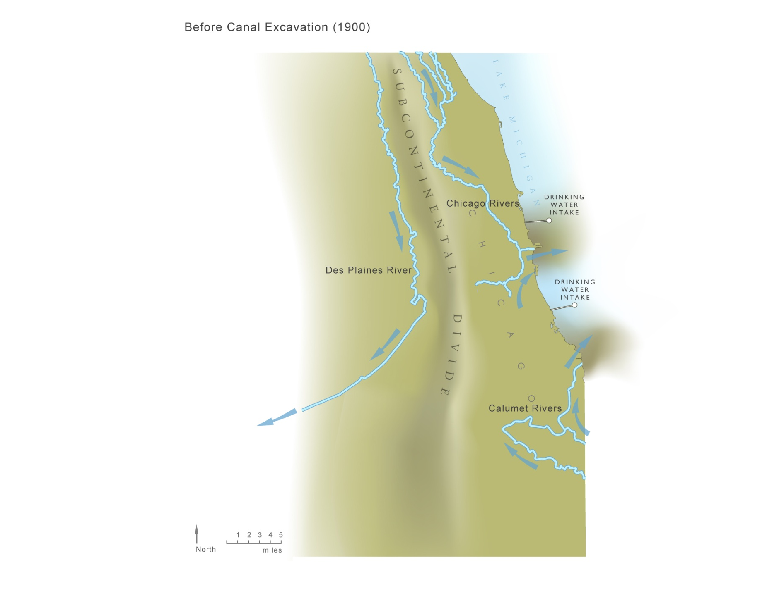
Chicago Area Waterways before 1900

Slide 16
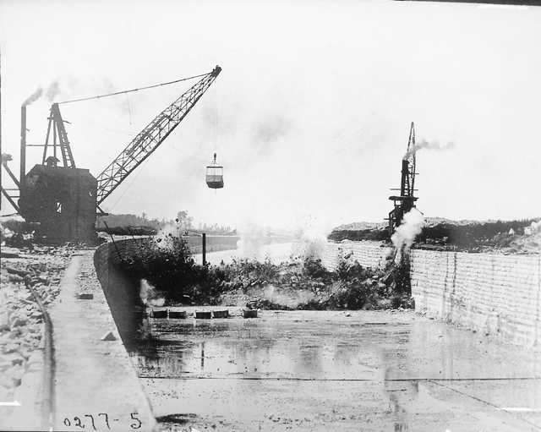
Lake Michigan Watershed
Notes:
16

Slide 17
September 28, 1899

Slide 18
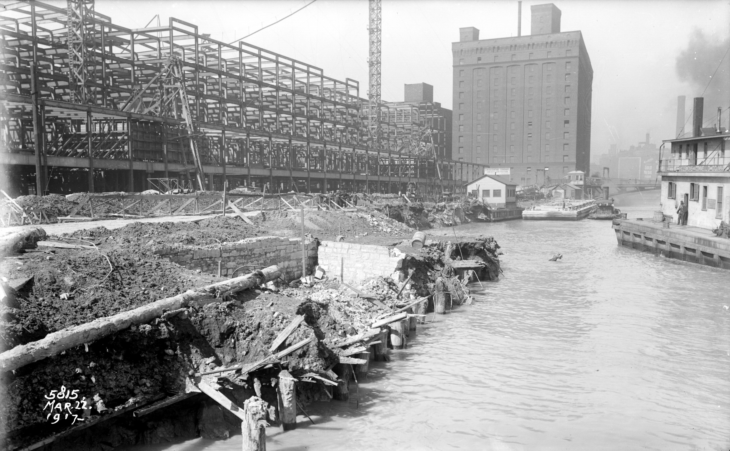
March 22, 1917 - Chicago River between Polk and Taylor Streets

Slide 19
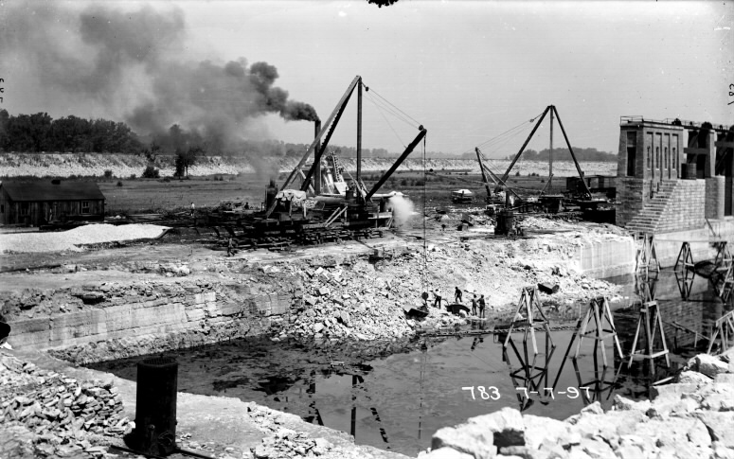
July 7, 1897 – Construction of the Bear Trap Dam at Lockport looking west

Slide 20
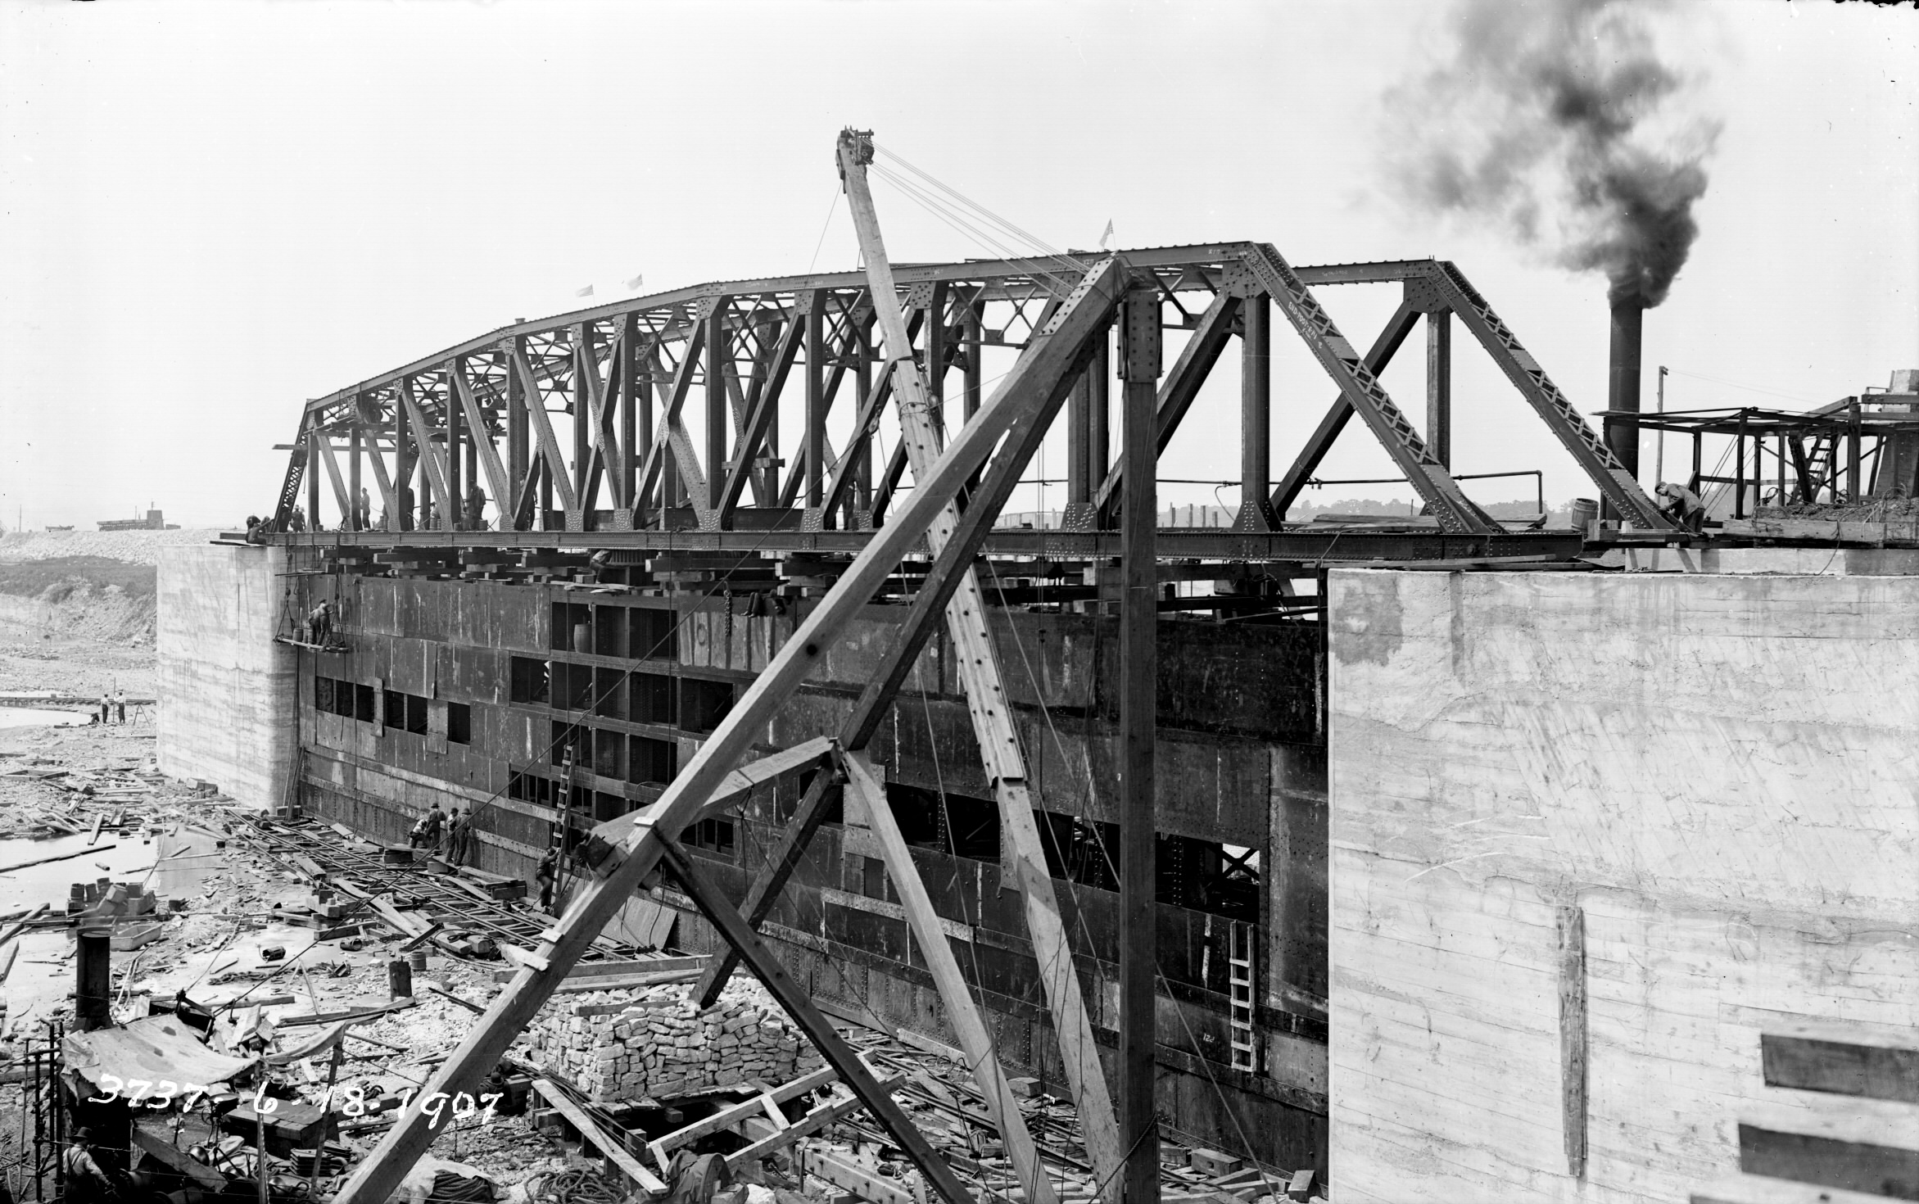
June 6, 1907 – Lockport Powerhouse from point in trail race

Slide 21
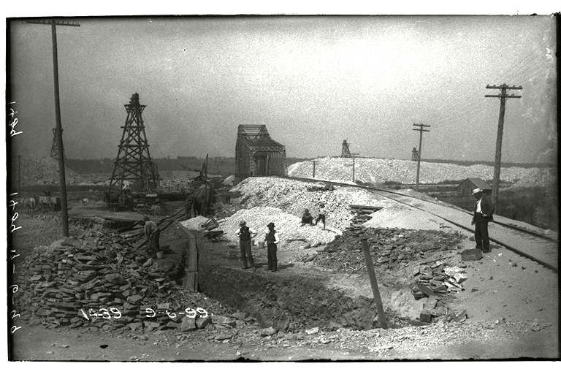
September 6, 1899 - Excavation for foundation of the
Santa Fe Railroad viaduct over Stephen Street.

Slide 22
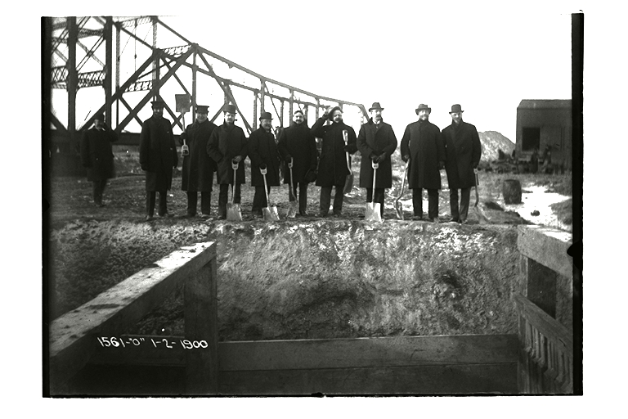
January 2, 1900 - SDC trustees preparing to symbolically dig a channel to connect the
Collateral Channel to the excavated CSSC to start the filling process

Slide 23
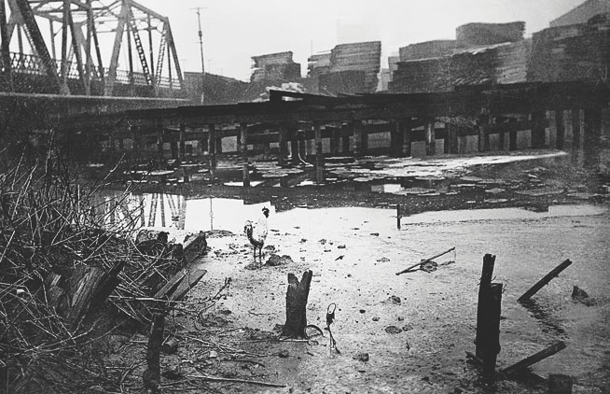
Enter Caption
BUBBLY CREEK, WITH ROOSTER STANDING ON CRUSTED SEWAGE, 1911
COURTESY OF CHICAGO HISTORY MUSEUM
Notes:
23

Slide 24
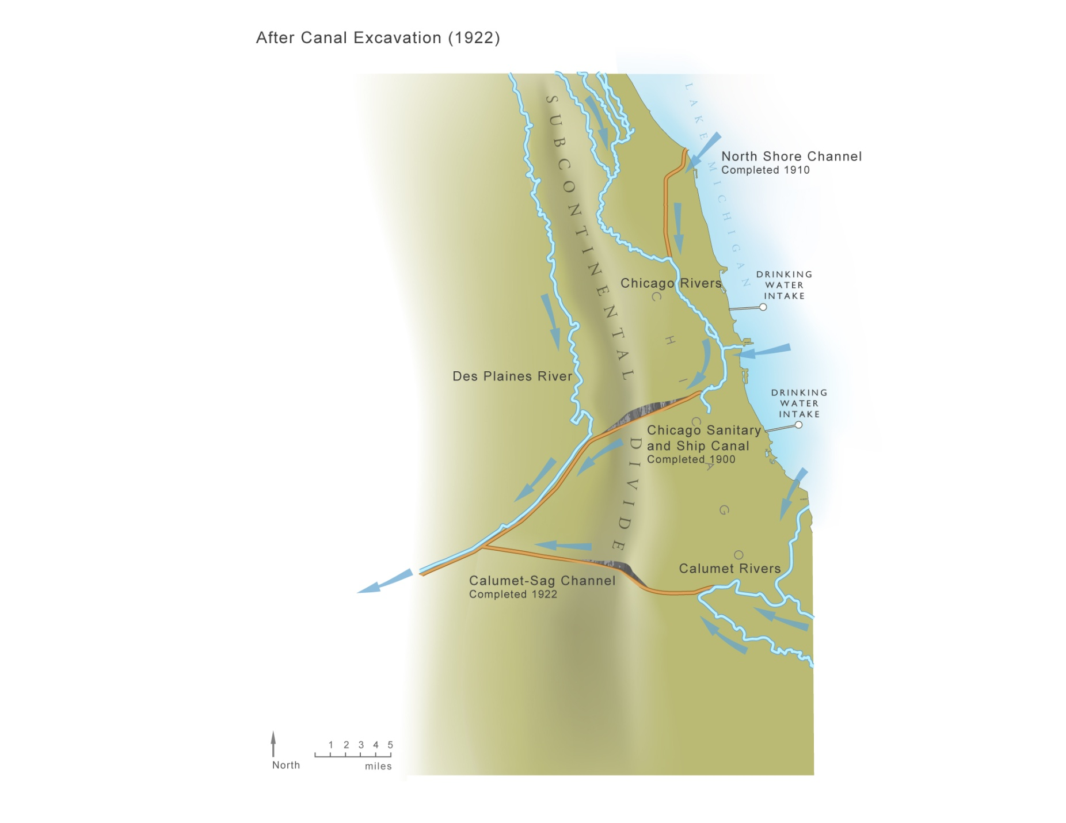
Chicago Area Waterways after 1922

Slide 25
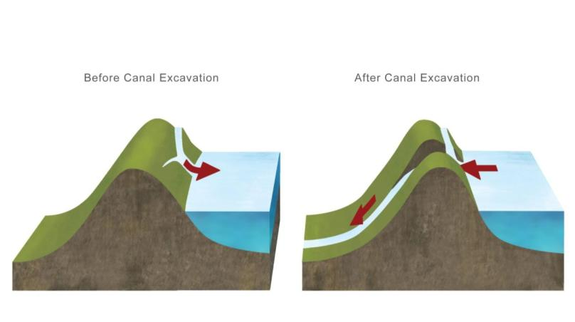
Chicago River Reversal
Notes:
25

Slide 26
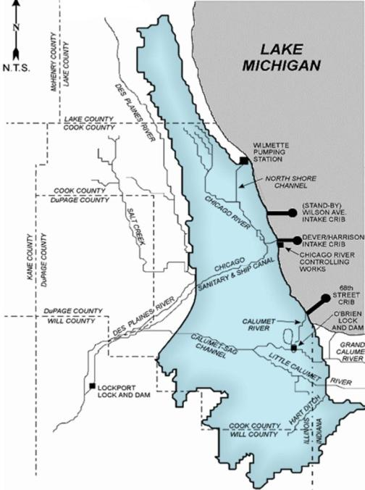
30 Trillion Gallons
Of water have been diverted from Lake
Michigan since 1967

Slide 27
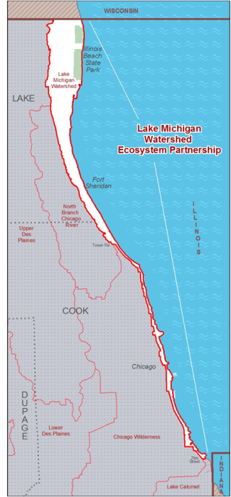
30 Trillion Gallons
Of water have been diverted from Lake
Michigan since 1967

Slide 28
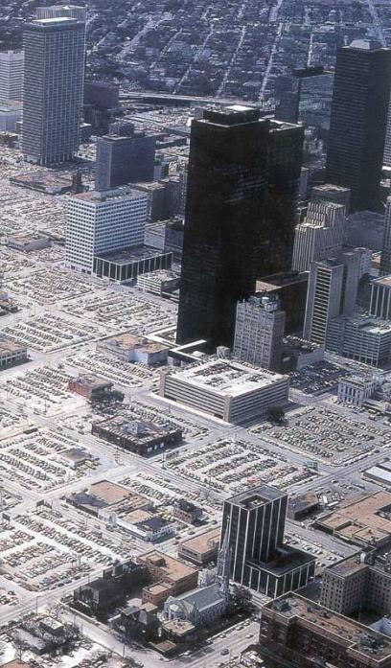
30 Trillion Gallons
Of water have been diverted from Lake
Michigan since 1967
42%
Of Cook County is impervious

Slide 29
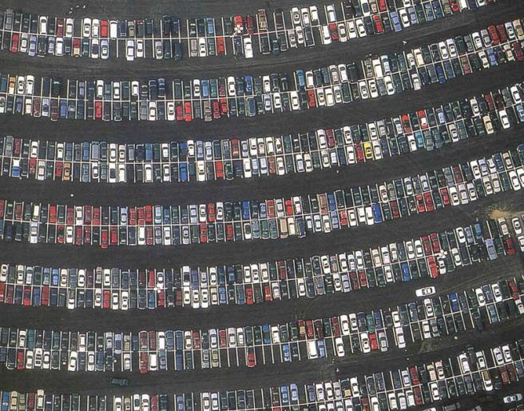
30 Trillion Gallons
Of water have been diverted from Lake
Michigan since 1967
42%
Of Cook County is impervious

Slide 30
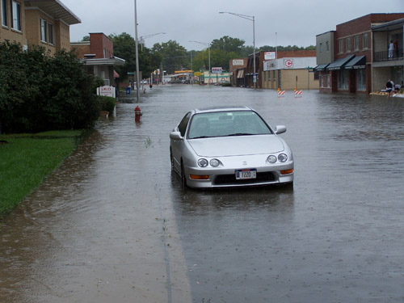
30 Trillion Gallons
Of water have been diverted from Lake
Michigan since 1967
42%
Of Cook County is impervious
60%
Of rainfall is under ½” episodes

Slide 31
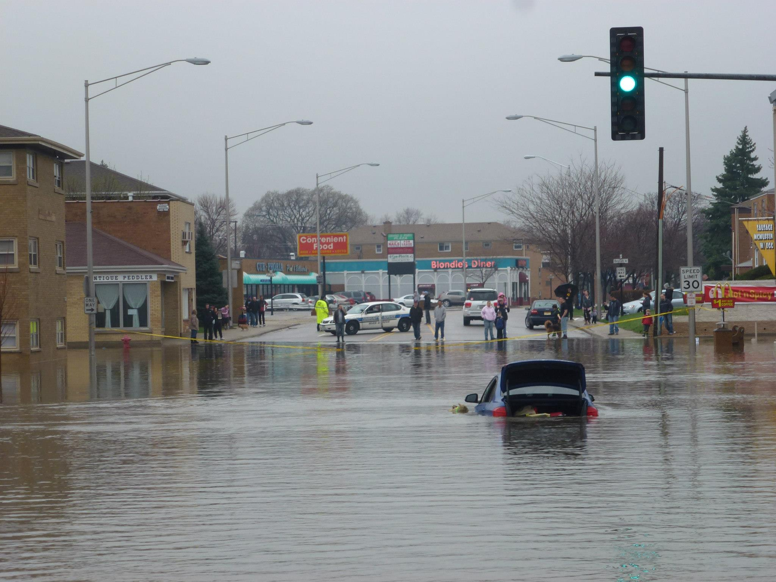

Slide 32
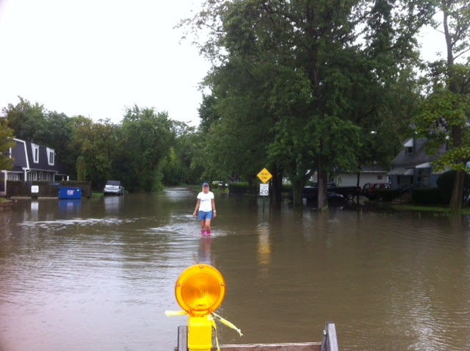

Slide 35
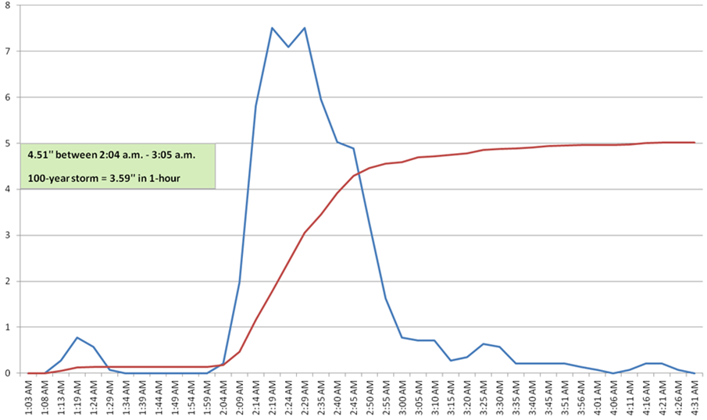

Oak Lawn/Burbank, 8.22.2014, 1:03 a.m. – 4:31 a.m.
7.5
7.5
4.9
5.01
4.7
3.2
0.8
0.81
0.78
0.1
0.1
0.23

Slide 36
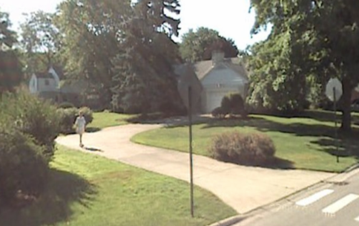
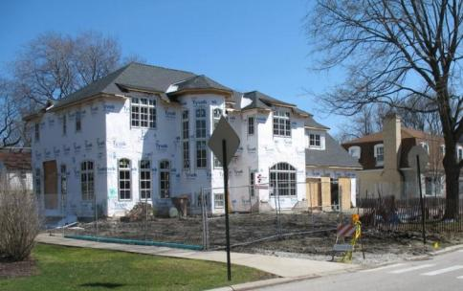
Runoff
Teardowns increase
& reduce
Permeability
1998 Home:
3,560 sqft
Impervious Area
2008 Home:
5,650 sqft
Impervious Area

Slide 37
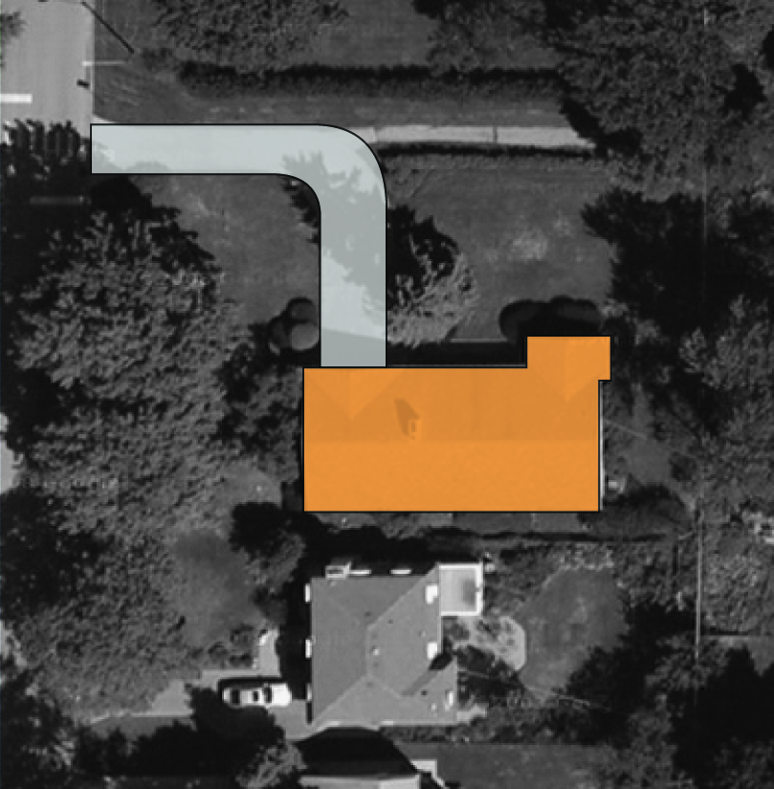
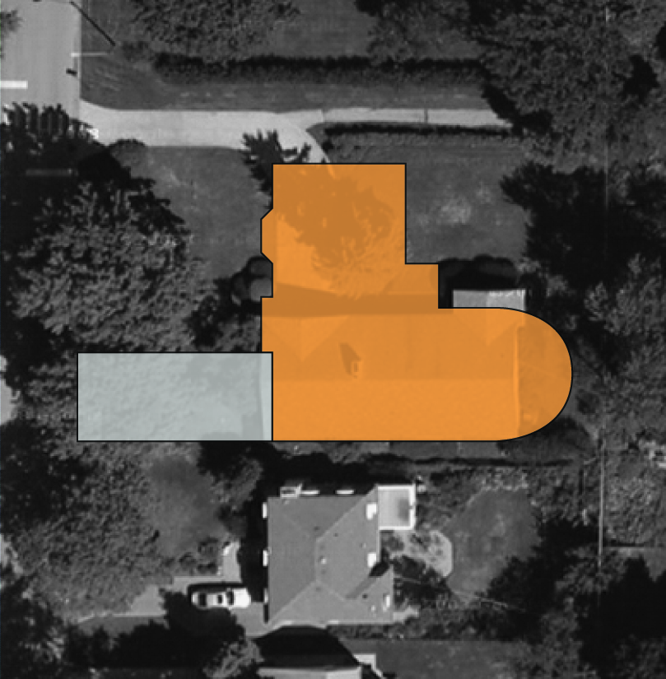
Runoff
Teardowns increase
& reduce
Permeability
1998 Home:
3,560 sqft
1,560 SQFT
Impervious Area
3,650 SQFT
2,000 SQFT
2,000 SQFT
2008 Home:
5,650 sqft
Impervious Area

Slide 38
Runoff
Teardowns increase
& reduce
Permeability
Increase in Annual Runoff
 | Bldg Size (ft²) | Total Impervious Area (ft²) | Lot Percent Impervious | Increase in Runoff from 1954 (gal)
1954 original | 1,600 | 3,160 | 23% | --
1998 remodel | 2,000 | 3,560 | 26% | 9,000
2008 rebuild | 3,650 | 5,650 | 41% | 50,000 gallons
1998 Home:
3,560 sqft
Impervious Area
2008 Home:
3,650 SQFT
5,650 sqft
2,000 SQFT
Impervious Area

Slide 39
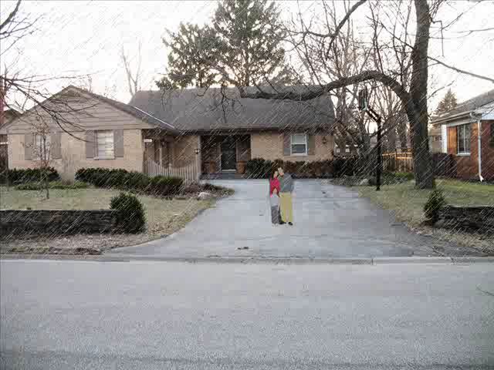


Slide 40
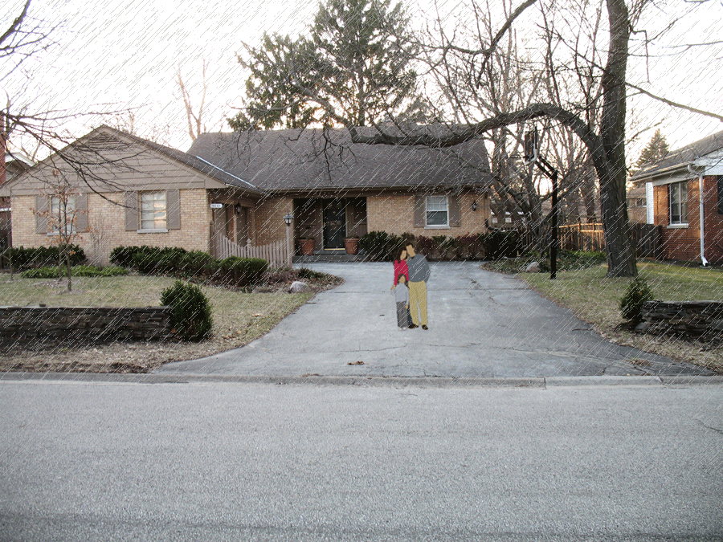

Slide 41
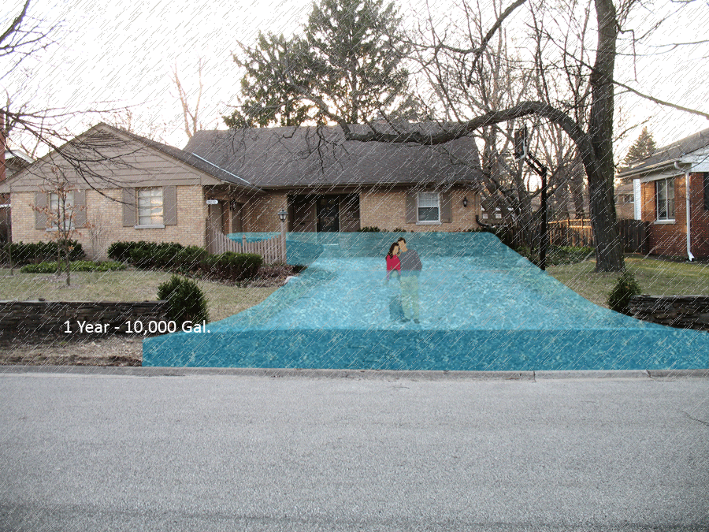

Slide 42
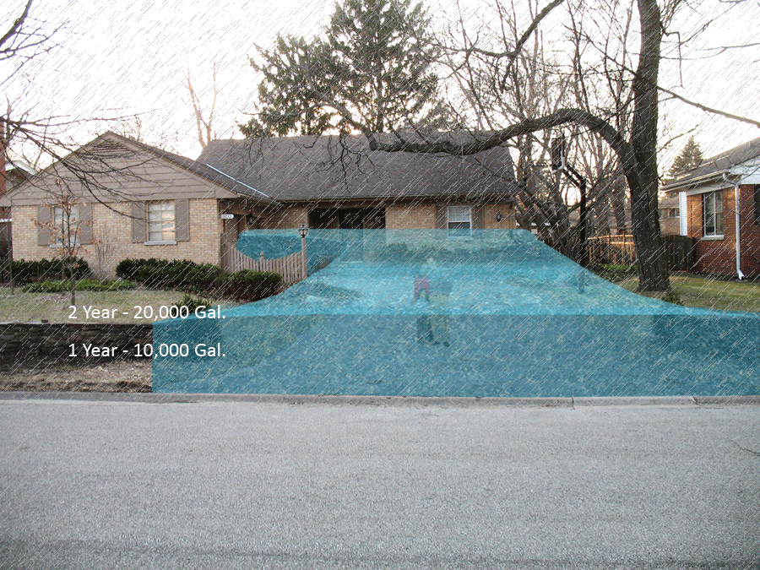

Slide 43
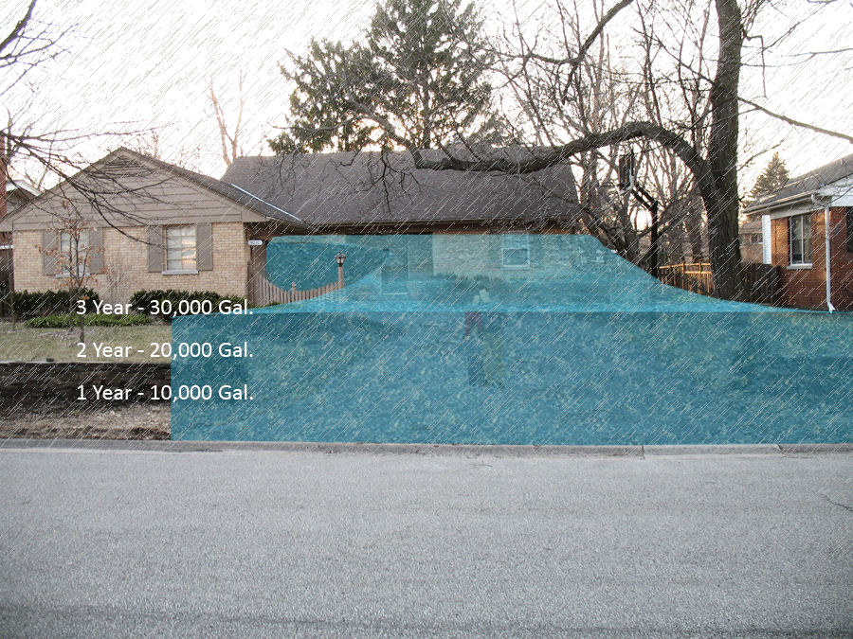

Slide 44
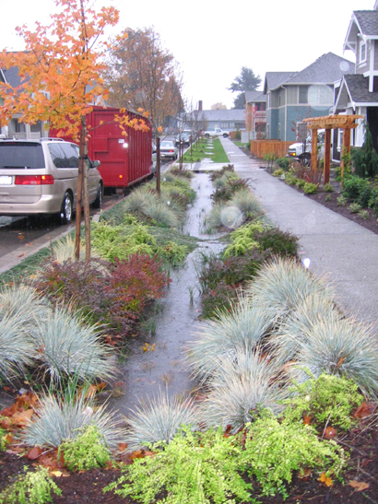


Slide 45
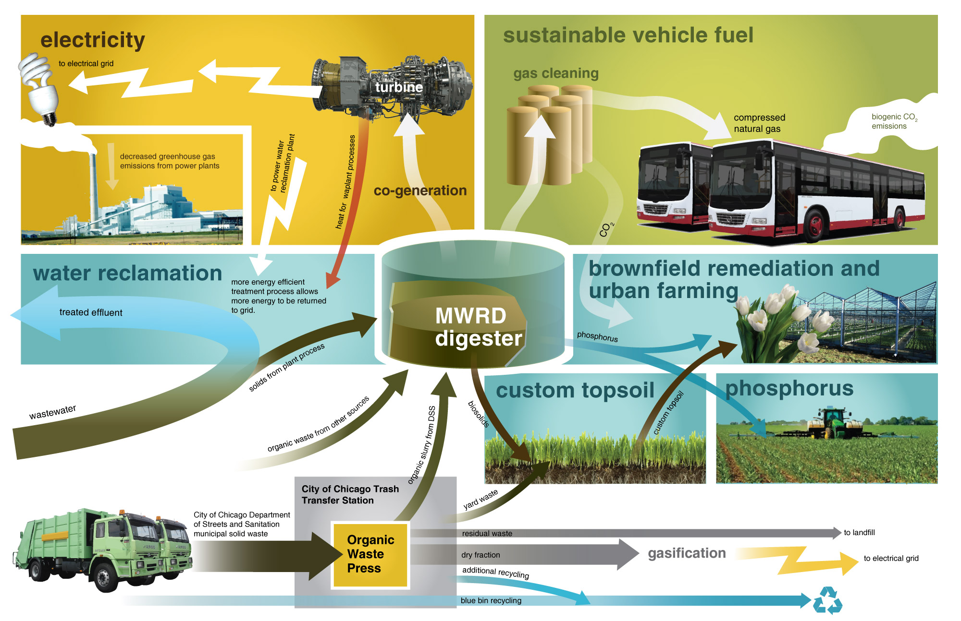
Sustainability: A New Paradigm
Notes:
^{MWRD Facility Improvements}
Generating up to 80 MW of electricity from sewage treatment solids and organic matter
Capturing and using heat energy from co-generation facilities
Save $20 million per year in wastewater plant ^{electricity purchase costs}
Generating $9 million per year in electricity revenue
Eliminating 850,000 tons per year of waste to landfills
Eliminating $38 million per year in landfill ^{tipping fees}
Producing up to 35 million equivalent gallons of gasoline per year of CNG vehicle fuel
Reducing 488,000 MT eCO2/yr greenhouse gases from fossil fuel ^{power plants emissions}
Reducing 357,000 MT eCO2/yr greenhouse gases from vehicle emissions
Recovering 10,000 tons per year of phosphorus as a slow-release fertilizer

Slide 46
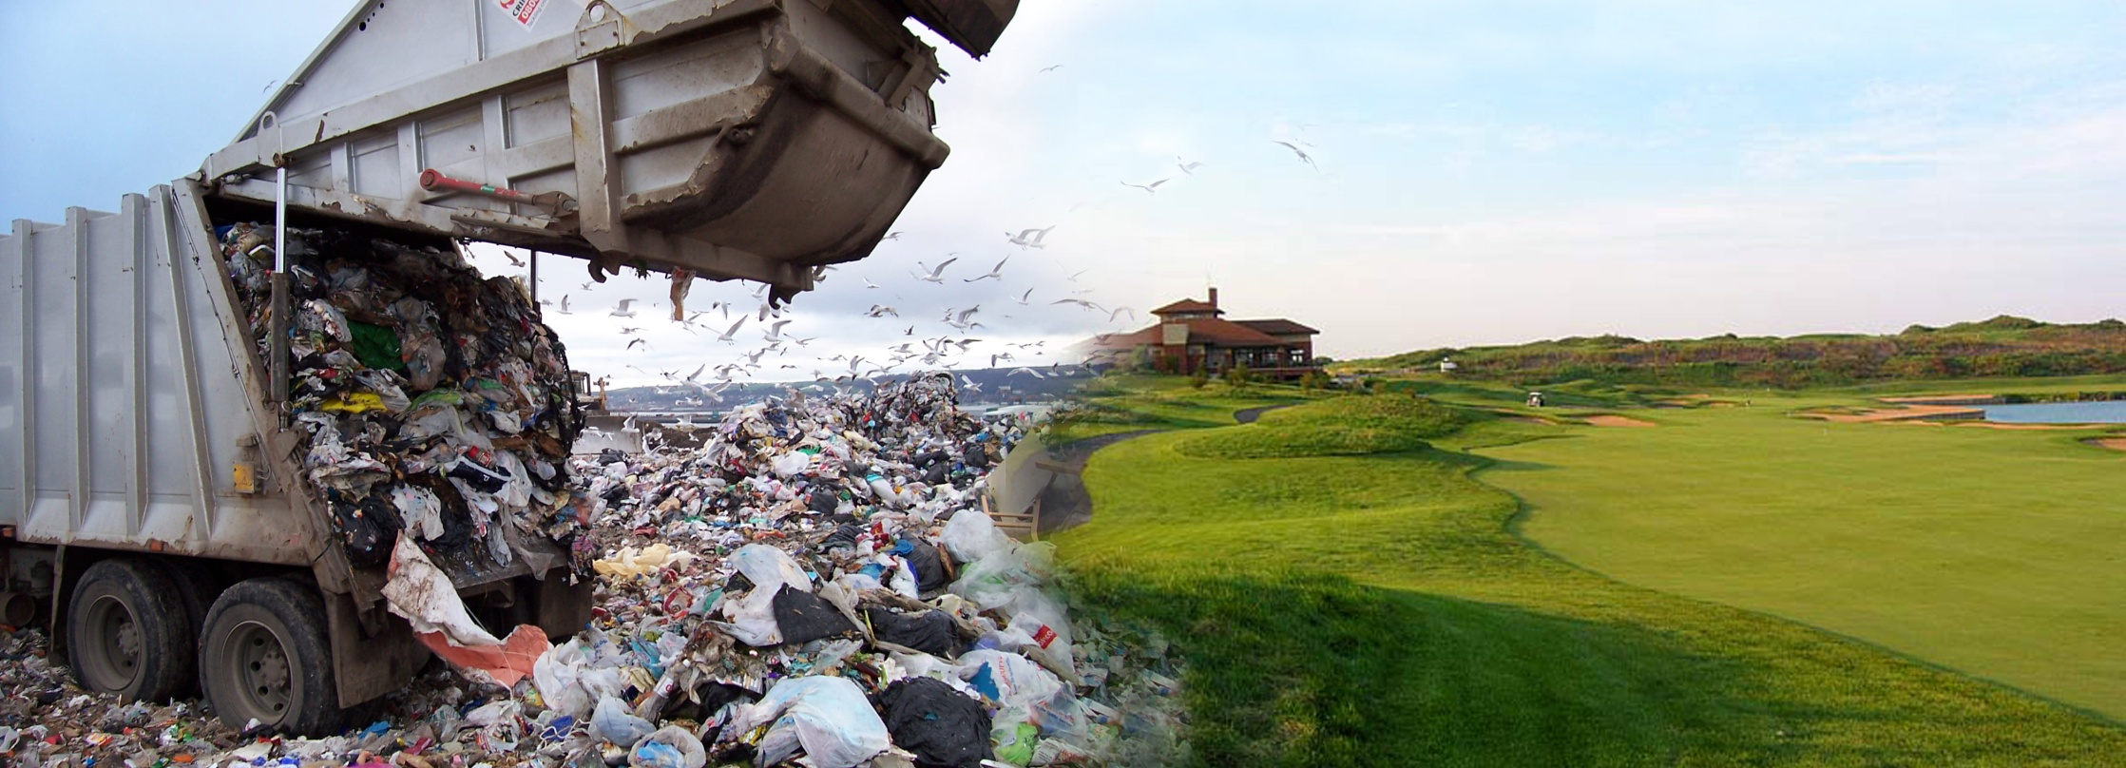
Sustainable Landscape
Dramatically Reducing Landfilling of Wastes
30% of 1,000,000 tons are organic
30% Syngas Fuel
20% Recycle Product
Notes:
A significant reduction of landfill waste is possible. Chicago’s Blue Bin program has been implemented to reclaim recyclable plastic, metal and paper, but there is also valuable material in the black bins. An additional 15% of the waste in the black bins may be recovered for recycling. Organic matter can be extracted from the black bins using a screen and press process; as a result, 30% of black bin waste could go to the MWRD for anaerobic digestion. Of the remaining 55%, 30% may be suitable for producing syngas in a gasification process. The syngas can be combusted for electricity generation. This would reduce the overall volume of black bin residuals sent to the landfill to 15% of the current volume, a reduction of 85%.

Slide 47
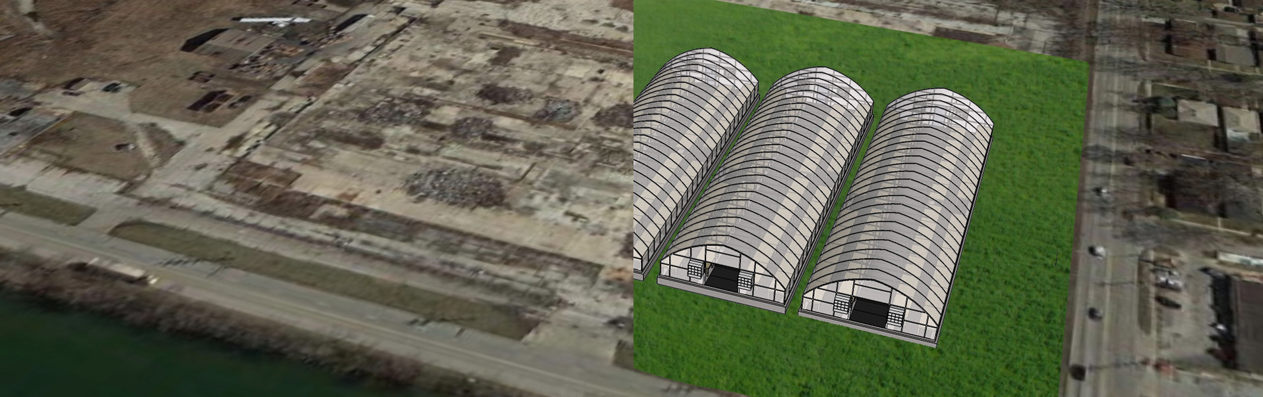
Sustainable Support
Brownfield Mitigation / CO2 Recovery
Millennium Reserve
Green Infrastructure
Notes:
Brownfields could be converted into recreational parks, rain gardens, and commercial greenhouses using the blend of composted biosolids and yard waste blend to build healthy soil and turf surfaces.
Carbon dioxide produced from biogas cleaning processes could be used as a supplement to increase productivity and improve the economic viability of greenhouses and algal ponds installed on reclaimed brownfields.

Slide 48

Sustainable Energy
Creating Electricity from Sewage Solids and Organic Waste Materials
MWRD Footprint 13 MW
Minor Modifications 22 MW
Waste to Energy Potential 80 MW
Notes:
The MWRD Stickney and Calumet plants require on average 45 MW of electricity. MWRD digesters currently produce enough biogas to generate 13 MW of electricity, which could be used to offset this demand. With treatment plant process modifications based on new technologies, the electricity generation can be increased to 22 MW, and the plants’ energy demand reduced to 35 MW. Co-digestion of treatment plant solids with the addition of high-strength organic solids and waste material from black bins, institutional food waste, industrial food processing waste, high-strength industrial waste, fats, oils and grease and biodiesel processing waste, can produce up to 80 MW of electricity. Since the two largest MWRD facilities, Stickney and Calumet, could potentially require 35 MW of electricity, up to 44 MW of electricity could be sold back to the grid, which is enough to power about 13,200 homes.

Slide 49
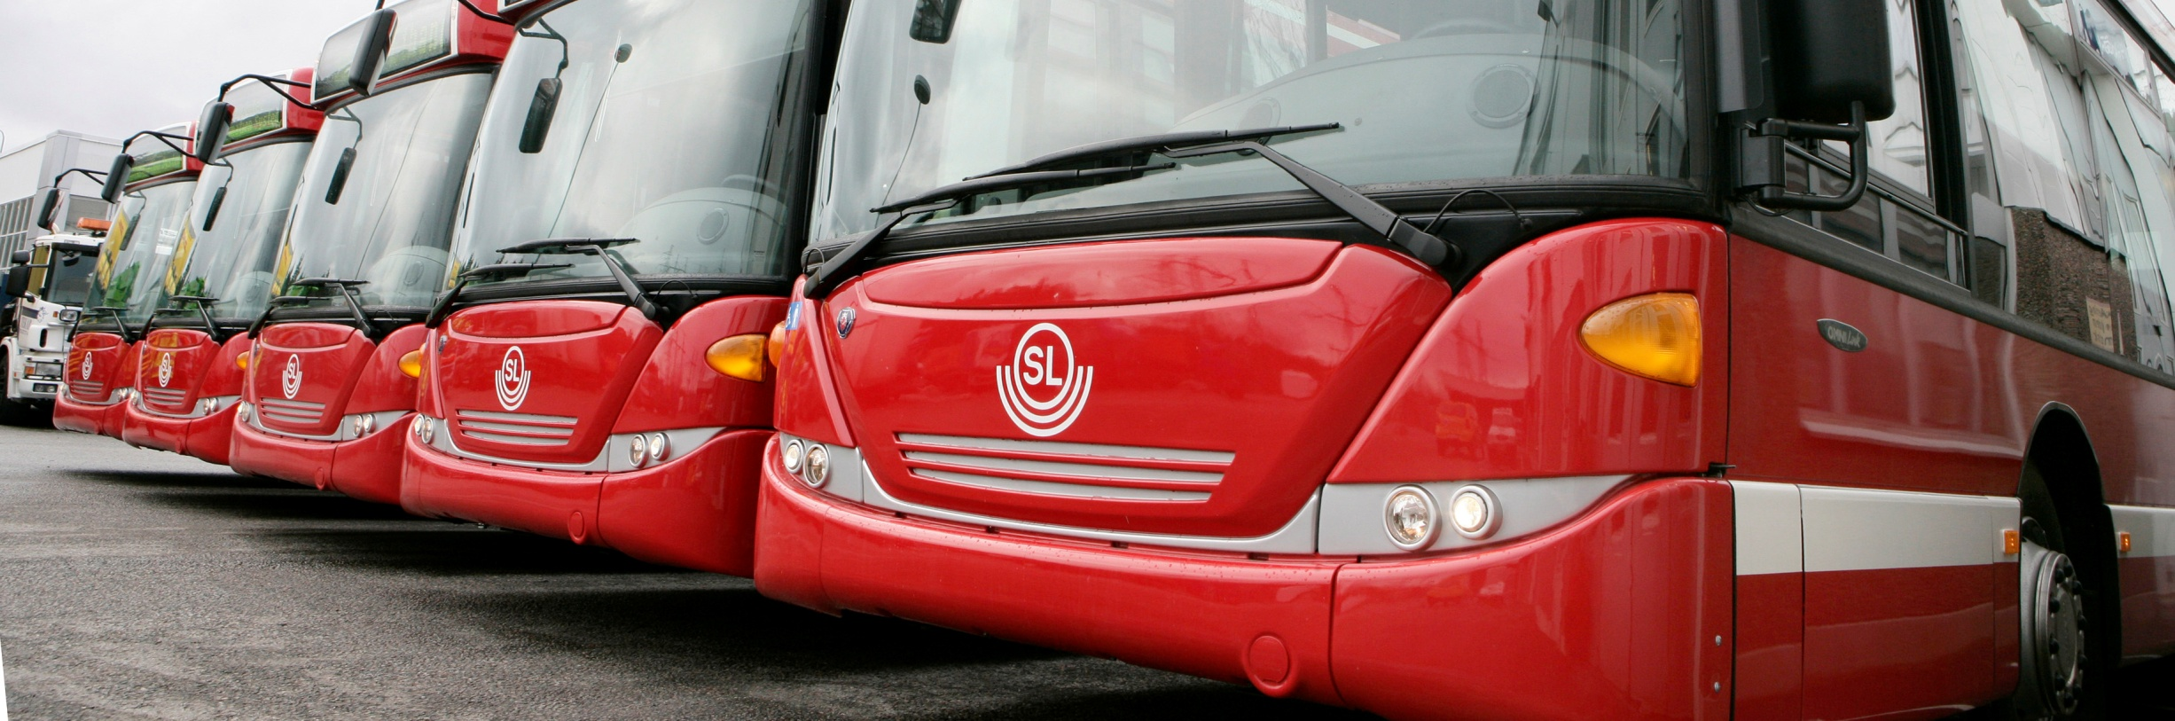
Sustainable Fleet
CTA, City of Chicago, Parks, MWRD
Compressed Natural Gas
Notes:
The additional natural gas produced in MWRD digesters can be converted to compressed natural gas (CNG) for vehicle fuel in sufficient amounts to offset 35 million equivalent gallons of gasoline per year.
The resulting steady supply of CNG could also be made available to the public and reduce the CTA’s and City of Chicago’s reliance upon gasoline and diesel fuel.
The city fleet uses about 8 million gallons of fuel per year. If the entire fleet were to be converted to CNG that would result in a reduction of 8,000 MT eCO₂ ^{per year.}

Slide 50
Notes:
Sewage solids combine with high strength waste, food waste, and FOGs in anaerobic digesters where bacteria systematically break down organic matter into simpler compounds, producing digester gas or “biogas”. Biogas is about 60% methane, 35% carbon dioxide, and 5% volatile organic and sulfur compounds.
Source: “MWRD Perspectives on Co-Digestion and Biogas Utilization” – Thomas Kunetz

Slide 51
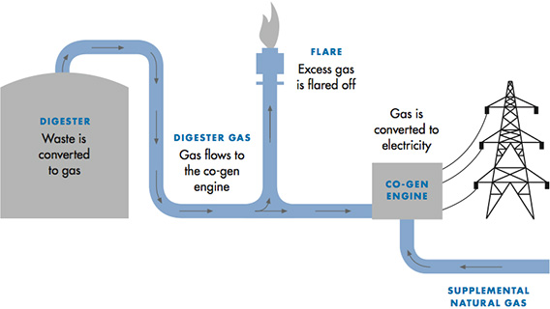

Slide 52
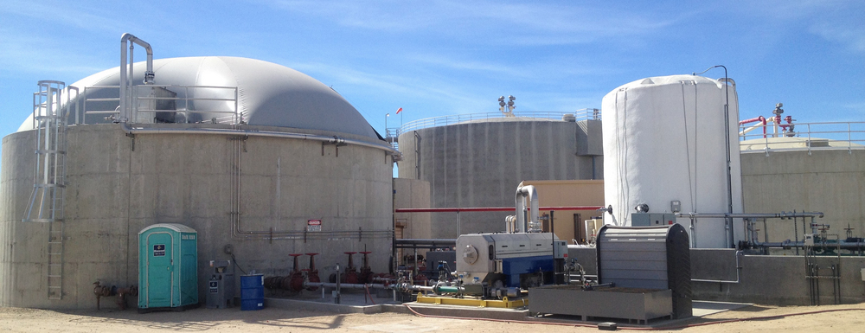
Biogas production at MWRD
Average Production from 2007-2009
3,400 Mcf/day
Future Production:
6,722+ Mcf/day

Slide 53

Sustainable Soils
Class A Biosolids: 140,000 tons/year
City of Chicago Yard Waste Blend
Reduction in maintenance costs – better results
Notes:
Chicago and the MWRD have the resources available to produce a unique blend of custom topsoil by combining biosolids and residential yard waste. The blended product has a greater range of uses than either product alone, and would help reduce landscaping costs for the city, park district, and local municipalities and provide a revenue source if sold to the public.

Slide 54
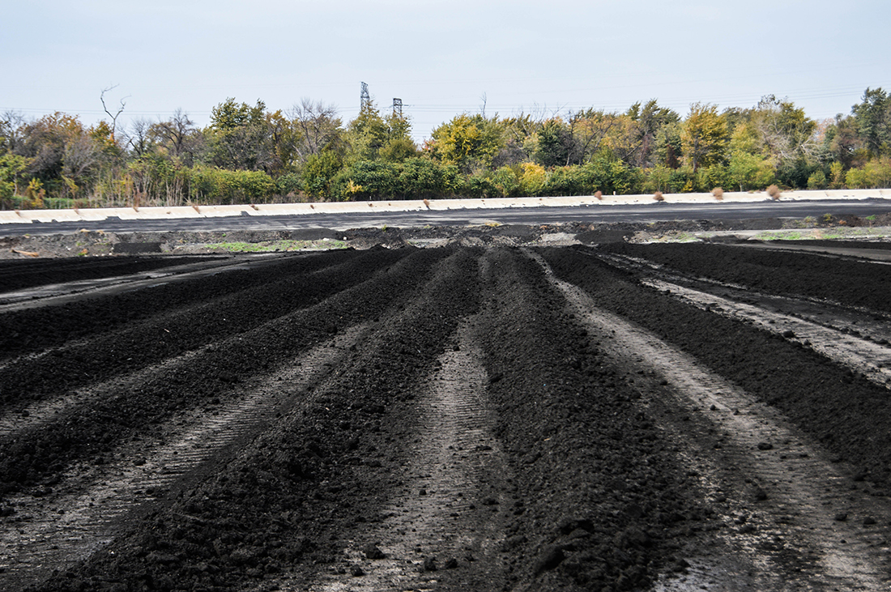

Slide 55


Slide 56

Science behind Biosolids Recycling
Pathogens removed
Metals below levels of concern and further immobilized in soil
Many metals are actually plant nutrients
Organic contaminants generally not present or at very low levels

Slide 57

Sustainable Water Management
Exploring opportunities for water reuse
Disinfecting wastewater effluent

Slide 58

Disinfection
Disinfection method at O’Brien
Ultraviolet Light
Disinfection method at Calumet
Chlorination

Slide 59

Sustainable Reduction
Deammonification / Denitritation
40% Energy Reduction – WERF 60% - 80%
Notes:
The MWRD has the ability to reduce energy consumption at water reclamation plants with modifications to the wastewater treatment process without reducing the quality of the effluent. For example, it is possible for the MWRD to reduce electricity demand at water reclamation plants by 120,000,000 kWh per year by converting from an activated sludge process to a mainstream denitritation process.

Slide 60

Sustainable Recovery
Closing the Phosphorus Cycle
Non-renewable resource
High Quality Environmentally Friendly Phosphorus
10,000 Tons Annual Yield Potential
Notes:
Phosphorus is a non-renewable resource and is essential for all life; there are no substitutes. It is essential for high-yield agriculture and a myriad of industrial uses. World supplies are dwindling. The MWRD has the means to recover up to 10,000 tons per year of phosphorus and convert it into a usable, marketable product. Recovering phosphorus locally is sustainable versus the alternative: rock mining and transporting tremendous distances.

Slide 61



Phosphorus Removal & Reuse
Ostara Phosphorus Recovery creates
Crystal Green Fertilizer
ClearAs Water Solutions can create
Bioplastics

Slide 62
“Life can multiply until all phosphorus has gone, and then there is an inexorable halt which nothing can prevent.”
— Isaac Asimov

Slide 63


Slide 64

http://ostara.com/mwrd/
http://ostara.com/mwrd/

Slide 65

http://crystalgreen.com/turf/golf-course/

Slide 66


Current will serve as a platform for the Chicago region’s water industry to leverage its strengths for greater economic impact.

Slide 67

Recreation on an urban working river
Notes:
67

Slide 68

Recreation on an urban working river
Notes:
68

