Slide 1
Investigating Parkinson’s Disease symptoms using Caenorhabditis elegans
Andrea Tapia, Emily Canterbury, Brian Basulto and Matt Simonson (Mentor)

Slide 2
Outline
Background on Parkinson's Disease
C. elegans as a model to study Parkinson’s Disease
Chemosensation
Methods to carry this research out
Results and discussion
Notes:
Matt

Slide 3
Parkinson’s Disease Background
Second most common neurodegenerative disease
Has genetic and environmental components
Symptoms include:
Hypokinetic movement
Tremors
Olfaction (sense of smell)
Yan, M; Huo, Yazhen; Yin, Shutao; Hu, Hongbu. (2018) “Review of Parkinson's Disease Etiology” Journal of Biochemistry. Vol. 17 pages 274-283.
Notes:
Matt

Slide 4
C. elegans
^{What are C. elegans?}
They're self-fertilizing hermaphrodites with a simple set of systems.
^{What are their benefits?}
small size, short lifespan, low maintenance, long-term cryopreservation, transparency, and benign to humans
Why are they useful?
Simple model for studying biological problems
Mutations can be easily identified, due to their general anatomy
Corsi, Ann K.; Wightman, Bruce; Chalfie, Martin. (2015) "A Transparent window into biology: A primer on Caenorhabditis elegans." Worm Book. pages 2–10.
Notes:
Emily

Slide 5
Chemosensation
What is Chemosensation?
In relation to our project:
Chemosensation is the most widespread sensory modality in animals which include the senses of smell and taste.
Chemosensation plays a major part in our experiment because C. elegans have roughly 500 receptors which are mostly odor pathfinding.
Diacetyl and Benzaldehyde have been shown to attract nematodes as well as humans…
Usage of Chemosensation?
Chemosensation is used to find food, avoid harmful situations, and mate.
Bargmann, CI. 2005 "Chemosensation in C. elegans" Worm Book Vol. 8(10) pages 12-27
Notes:
Andrea

Slide 6
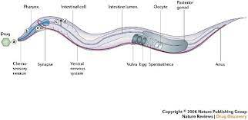
-Parkinson’s Disease worms will be hyposensitive to a variety of odorants due to the disease pathology as compared to the normal (healthy) worm
Our Hypothesis
Objective
Use C. elegans to study loss of ability to smell in Parkinson’s Disease
Notes:
Andrea

Slide 7
Modeling Parkinson’s Disease with C. elegans
Chemotaxis Assay: testing the worm's ability to sense a chemical in its environment
Add sodium azide to all four outer spots, then add worms to the center
Add experimental substance to the Ex. spots and Ethanol to the C spots
Incubate worms at room temperature and wait for an hour
Count worms, then calculate the CI number
N2/M
C
Ex.
Ex.
C
CI Number: # of worms at Ex - # of worms at C
_____________________________
Total number of worms on plate
Notes:
Emily

Slide 8
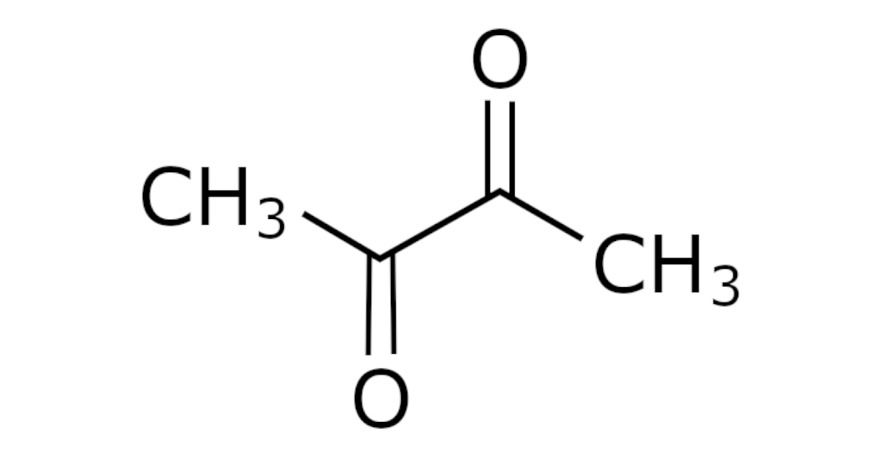
Diacetyl (butter odor) Receptivity in Parkinson's Worm
^{All worms counted}
^{Adult worms only counted}
P-value = 0.42 (Insignificant)
^{P-value = 0.01 (Significant)}
Notes:
Andrea

Slide 9
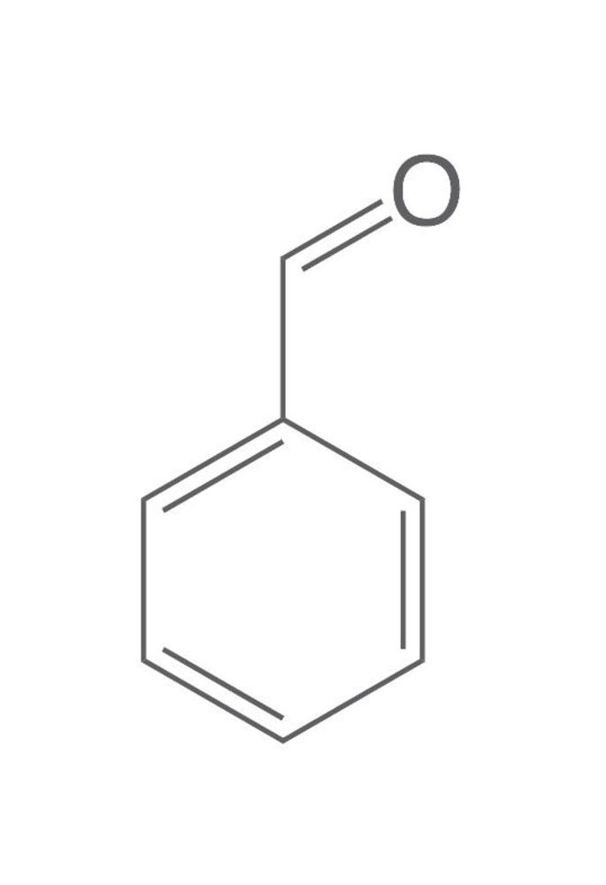
Benzaldehyde (cherry) Receptivity in Parkinson's Worm
Both strains are attracted to Benzaldehyde
No significant difference between Parkinson’s worm and healthy worm ability to sense
Neuron that senses Benzaldehyde not defective
S
P-value = 0.89 (insignificant)
Notes:
Matt

Slide 10
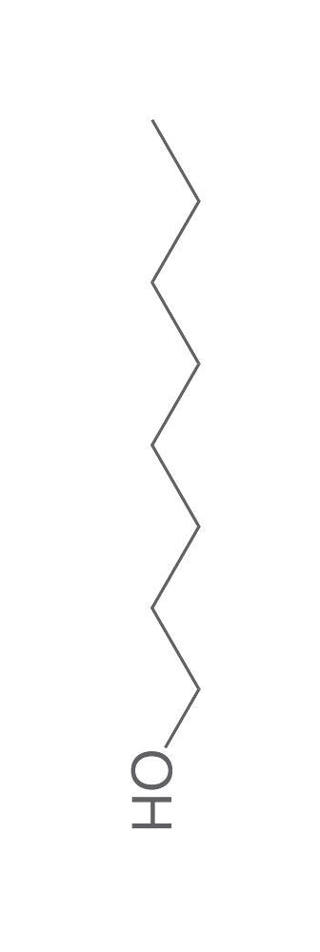
Octanol (repellant) Receptivity in Parkinson's Worm
No significant difference between healthy worms and Parkinson’s worms
Both strains of worms are repulsed by Octanol.
Sensory pathway involving octanol not defective in Parkinson’s mutant
P value= 0.62 Insignificant
Notes:
Andrea

Slide 11
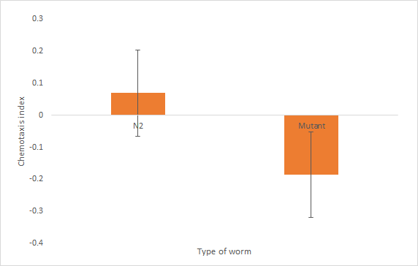
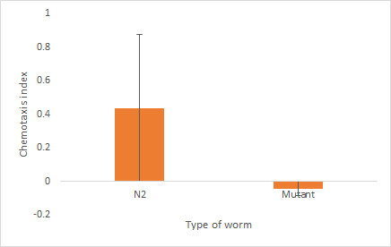
Diacetyl Receptivity in Parkinson's Worm
P-value: 0.25285
No significant difference
P-value: 0.186461
No significant difference
All worms counted
Only adults counted
Notes:
Emily

Slide 12
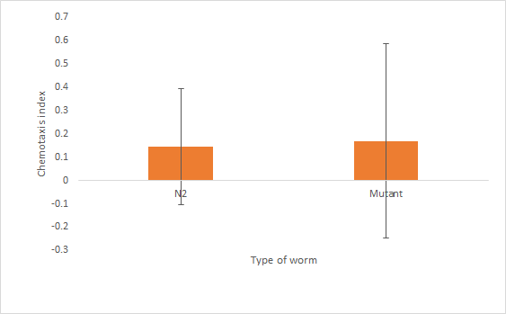
Octanol Receptivity in Parkinson's Worm
P-value=0.965762
There is no significant difference between the normal (healthy) worms and the Parkinson's mutants.
Notes:
Emily

Slide 13
In Summary
Tested a variety of odorants on C. elegans
Compared movement preference of Parkinson’s worm to healthy worm
Came to insightful conclusions
Future assays to further study chemosensation defects caused by PD
Notes:
Matt

Slide 14
Acknowledgments
Dr. Ugolino
Brian Basulto

Slide 15
Questions?

